Slide 1


Master of Science in Informatics at Grenoble
Parallel, Distributed and Embedded Systems
Université Grenoble Alpes
Investigating Job Allocation Policies in Edge Computing Platforms
Anderson Andrei DA SILVA
Advisor: Prof. Denis TRYSTRAM
Jury:
Prof. Martin HEUSSE
Prof. Christophe CÉRIN
Prof. Hubert GARAVEL

Slide 2
Summary
Introduction
An use case: The Qarnot Computing
Job Allocation
Batsim / SimGrid
Experiments
Analyses of Results
Conclusion
Further Remarks
Investigating Job Allocation in Edge Computing Platforms
Anderson Andrei DA SILVA, Denis TRYSTRAM
Université Grenoble Alpes

Slide 3
Internet of Things, Cloud and Edge Computing
A scenario influenced by:
The growth of computation power embedded by IoT and mobile devices
The decentralization of Cloud Computing
The production and consumption of data in the edge
Investigating Job Allocation in Edge Computing Platforms
Anderson Andrei DA SILVA, Denis TRYSTRAM
Université Grenoble Alpes

Slide 4
Internet of Things, Cloud and Edge Computing: State of Art
A scenario influenced by:
The growth of computation power embedded by IoT and mobile devices
The decentralization of Cloud Computing
The production and consumption of data in the edge
W. Shi, et al [1,2]:
We will arrive in the post-cloud era, where, by 2019:
  Data produced by people, machines, and things will reach 500 zettabytes, as estimated by Cisco Global Cloud Index,
  However, the global data center IP traffic will only reach 10.4 zettabytes by that time.
  45% of IoT-created data will be stored, processed, analyzed, and acted upon close to, or at the edge of, the network.
Y. Mao, et al. [3] :
Mobile devices tends to growth in terms of usability and processing of data, implicating the decentralization from the Cloud’s presence.
Investigating Job Allocation in Edge Computing Platforms
Anderson Andrei DA SILVA, Denis TRYSTRAM
Université Grenoble Alpes

Slide 5
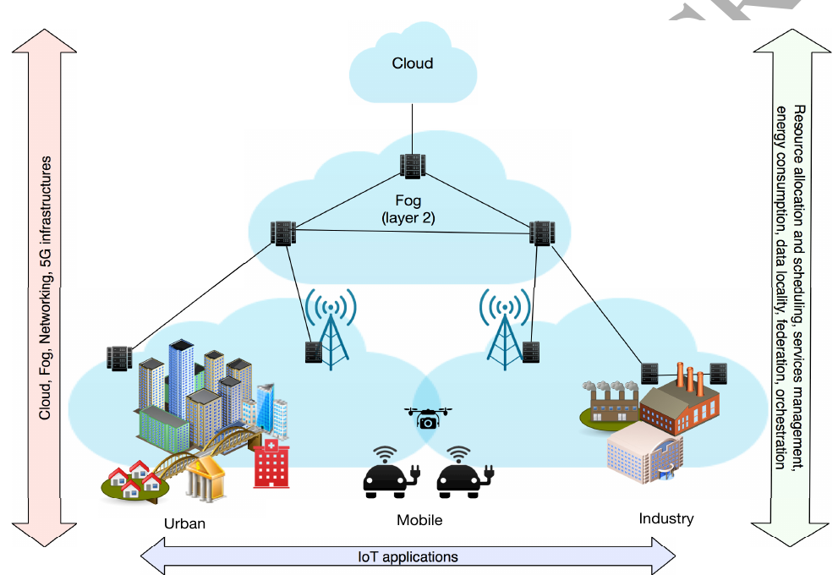
Internet of Things, Cloud and Edge Computing
Figure 1: Illustrative overview, within the IoT-Fog-Cloud infrastructure [4]
Investigating Job Allocation in Edge Computing Platforms
Anderson Andrei DA SILVA, Denis TRYSTRAM
Université Grenoble Alpes

Slide 6
Job Allocation: Importance and Impacts
How to manage jobs and resources, in order to fit the jobs among the resources in the best way.
Investigating Job Allocation in Edge Computing Platforms
Anderson Andrei DA SILVA, Denis TRYSTRAM
Université Grenoble Alpes

Slide 7
Job Allocation: State of Art
How to manage jobs and resources, in order to fit the jobs among the resources in the best way.
S. M. Parikh [6] points that the management of flexible resources allocation is a problem emerged in the context of Cloud/ Edge Computing, due to heterogeneity in hardware capabilities, workload estimation and a variety of services, also as the maximization of the profit for cloud providers and the minimization of cost for cloud consumers.
Lu Huang et al. [7] affirm that to make appropriate decisions when allocating hardware resources to the tasks and dispatching the computing tasks to resource pool has become the main issue in cloud computing.
According to Hameed Hussain et.al [8] the resource management mechanism determines the efficiency of the used resources and guarantees the Quality of Service (QoS) provided to the users.
Investigating Job Allocation in Edge Computing Platforms
Anderson Andrei DA SILVA, Denis TRYSTRAM
Université Grenoble Alpes

Slide 8
An Use Case
Investigating Job Allocation in Edge Computing Platforms
Anderson Andrei DA SILVA, Denis TRYSTRAM
Université Grenoble Alpes

Slide 9

Use case: The Qarnot Computing
Incorporated in 2010, the Qarnot Computing used IT waste heat in a viable heating solution for buildings with a distributed infrastructure in housing buildings, offices and warehouses across several geographical areas in France and Europe.
The whole platform is composed of about:
1,000 computing devices hosting
3,000 diskless machines.
Figure2: https://www.qarnot.com/
Investigating Job Allocation in Edge Computing Platforms
Anderson Andrei DA SILVA, Denis TRYSTRAM
Université Grenoble Alpes

Slide 10

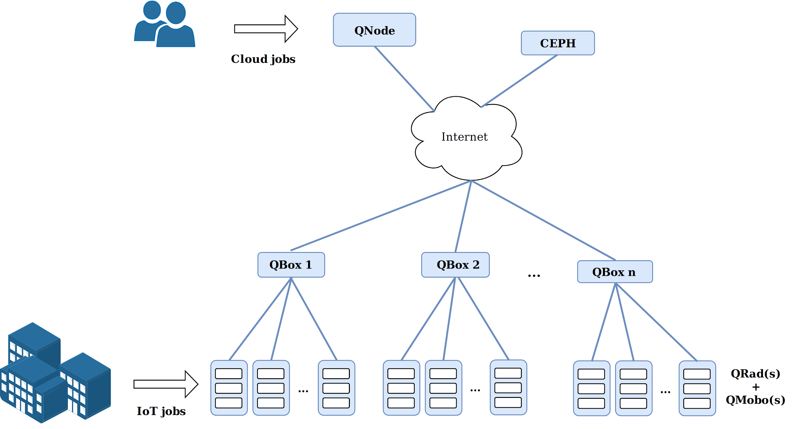
Use case: The Qarnot Computing
Infrastructure: QWare
Figure3: https://www.qarnot.com/
Investigating Job Allocation in Edge Computing Platforms
Anderson Andrei DA SILVA, Denis TRYSTRAM
Université Grenoble Alpes

Slide 11
Investigating Scheduling Policies Applied in the Use Case
Investigating Job Allocation in Edge Computing Platforms
Anderson Andrei DA SILVA, Denis TRYSTRAM
Université Grenoble Alpes

Slide 12
Job Allocation: Implemented Scheduling Policies in the Use Case
Policies implemented and compared:
Standard (current Qarnot policy)
Locality Based
Full Replicate
3 Replicate
10 Replicate
Job’s detail:
Priorities: Background, Low, High
Data sets dependencies
Investigating Job Allocation in Edge Computing Platforms
Anderson Andrei DA SILVA, Denis TRYSTRAM
Université Grenoble Alpes

Slide 13
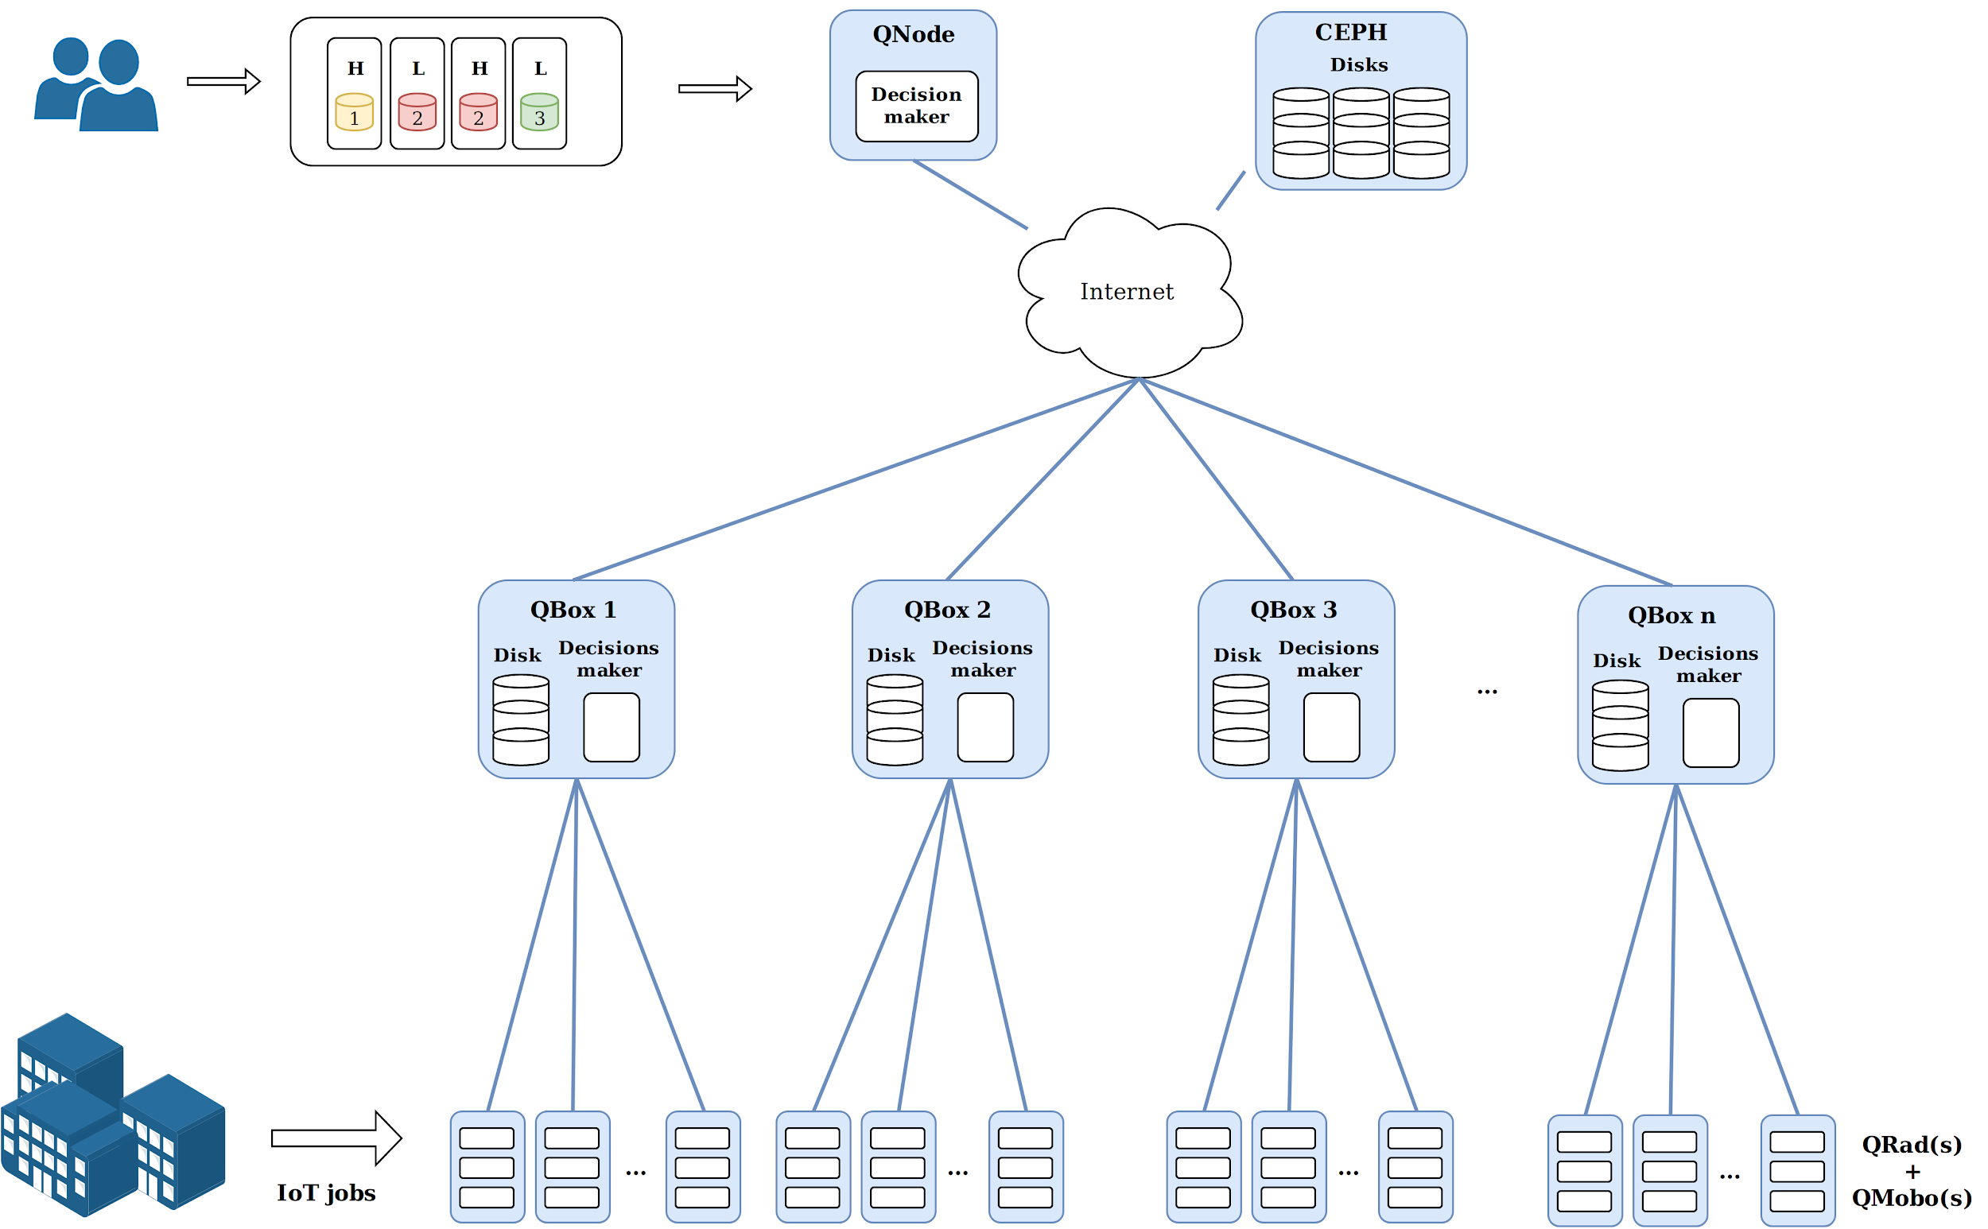
Qarnot Infrastructure: The QWare in Details
Investigating Job Allocation in Edge Computing Platforms
Anderson Andrei DA SILVA, Denis TRYSTRAM
Université Grenoble Alpes

Slide 14
Standard
- Current Qarnot’s policy.
- It dispatches instances, ordered by their priorities, to the QRads that need more heating.
Investigating Job Allocation in Edge Computing Platforms
Anderson Andrei DA SILVA, Denis TRYSTRAM
Université Grenoble Alpes

Slide 15
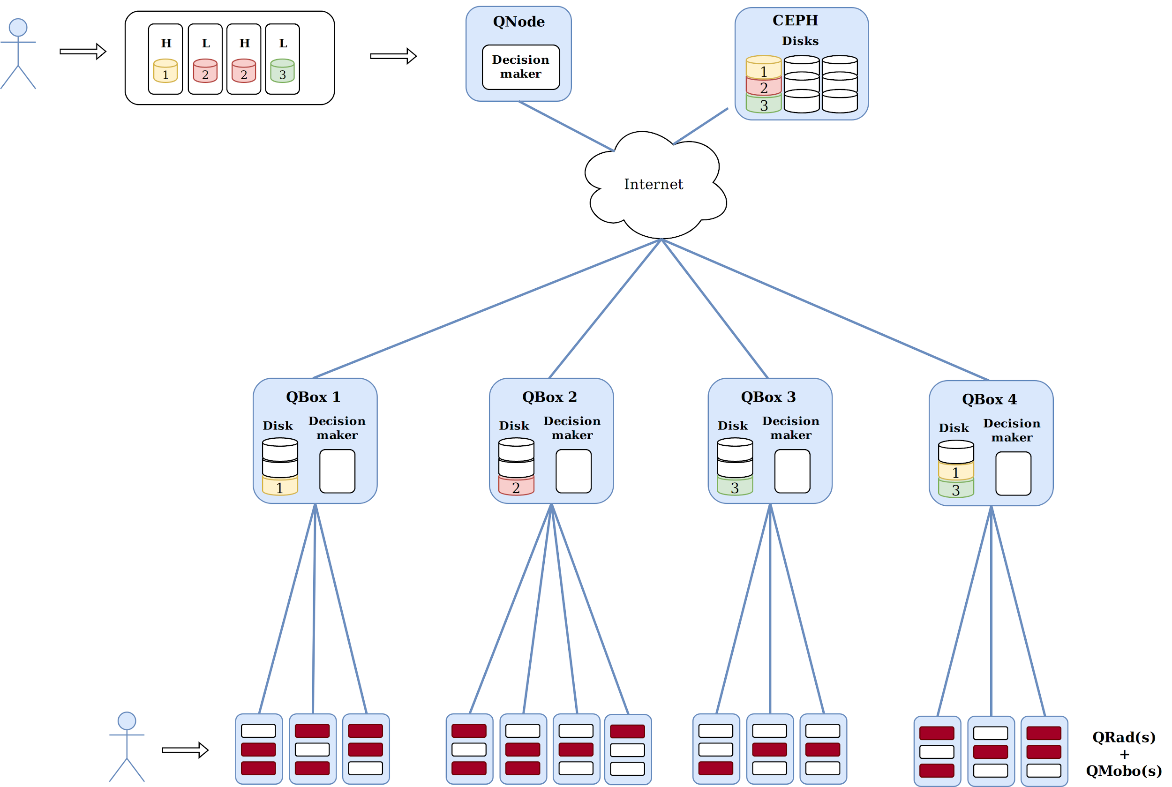
Job Allocation Policies - Standard
Investigating Job Allocation in Edge Computing Platforms
Anderson Andrei DA SILVA, Denis TRYSTRAM
Université Grenoble Alpes

Slide 16
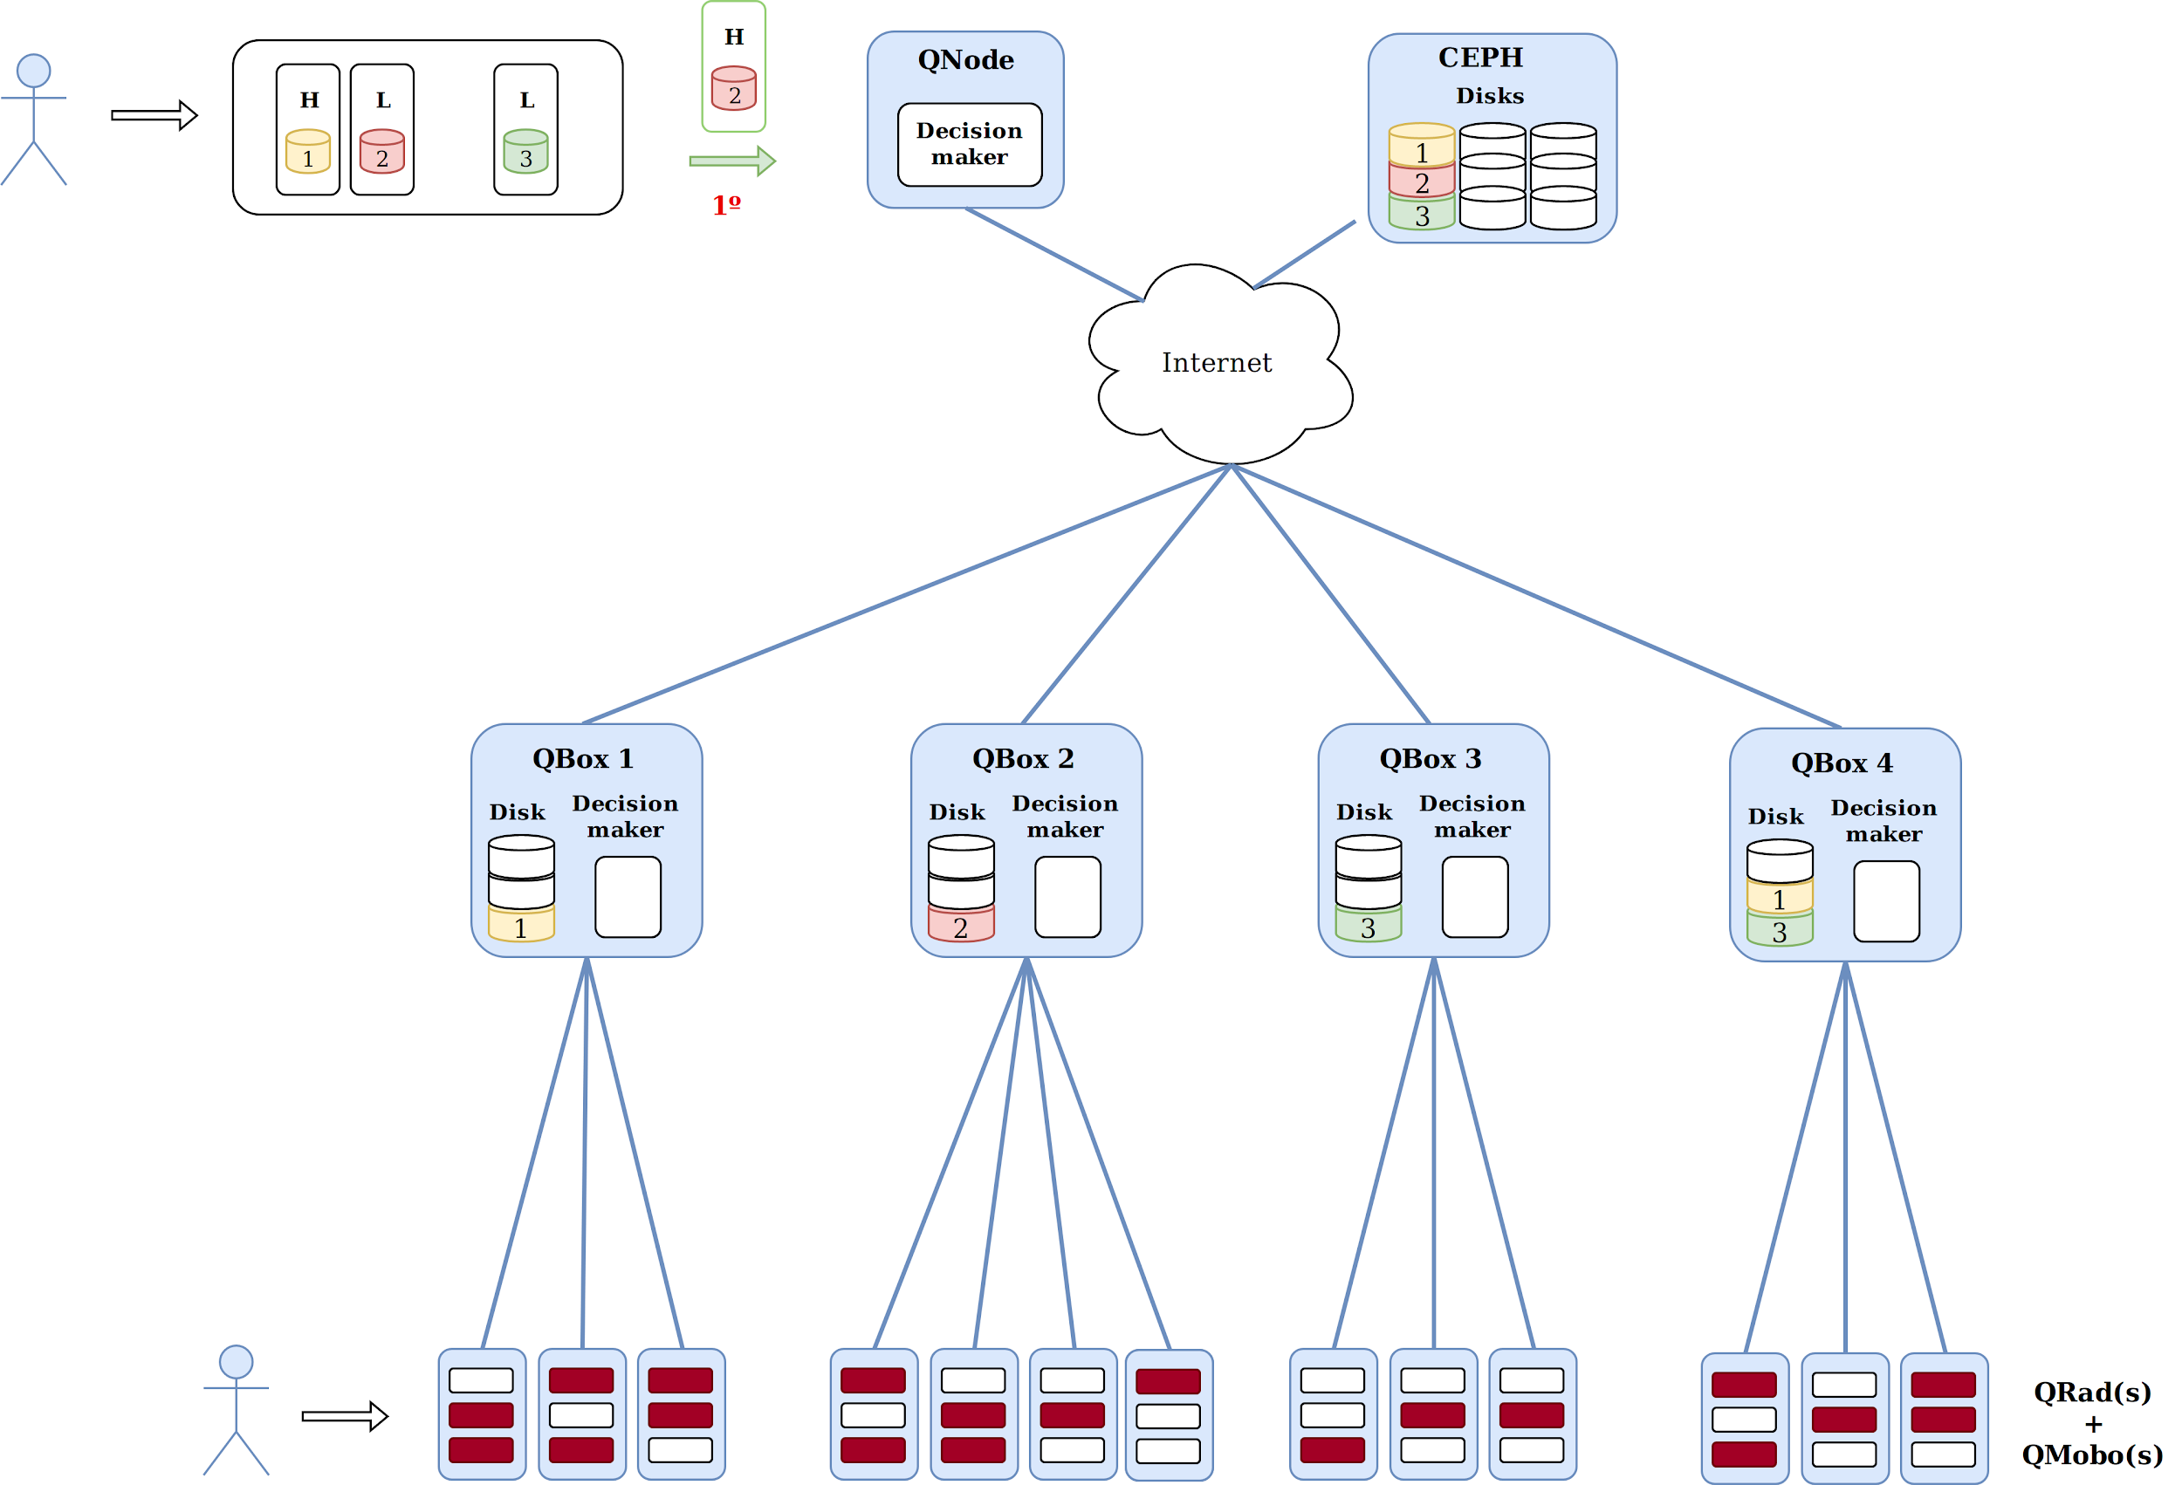
Job Allocation Policies - Standard
Investigating Job Allocation in Edge Computing Platforms
Anderson Andrei DA SILVA, Denis TRYSTRAM
Université Grenoble Alpes

Slide 17
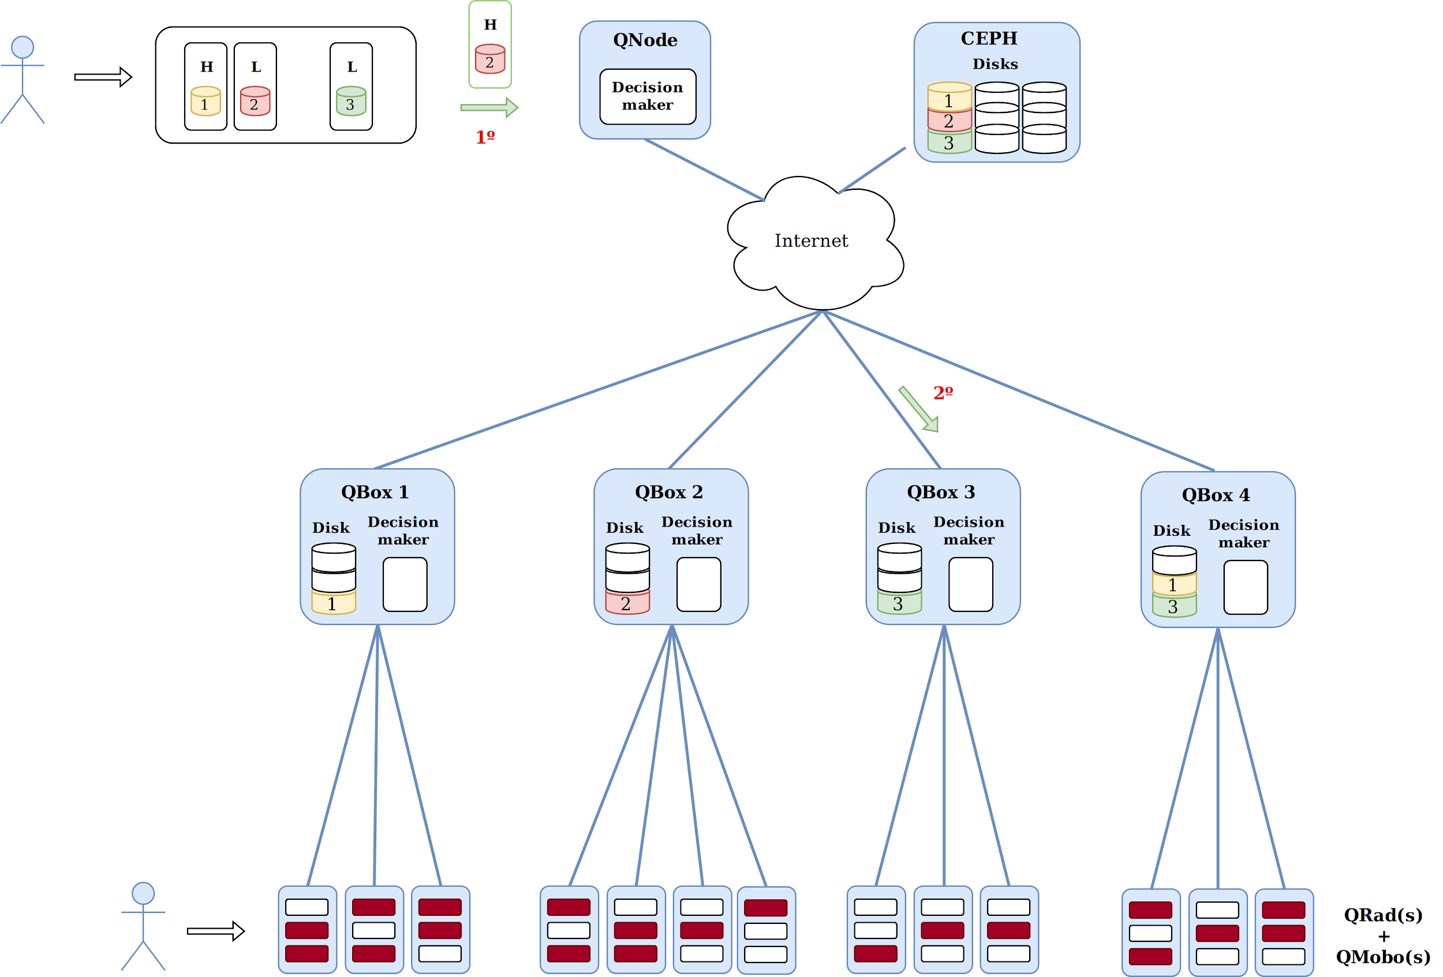
Job Allocation Policies - Standard
Investigating Job Allocation in Edge Computing Platforms
Anderson Andrei DA SILVA, Denis TRYSTRAM
Université Grenoble Alpes

Slide 18
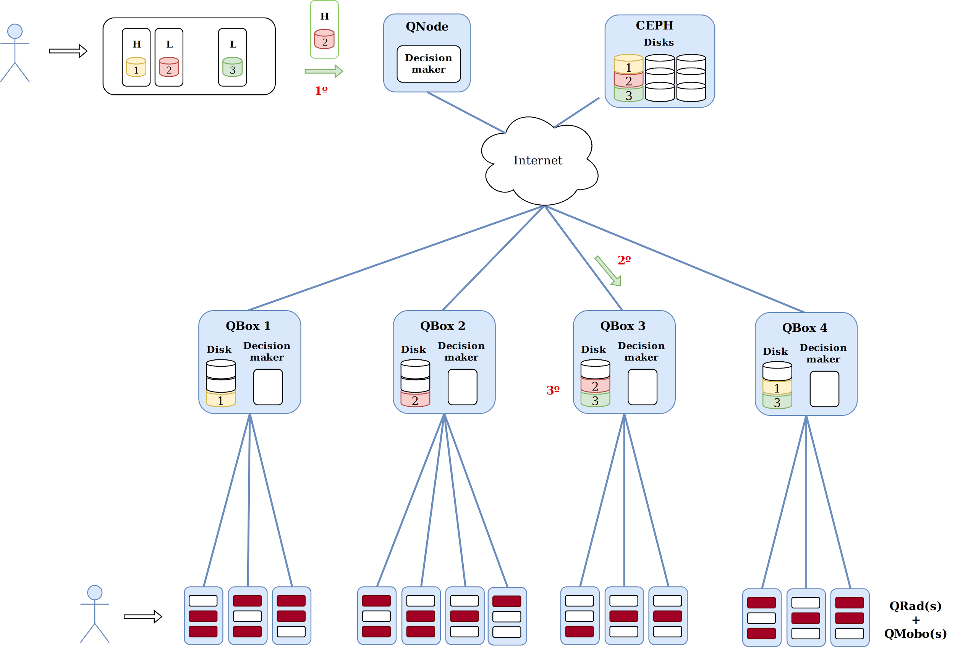
Job Allocation Policies - Standard
Investigating Job Allocation in Edge Computing Platforms
Anderson Andrei DA SILVA, Denis TRYSTRAM
Université Grenoble Alpes

Slide 19

Job Allocation Policies - Standard
Investigating Job Allocation in Edge Computing Platforms
Anderson Andrei DA SILVA, Denis TRYSTRAM
Université Grenoble Alpes

Slide 20
Locality Based
- Based on Standard policy
- It dispatches instances, ordered by their priorities, to the QRads that need more heating, by prioritizing the ones that already have the required data set.
Investigating Job Allocation in Edge Computing Platforms
Anderson Andrei DA SILVA, Denis TRYSTRAM
Université Grenoble Alpes

Slide 21
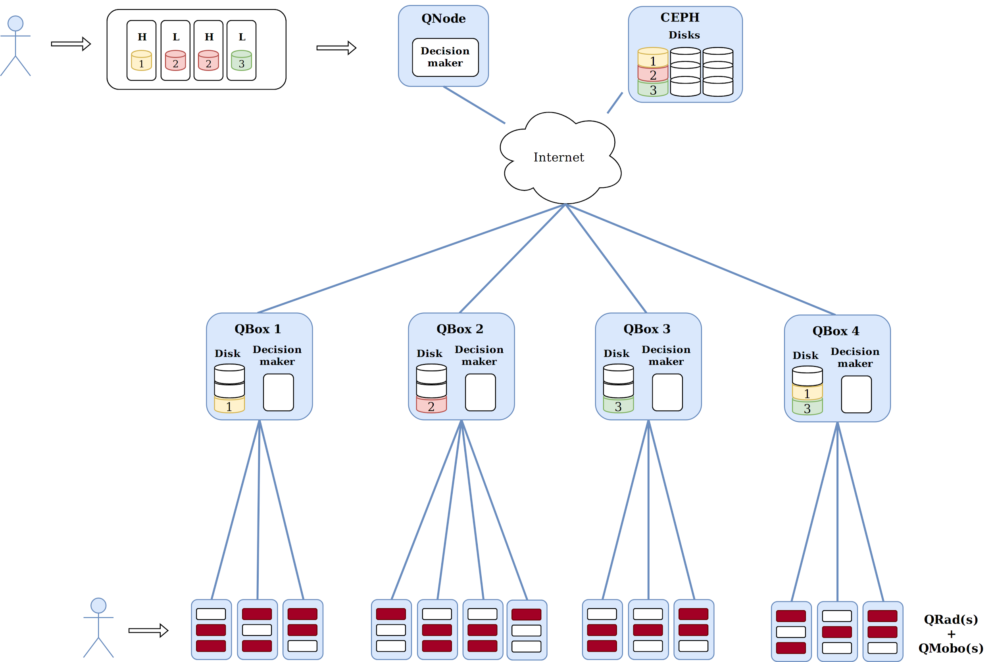
Job Allocation Policies - Locality Based
Investigating Job Allocation in Edge Computing Platforms
Anderson Andrei DA SILVA, Denis TRYSTRAM
Université Grenoble Alpes

Slide 22
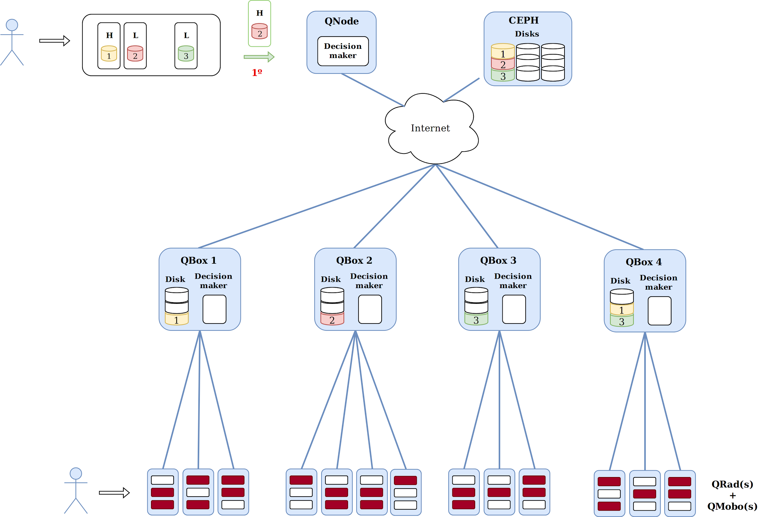
Job Allocation Policies - Locality Based
Investigating Job Allocation in Edge Computing Platforms
Anderson Andrei DA SILVA, Denis TRYSTRAM
Université Grenoble Alpes

Slide 23

Job Allocation Policies - Locality Based
Investigating Job Allocation in Edge Computing Platforms
Anderson Andrei DA SILVA, Denis TRYSTRAM
Université Grenoble Alpes

Slide 24
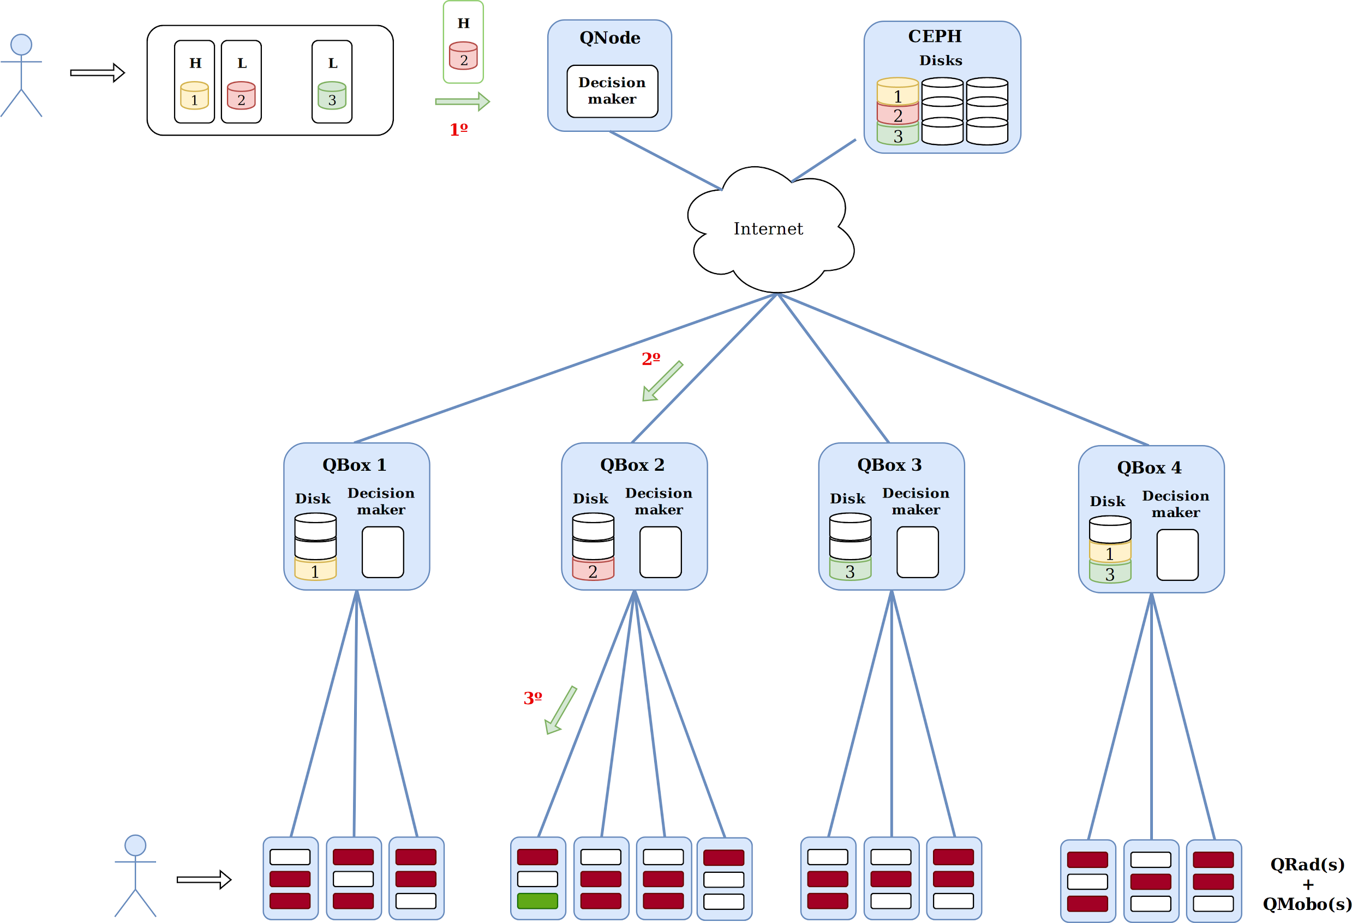
Job Allocation Policies - Locality Based
Investigating Job Allocation in Edge Computing Platforms
Anderson Andrei DA SILVA, Denis TRYSTRAM
Université Grenoble Alpes

Slide 25
Full Replicate
- Based on Qarnot’s policy
- It considers that all data sets are in all QRads upon an instance arrives.
- Dispatches instances, ordered by their priorities, to the QRads that need more heating.
Investigating Job Allocation in Edge Computing Platforms
Anderson Andrei DA SILVA, Denis TRYSTRAM
Université Grenoble Alpes

Slide 26
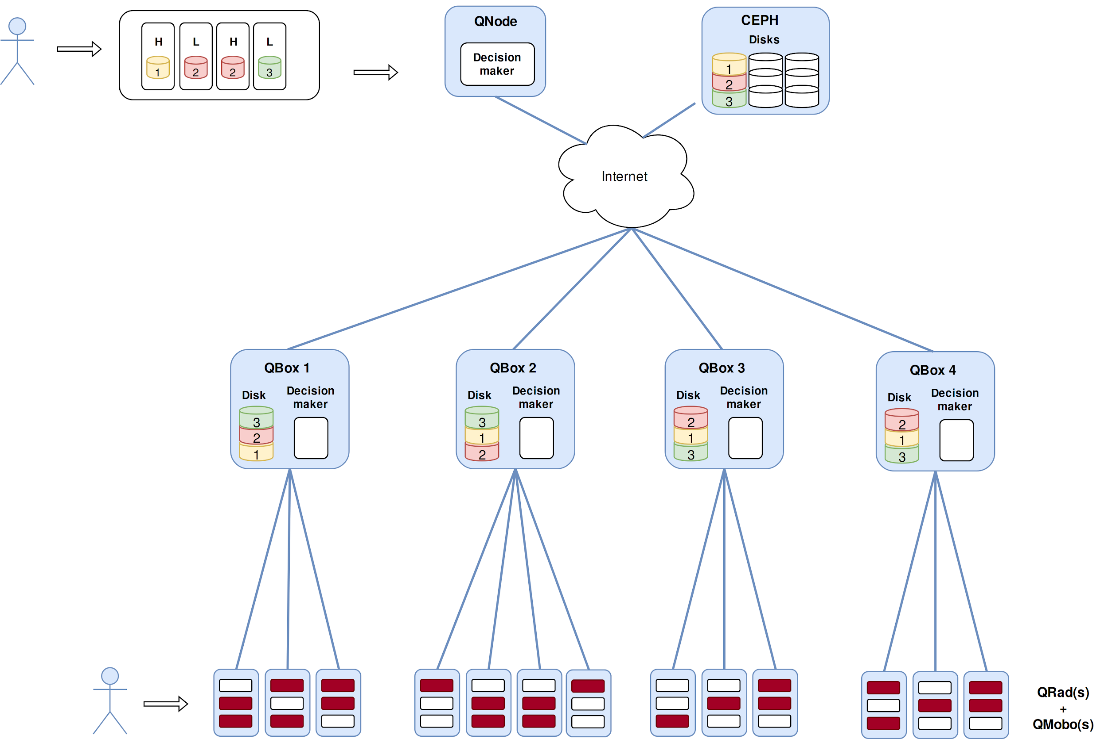
Job Allocation Policies - Full Replicate
Investigating Job Allocation in Edge Computing Platforms
Anderson Andrei DA SILVA, Denis TRYSTRAM
Université Grenoble Alpes

Slide 27
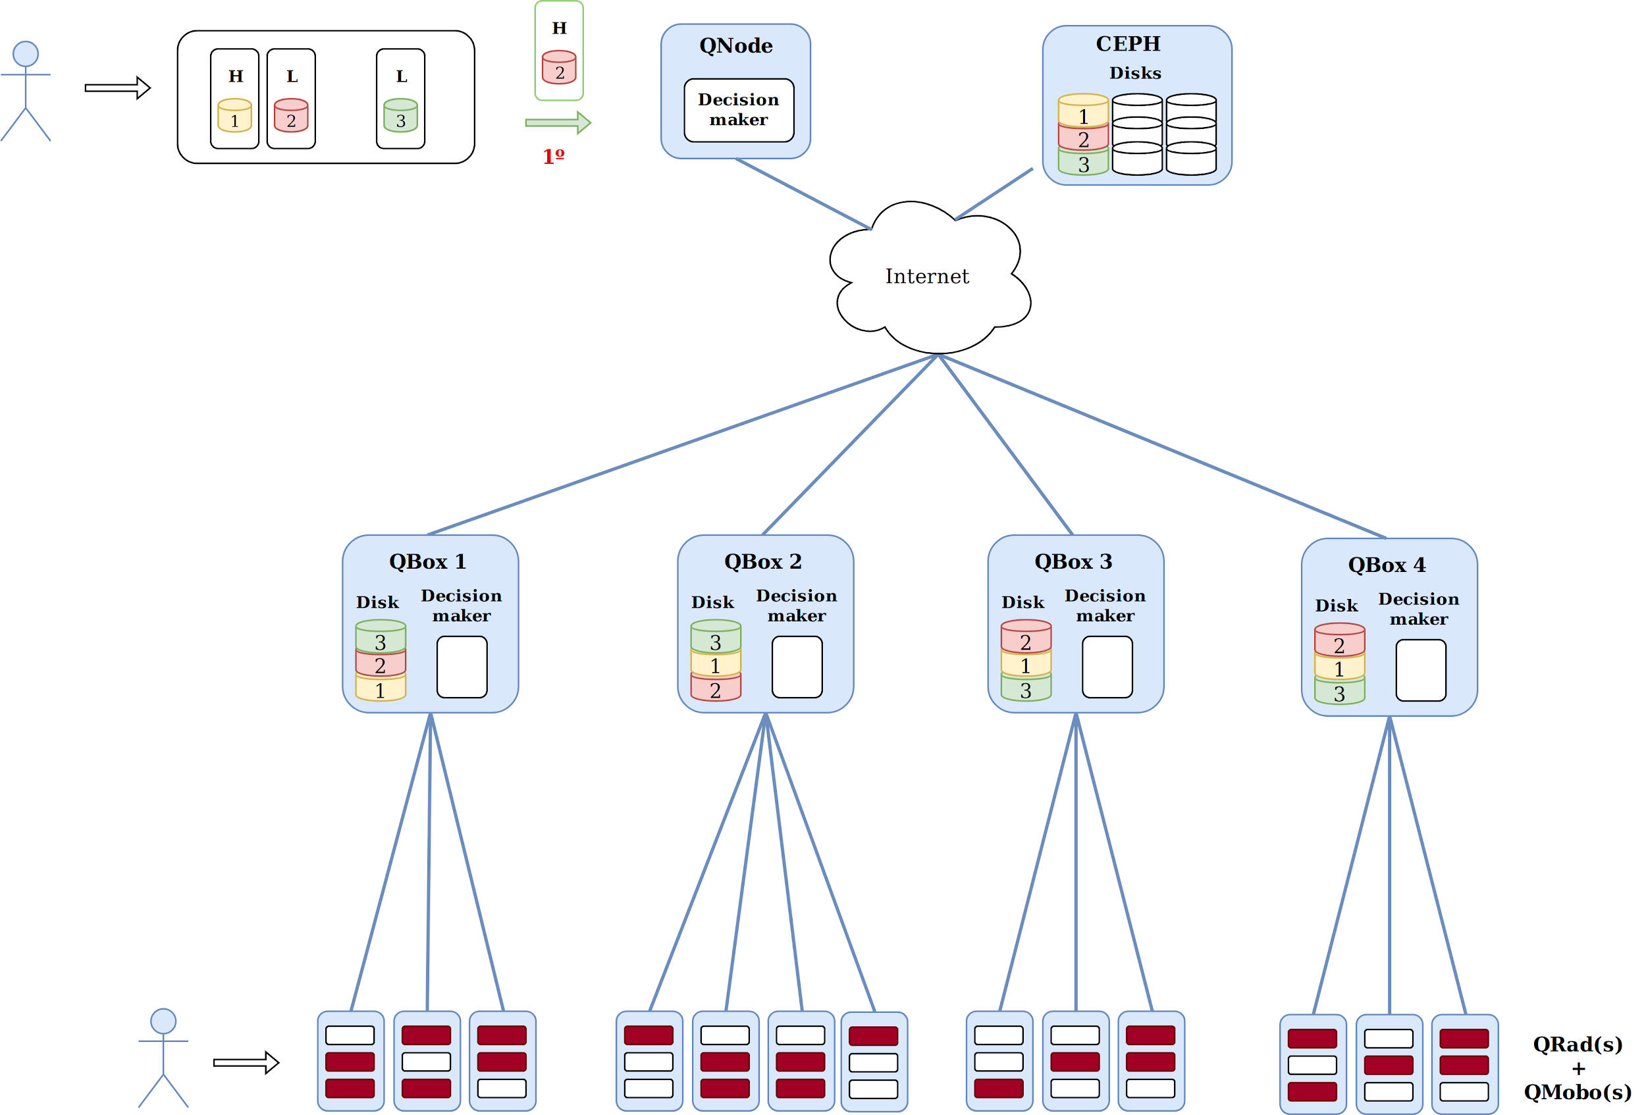
Job Allocation Policies - Full Replicate
Investigating Job Allocation in Edge Computing Platforms
Anderson Andrei DA SILVA, Denis TRYSTRAM
Université Grenoble Alpes

Slide 28
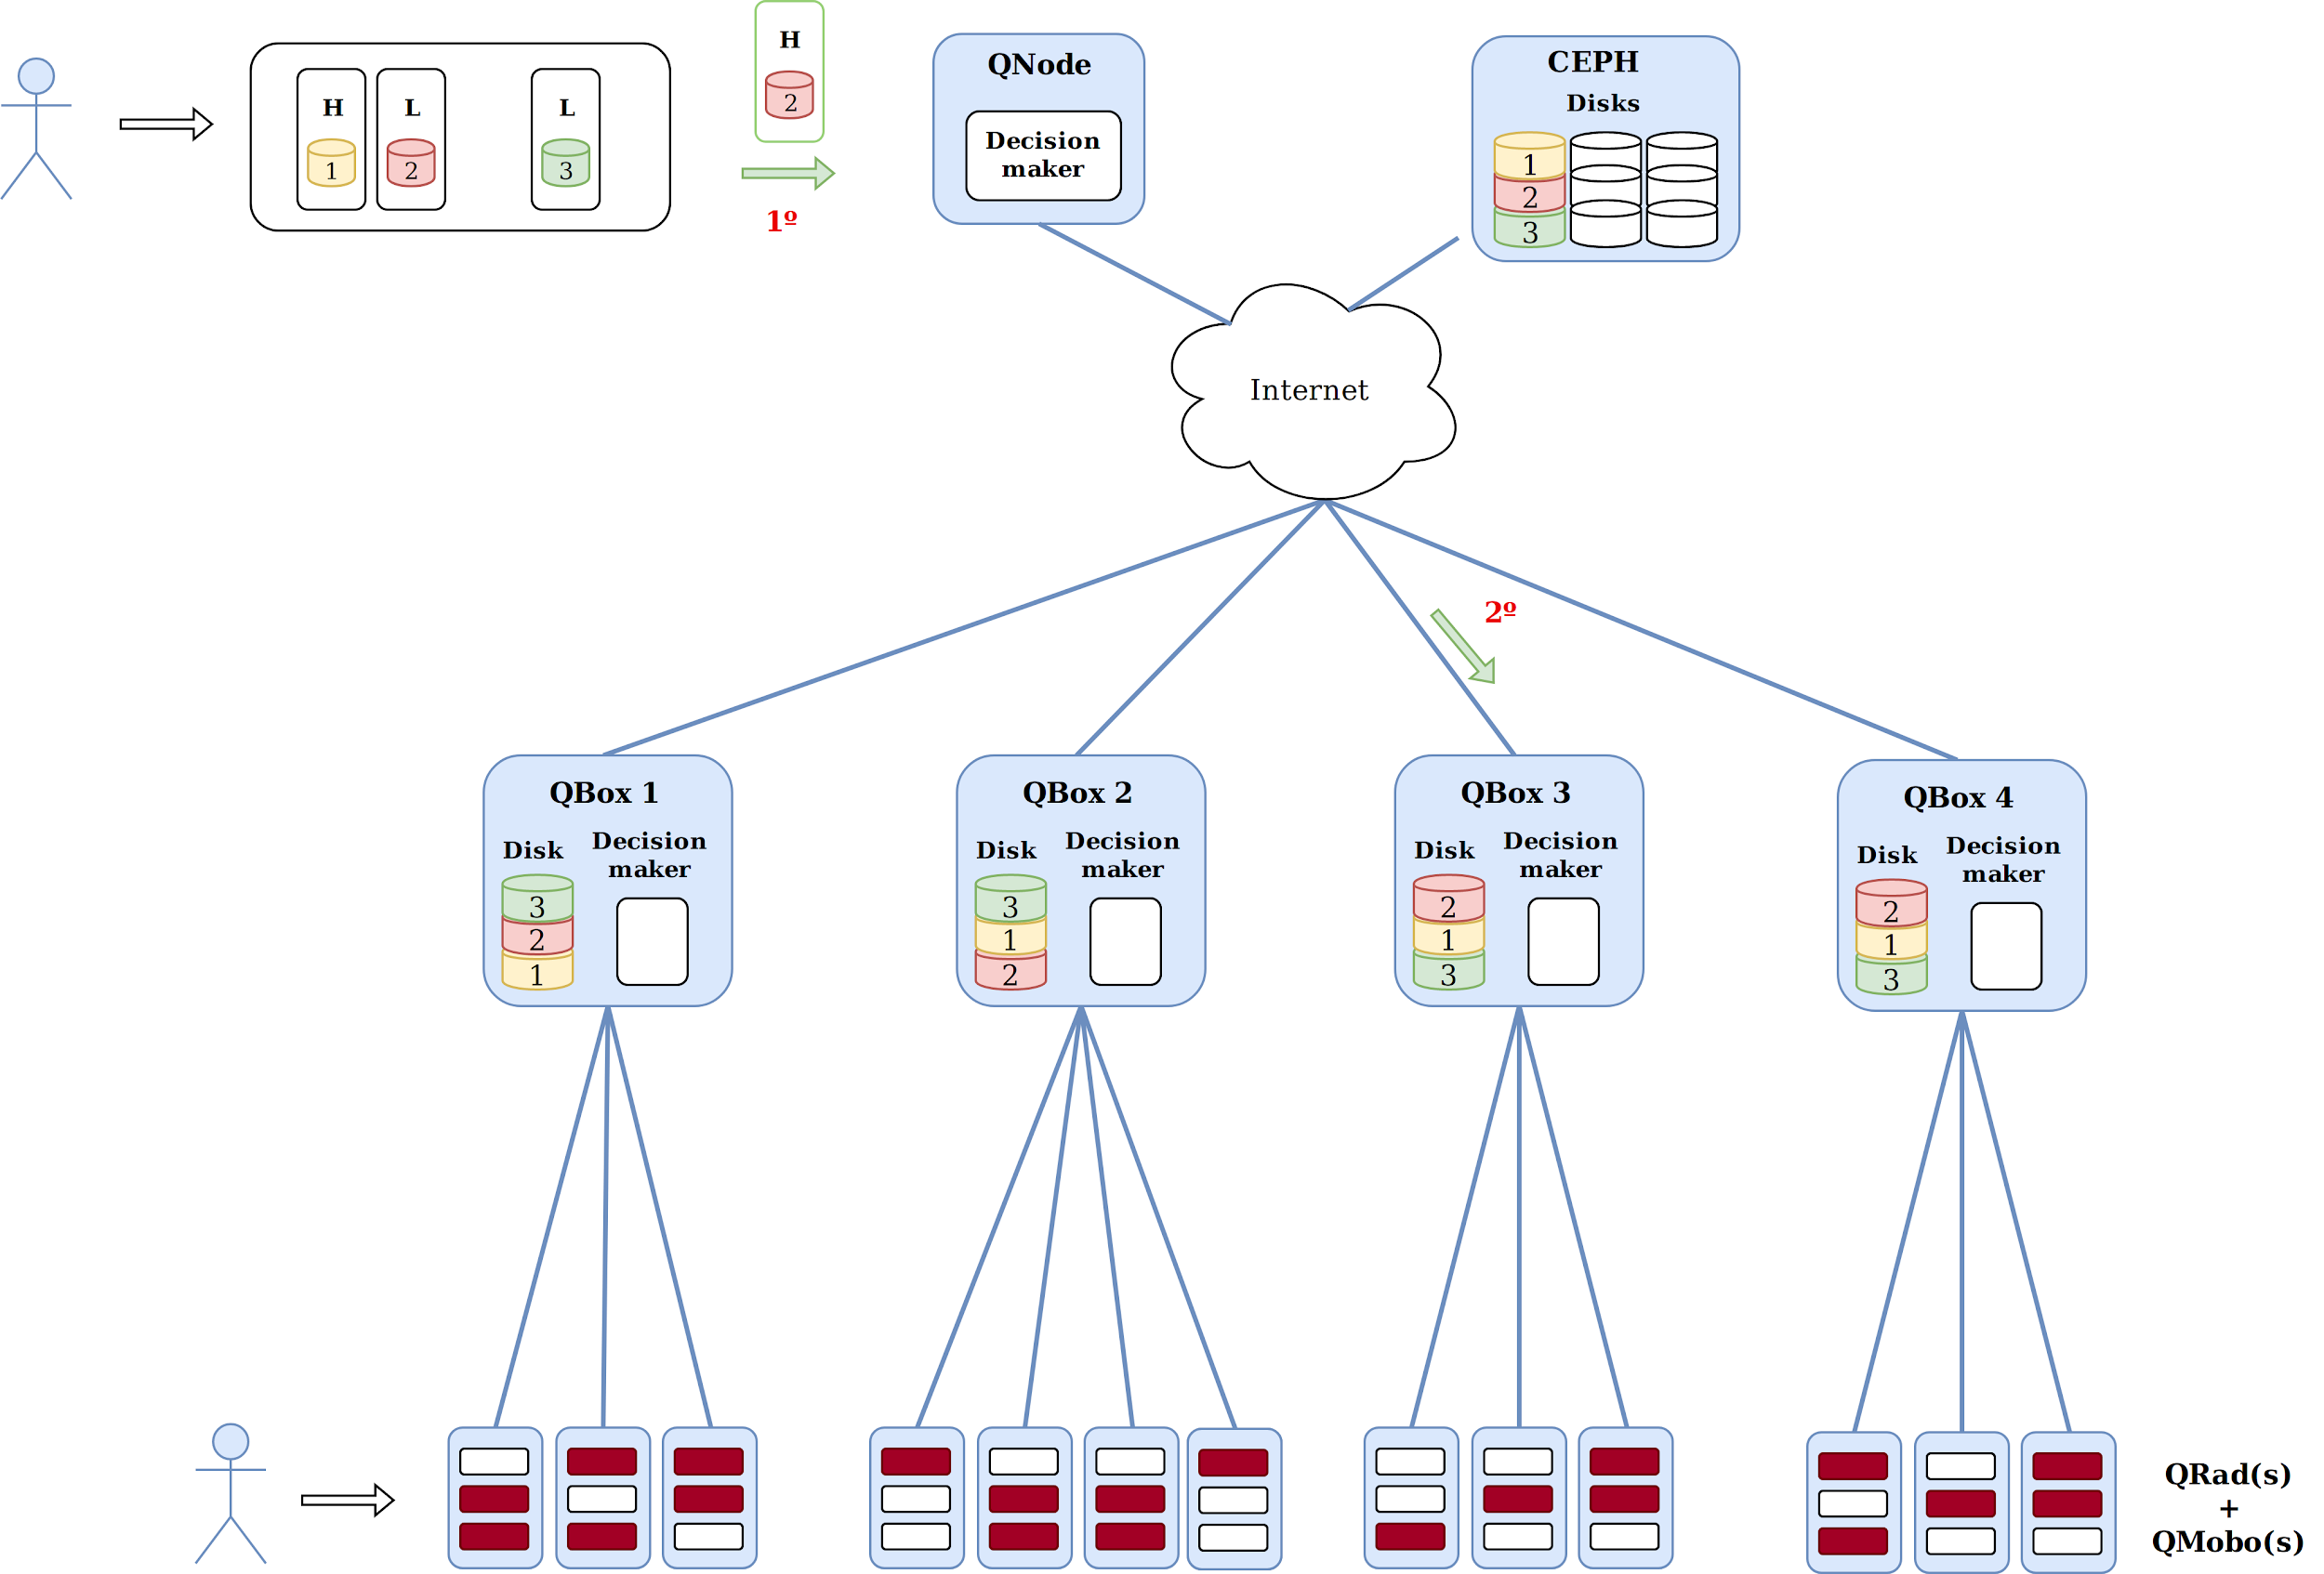
Job Allocation Policies - Full Replicate
Investigating Job Allocation in Edge Computing Platforms
Anderson Andrei DA SILVA, Denis TRYSTRAM
Université Grenoble Alpes

Slide 29
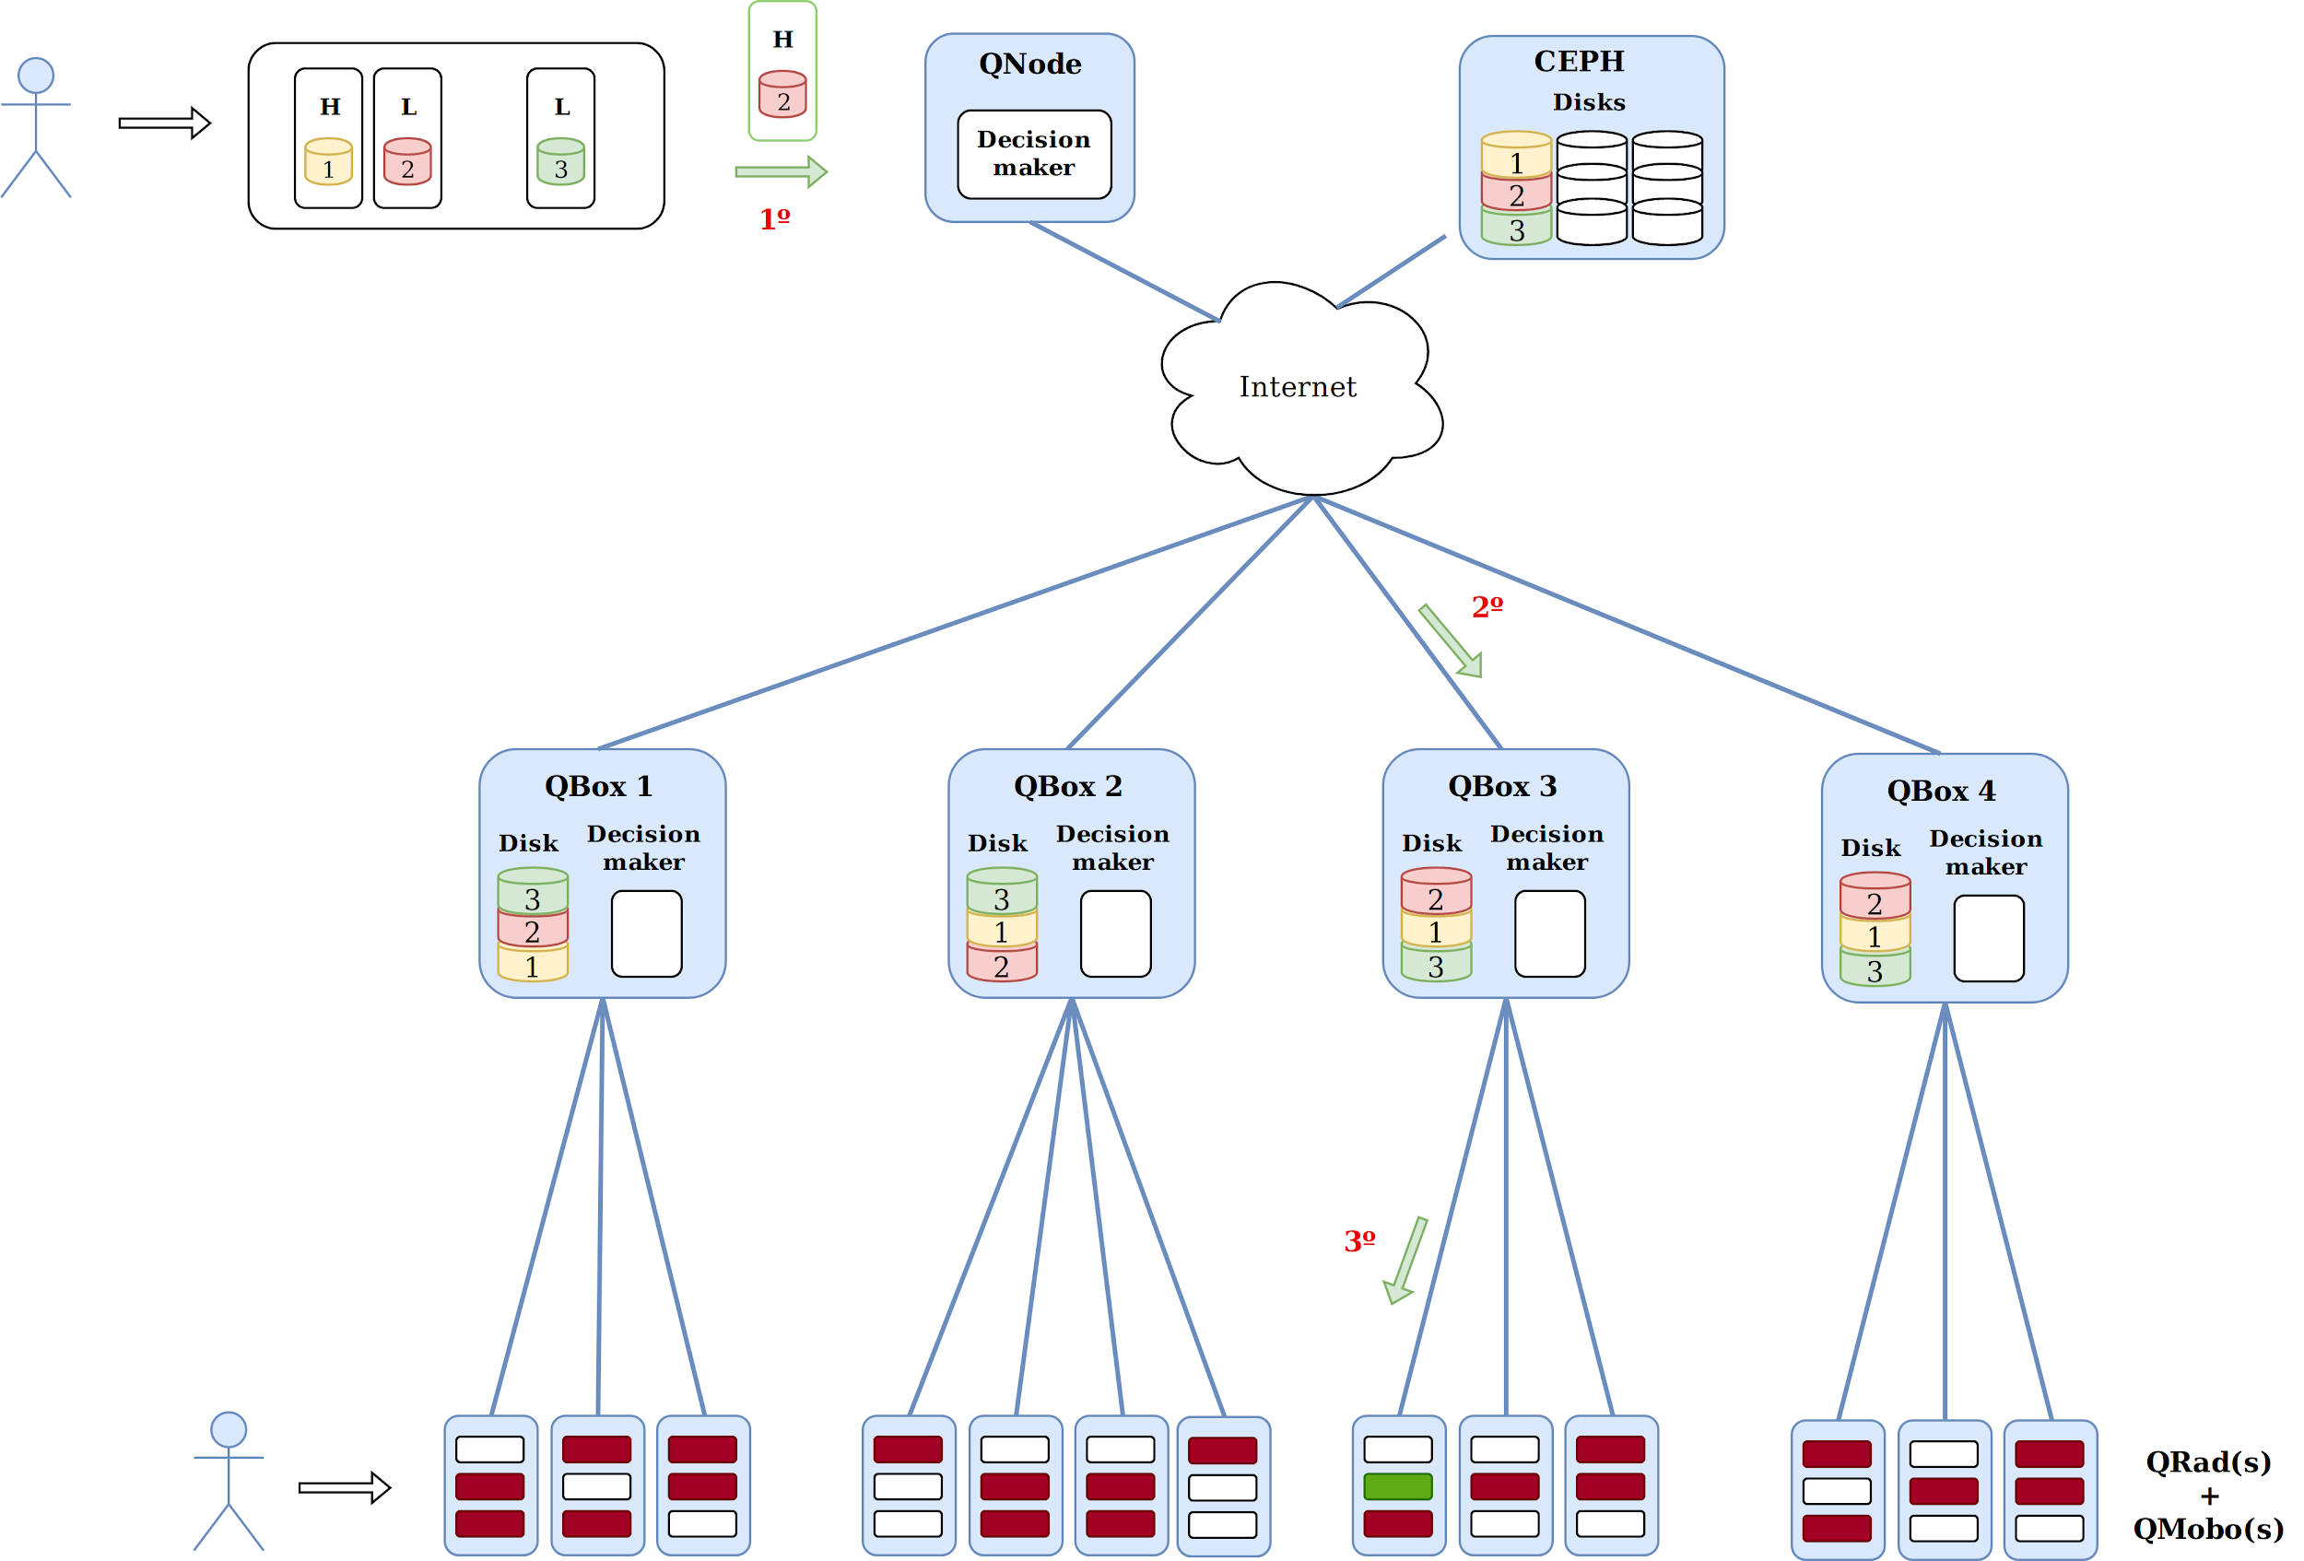
Job Allocation Policies - Full Replicate
Investigating Job Allocation in Edge Computing Platforms
Anderson Andrei DA SILVA, Denis TRYSTRAM
Université Grenoble Alpes

Slide 30
3-10 Replicate
- Based on the LocalityBased policy.
- Upon an instance arrives, its required data sets are transferred to the 3 or 10 QBoxes with least loaded disks.
- It dispatches instances, ordered by their priorities, to the QRads that need more heating, by prioritizing the ones that already have the required data set.
Investigating Job Allocation in Edge Computing Platforms
Anderson Andrei DA SILVA, Denis TRYSTRAM
Université Grenoble Alpes

Slide 31
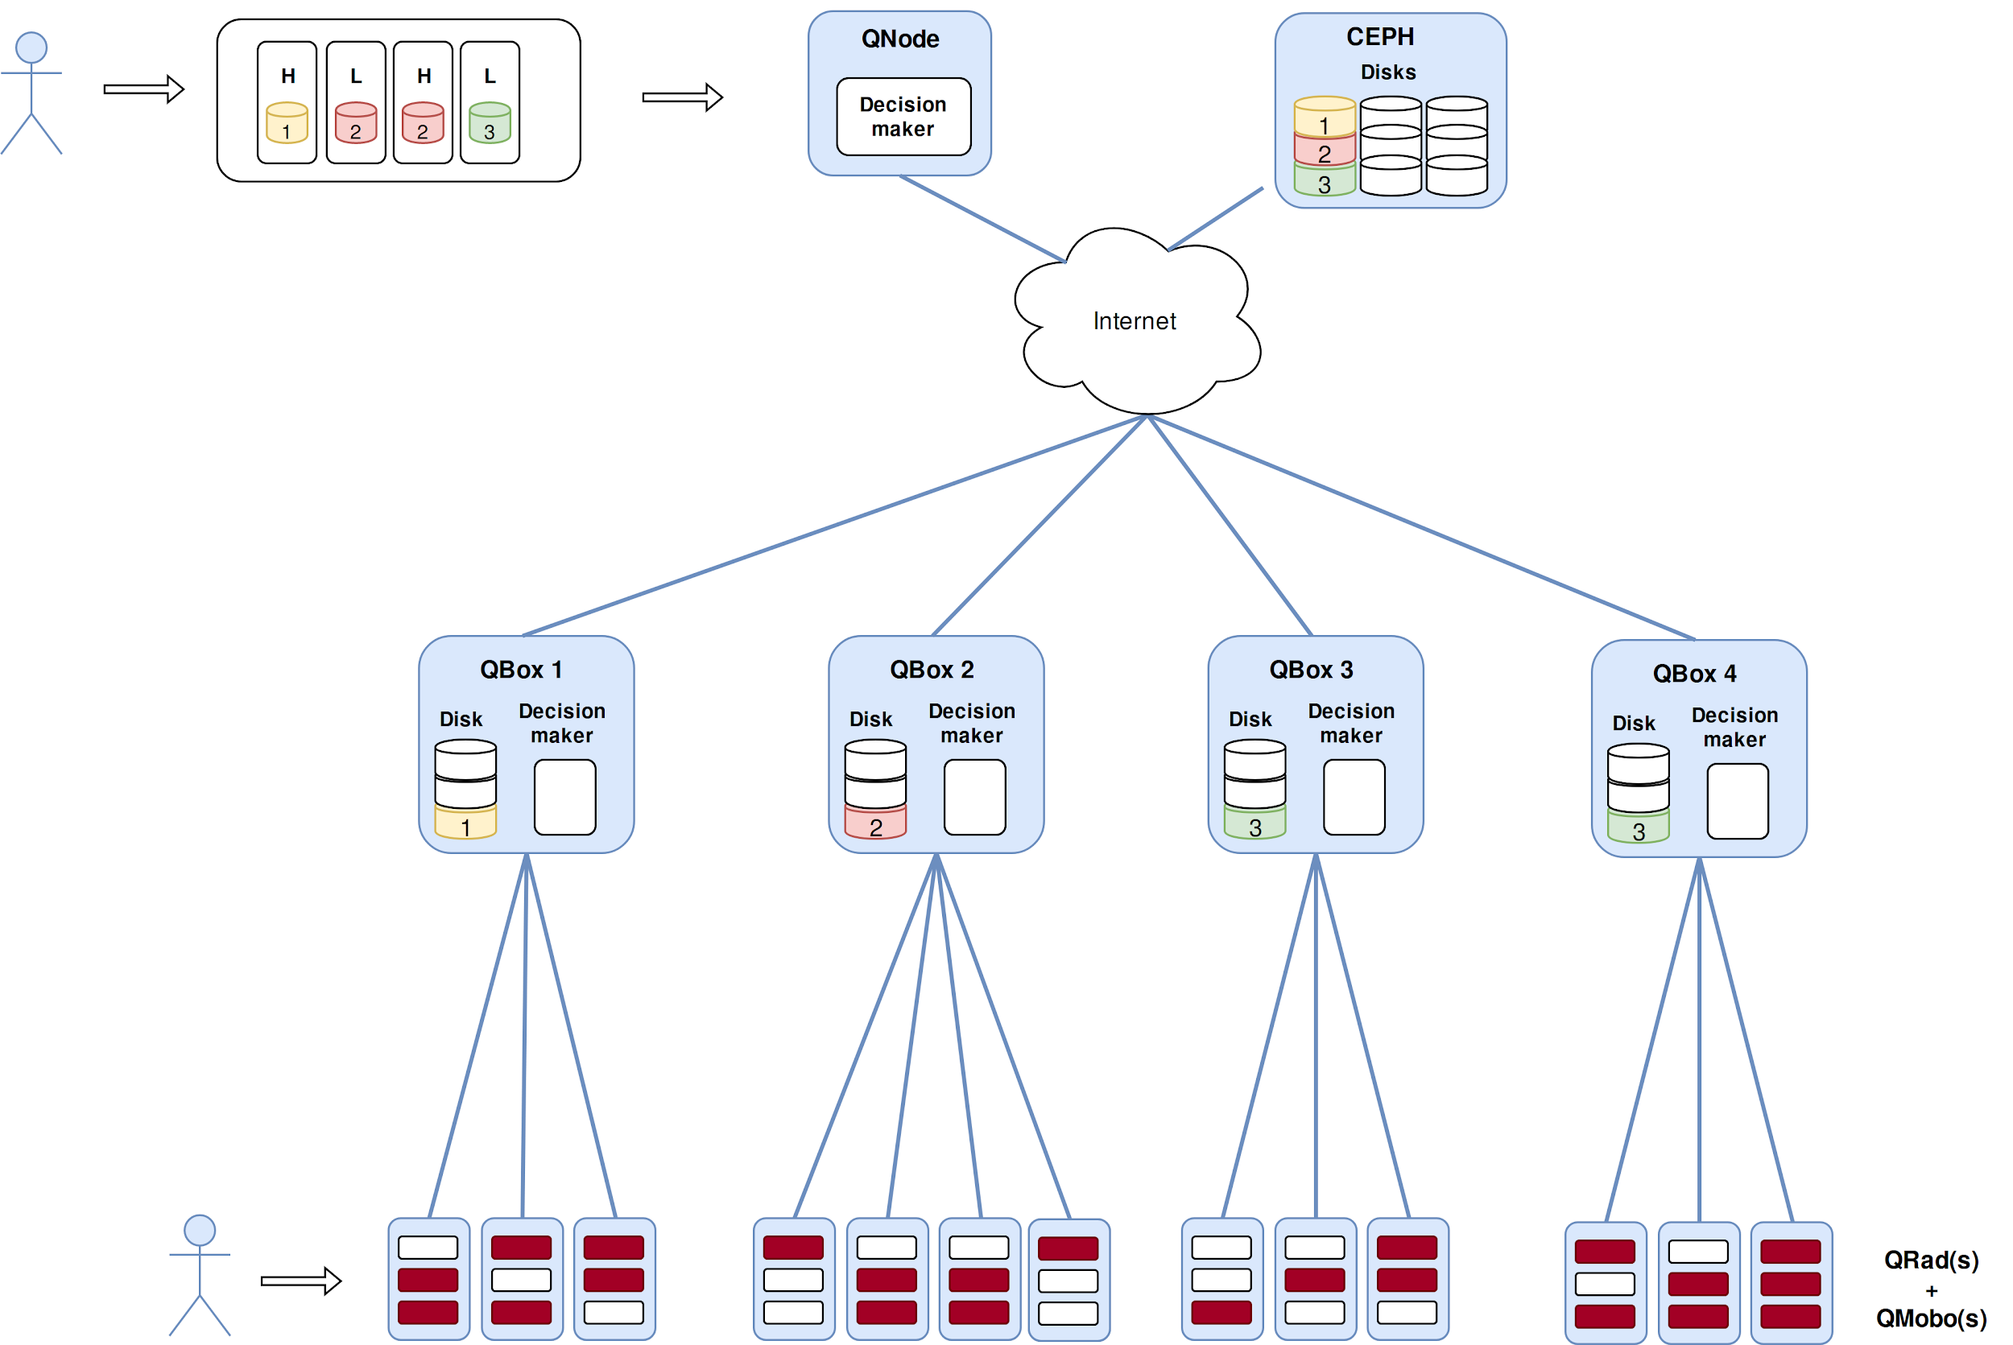
Job Allocation Policies - 3/10 Replicate
Investigating Job Allocation in Edge Computing Platforms
Anderson Andrei DA SILVA, Denis TRYSTRAM
Université Grenoble Alpes

Slide 32
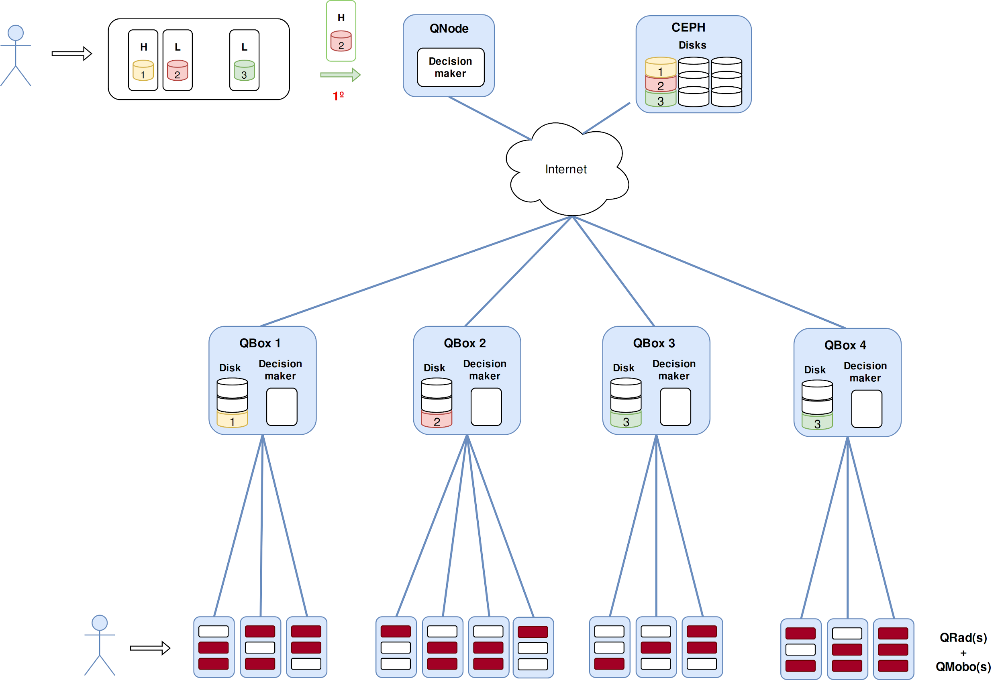
Job Allocation Policies - 3/10 Replicate
Investigating Job Allocation in Edge Computing Platforms
Anderson Andrei DA SILVA, Denis TRYSTRAM
Université Grenoble Alpes

Slide 33
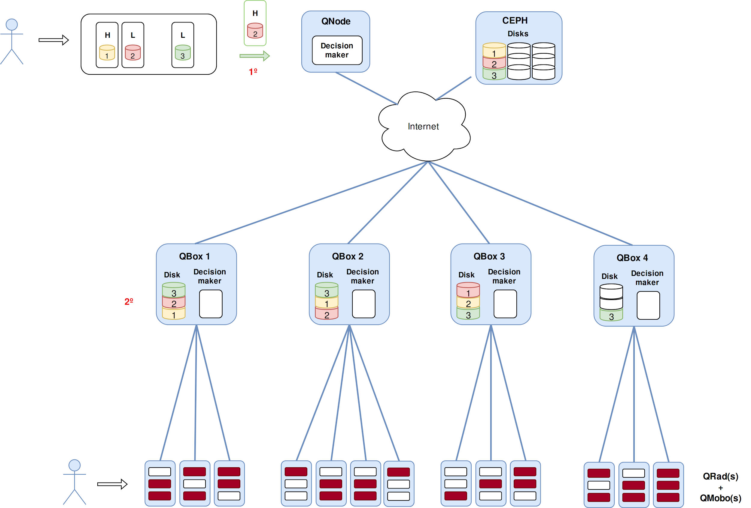
Job Allocation Policies - 3/10 Replicate
Investigating Job Allocation in Edge Computing Platforms
Anderson Andrei DA SILVA, Denis TRYSTRAM
Université Grenoble Alpes

Slide 34

Job Allocation Policies - 3/10 Replicate
Investigating Job Allocation in Edge Computing Platforms
Anderson Andrei DA SILVA, Denis TRYSTRAM
Université Grenoble Alpes

Slide 35
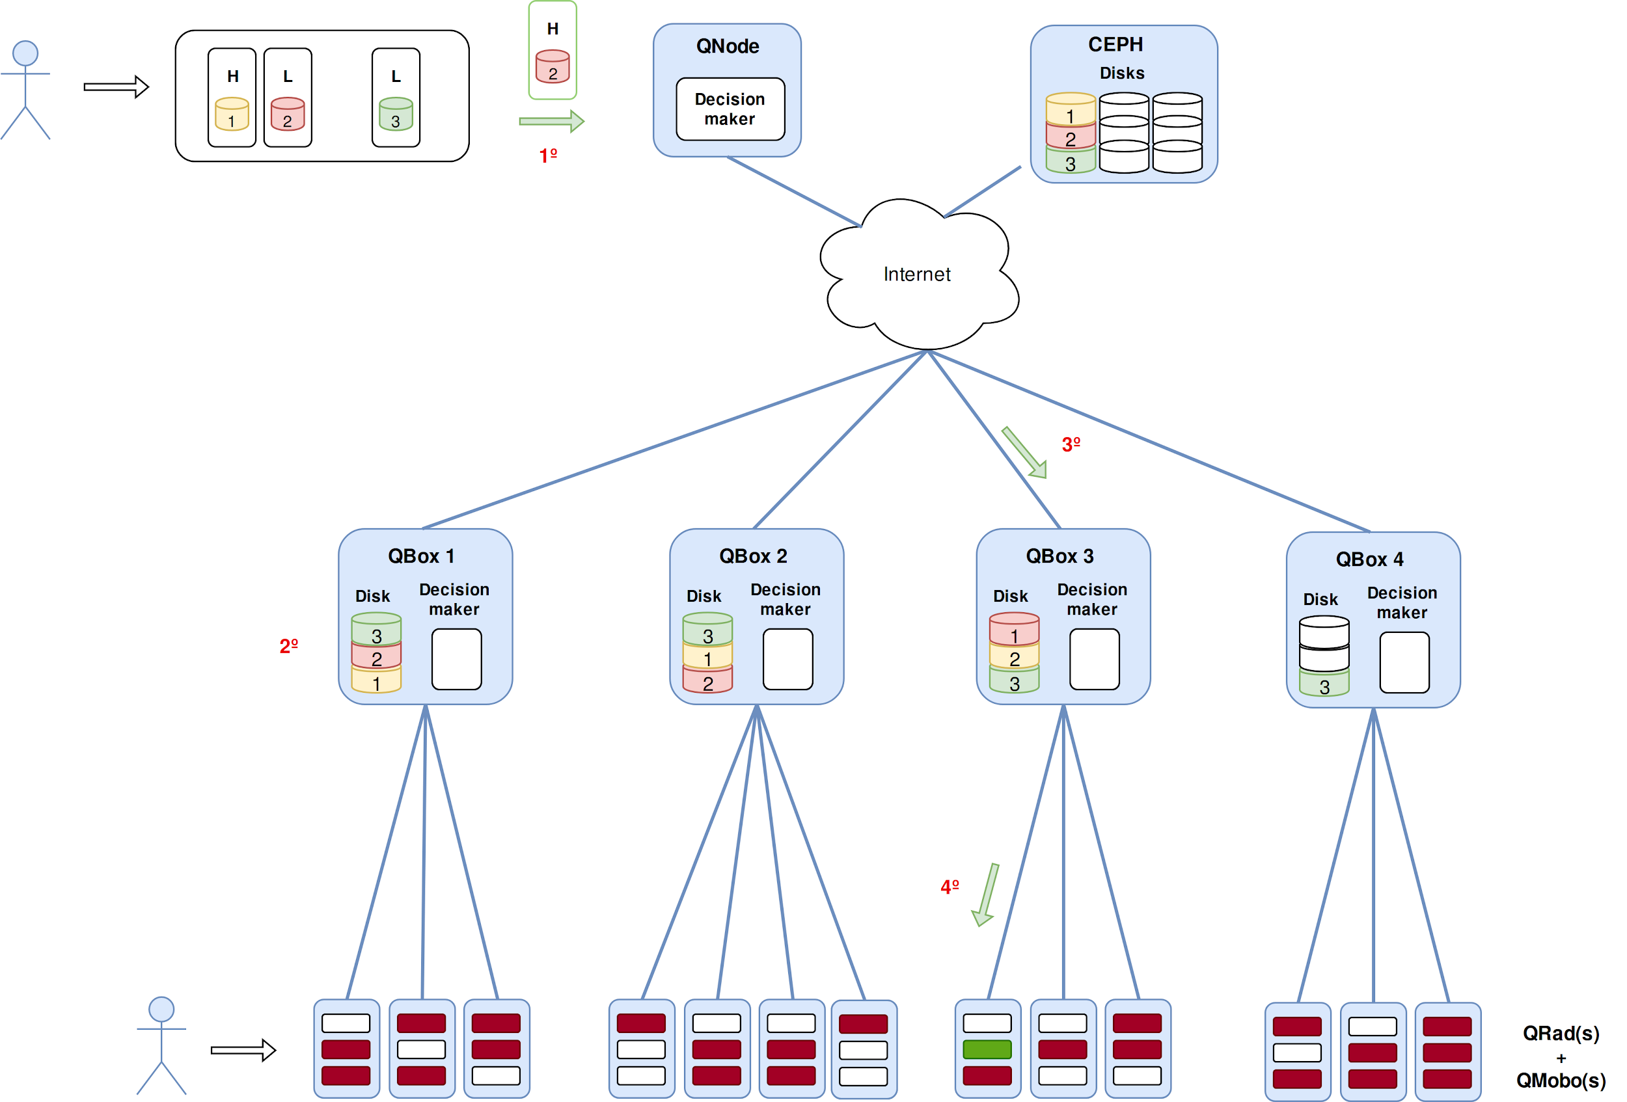
Job Allocation Policies - 3/10 Replicate
Investigating Job Allocation in Edge Computing Platforms
Anderson Andrei DA SILVA, Denis TRYSTRAM
Université Grenoble Alpes

Slide 36
Implementing Scheduling Algorithm in a Simulated Edge Platform
Investigating Job Allocation in Edge Computing Platforms
Anderson Andrei DA SILVA, Denis TRYSTRAM
Université Grenoble Alpes

Slide 37
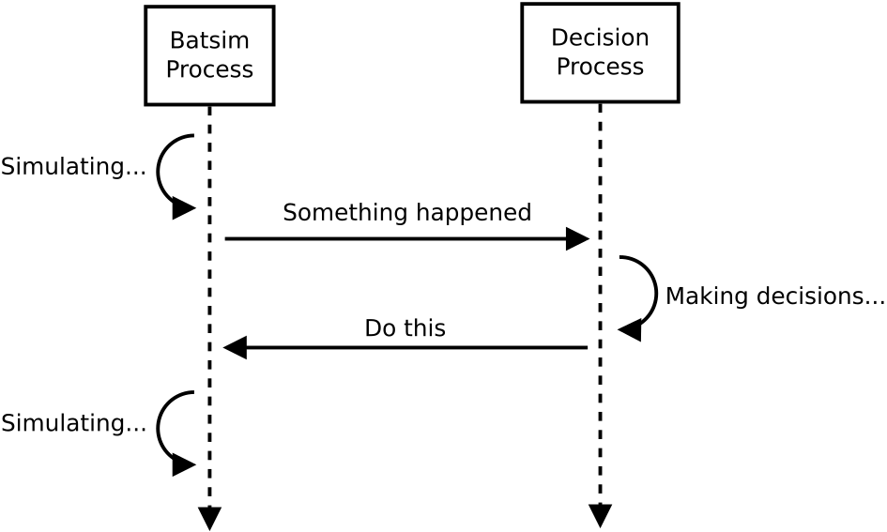
Platform Simulators
SimGrid (Platform): a scientific simulator to study the behavior of large scale distributed systems such as Grids, Clouds, HPC or P2P systems [9].
Batsim (Infrastructure): a dedicated simulator toolkit to help researchers investigate HPC scheduling strategies [10].
PyBatsim (Decision maker): Batsim API for development of scheduling policies.
Figure 4: Decision making process
Investigating Job Allocation in Edge Computing Platforms
Anderson Andrei DA SILVA, Denis TRYSTRAM
Université Grenoble Alpes

Slide 38
Platform Simulators: An extension, the Qarnot extractor
It generates from the Qarnot’s logs a set of files:
The platform description
The list of instances
The list of external events
The list of datasets
It extracts other data to be compared with the simulation outputs:
Logs of ambient temperature
Logs of instances placements
Logs of time regarding the execution (start, submission and finish)
Investigating Job Allocation in Edge Computing Platforms
Anderson Andrei DA SILVA, Denis TRYSTRAM
Université Grenoble Alpes

Slide 39
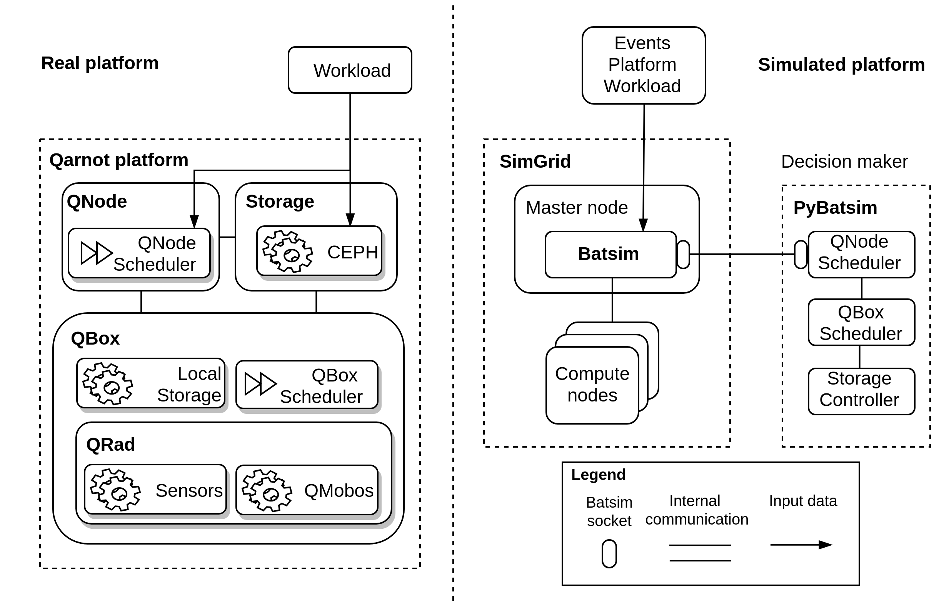
Platform Simulators: From the Qarnot’s Platform to the Simulated One
Figure 5: Real and Simulated Platform
Investigating Job Allocation in Edge Computing Platforms
Anderson Andrei DA SILVA, Denis TRYSTRAM
Université Grenoble Alpes

Slide 40
Experiments
Investigating Job Allocation in Edge Computing Platforms
Anderson Andrei DA SILVA, Denis TRYSTRAM
Université Grenoble Alpes

Slide 41
Experiments
Deterministic simulations.
Platform: About ~3390 QMobos, from ~669 QRads, managed by ~20 QBoxes.
Events: New temperatures
Workloads :
4 workloads with size of 1 week:
  1 week starting from 03 May, denoted by 1w_03
  1 week starting from 10 May, denoted by 1w_10
  1 week starting from 17 May, denoted by 1w_17
  1 week starting from 24 May, denoted by 1w_24
Investigating Job Allocation in Edge Computing Platforms
Anderson Andrei DA SILVA, Denis TRYSTRAM
Université Grenoble Alpes

Slide 42
Analyses of results
Analyses :
Jobs’ processing time
Data sets dependencies
Job allocation metrics:
  Number of data transfers
  Total data transferred (GB)
  Bounded Slowdown
Investigating Job Allocation in Edge Computing Platforms
Anderson Andrei DA SILVA, Denis TRYSTRAM
Université Grenoble Alpes

Slide 43
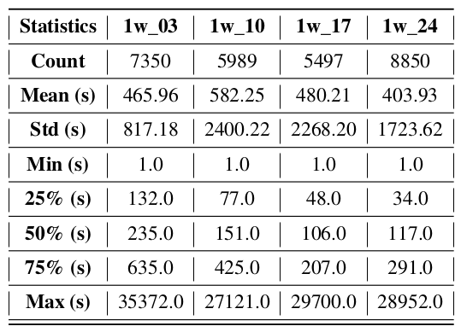
Analyses of Results: Jobs’ Processing Time
Table: Processing time distribution for all workloads
For all workloads, these distributions characterize the workloads as:
75% composed by short jobs,
25% composed by long jobs.
Investigating Job Allocation in Edge Computing Platforms
Anderson Andrei DA SILVA, Denis TRYSTRAM
Université Grenoble Alpes

Slide 44
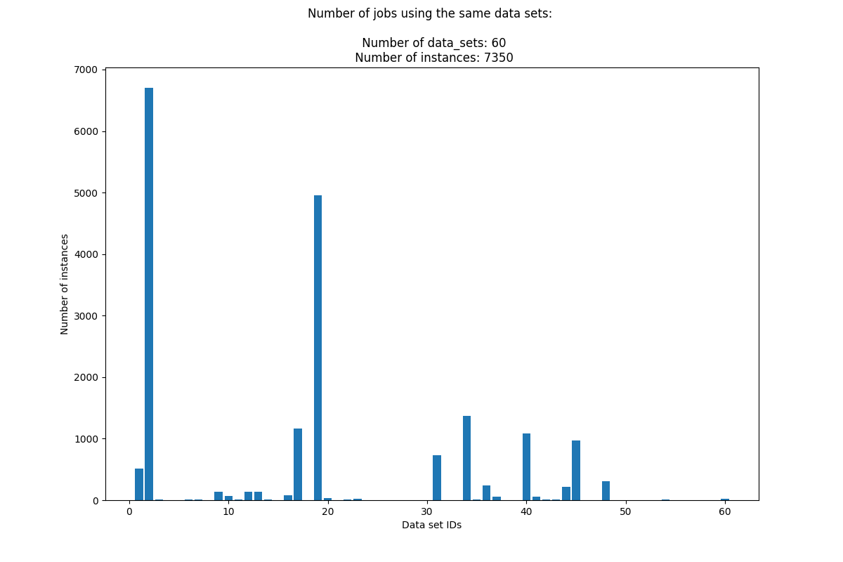
Analyses of Results: Data Sets Dependencies
One can see that :
The data set with ID 2 is required by about 6,700 instances, 91% of the total.
The data set with ID 19, about 5,000 instances, 68% of the total number of instances.
Other data set IDs reasonably required as 17, 34, 40 and 45.
Figure 6: Data sets dependencies for workload 1w_03
Investigating Job Allocation in Edge Computing Platforms
Anderson Andrei DA SILVA, Denis TRYSTRAM
Université Grenoble Alpes

Slide 45
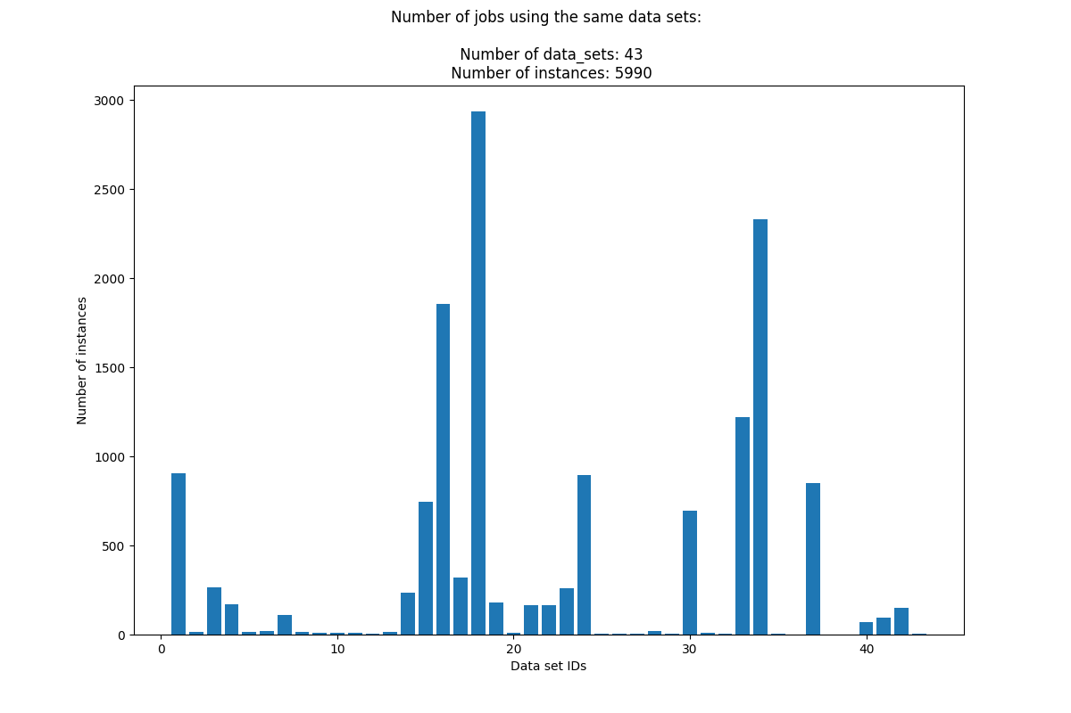
Analyses of Results: Data Sets Dependencies
One can see that:
The data set with ID 18 is required by about 2,900 48% of the total number of instances.
The data sets with ID 34 and 16, about respectively 2,400 and 1,700 instances, 40% and 28%.
Other data set IDs reasonably
required as 1, 15, 24, 33 and 37.
Figure 7: Data sets dependencies for workload 1w_10
Investigating Job Allocation in Edge Computing Platforms
Anderson Andrei DA SILVA, Denis TRYSTRAM
Université Grenoble Alpes

Slide 46
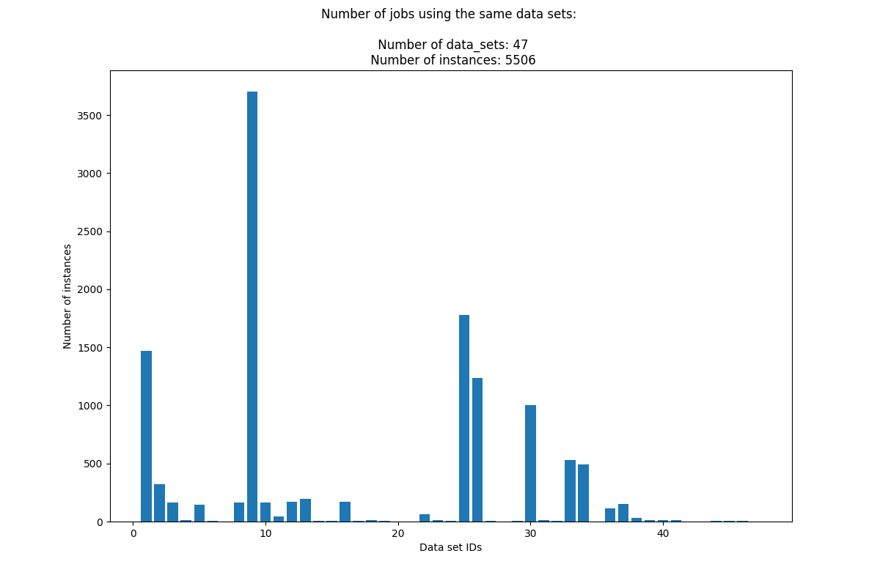
Analyses of Results: Data Sets Dependencies
One can see that:
The data set with ID 9 is required by about 3,700 instances, 67% of the total number of instances.
The data sets with ID 25 about 1,800 instances, representing 33% of the total number of instances.
Other data set IDs reasonably required as 1, 26 and 30
Figure 8: Data sets dependencies for workload 1w_17
Investigating Job Allocation in Edge Computing Platforms
Anderson Andrei DA SILVA, Denis TRYSTRAM
Université Grenoble Alpes

Slide 47
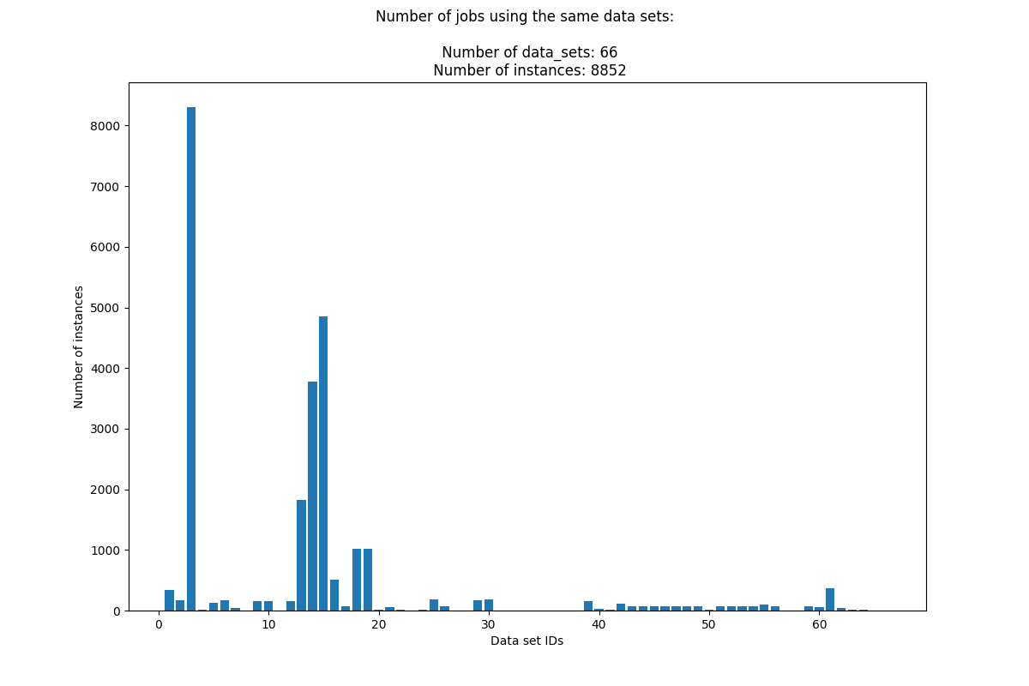
Analyses of Results: Data Sets Dependencies
One can see that:
The data set with ID 3 is required by about 8,500 instances, 96% of the total number of instances.
It is followed by the data sets with ID 15 about 5,000 instances, 56% of the total number of instances.
Other data set IDs reasonably required as 13 and 14
Figure 9: Data sets dependencies for workload 1w_24
Investigating Job Allocation in Edge Computing Platforms
Anderson Andrei DA SILVA, Denis TRYSTRAM
Université Grenoble Alpes

Slide 48
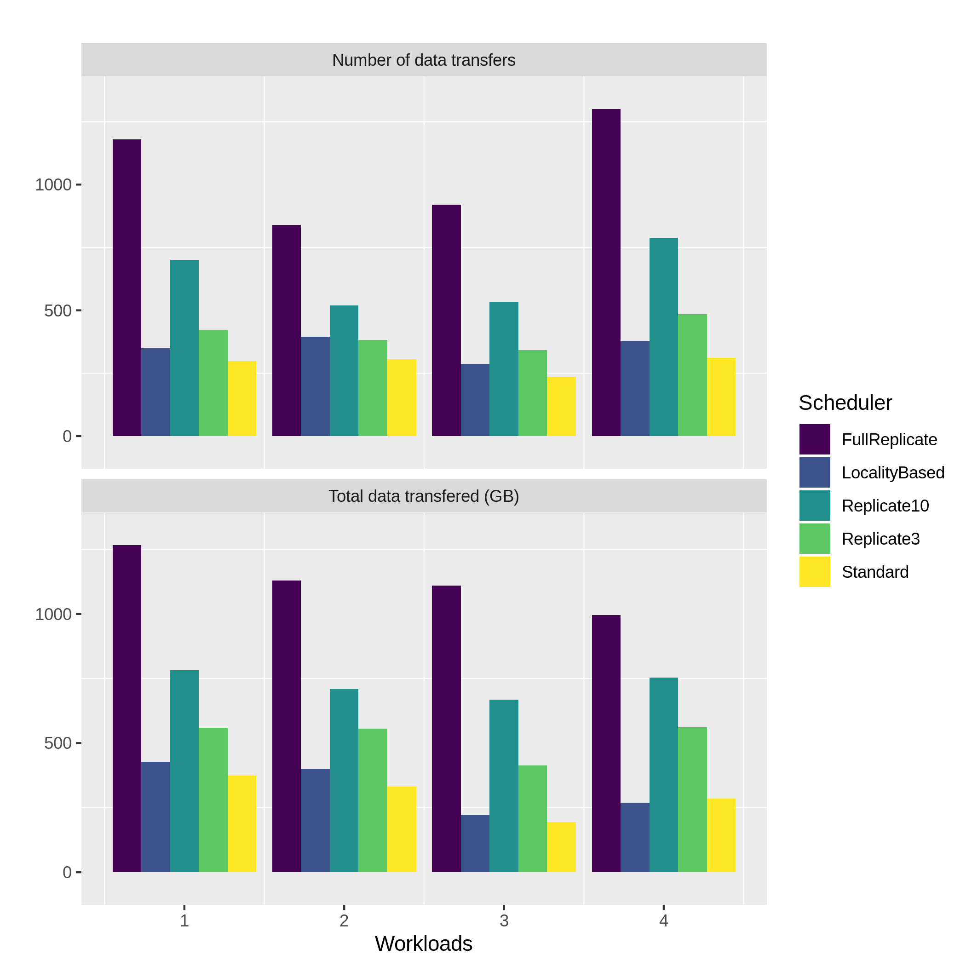
Analyses of Results: Data Transfer
One can see that
For both metrics the schedulers FullReplicate, Replicate10 and Replicate3 are the three with the highest values with the exception of the Replicate3 for the workload 2 in the Number of data transfers.
  It is totally expected since, respectively, they replicate data sets in all, 10 and 3 QBoxes.
The LocalityBased got close or higher values in comparison with the Standard scheduler
  It is explained by the data set dependencies.
Figure 10: Metrics for data transfers.
Investigating Job Allocation in Edge Computing Platforms
Anderson Andrei DA SILVA, Denis TRYSTRAM
Université Grenoble Alpes
Notes:
Around 600 QRads and jobs 11831

Slide 49
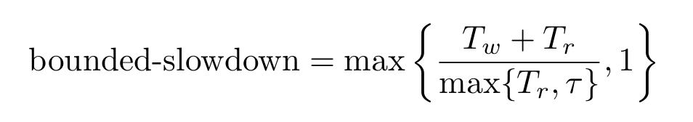
Analyses of Results: Bounded Slowdown
How does the waiting time behave?
Does the waiting time is proportional with the job’s size?
Where,
Tw is the waiting time,
Tr is the execution time,
is a threshold.
Investigating Job Allocation in Edge Computing Platforms
Anderson Andrei DA SILVA, Denis TRYSTRAM
Université Grenoble Alpes
Notes:
Around 600 QRads and jobs 11831

Slide 50
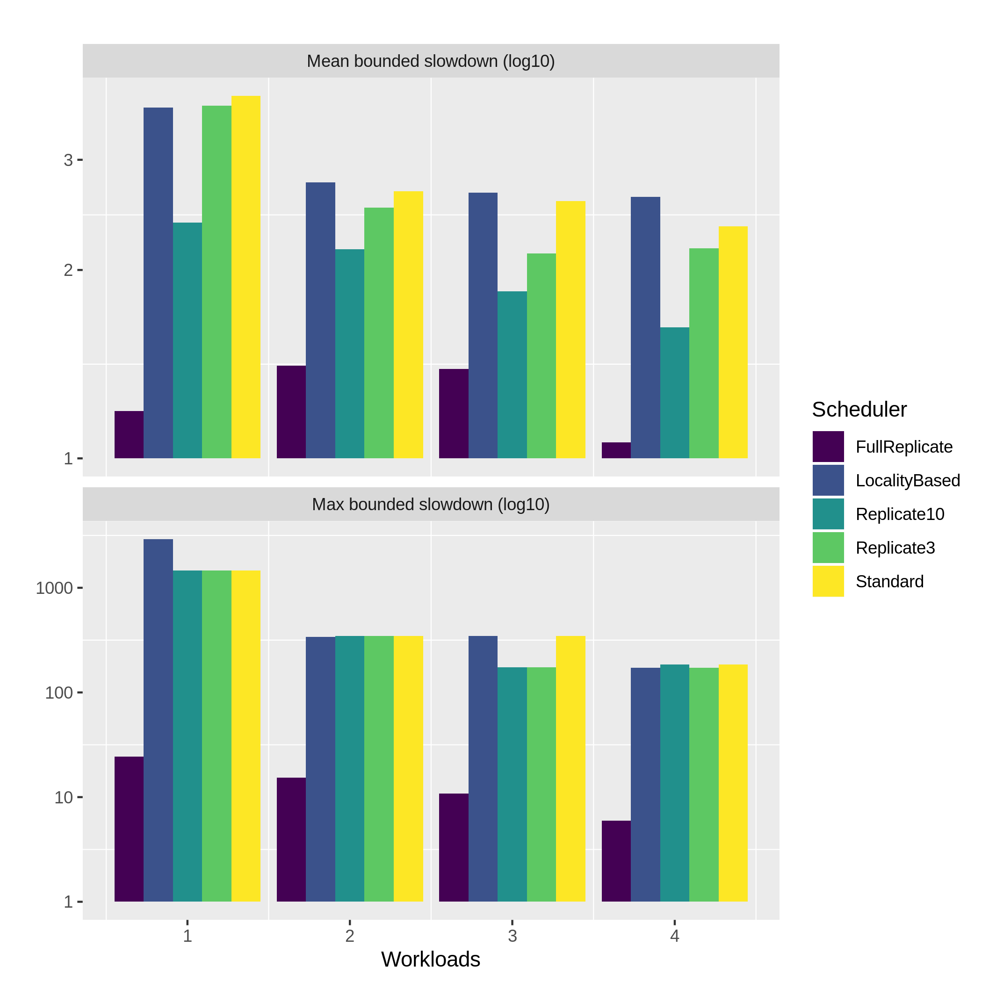
Analyses of Results: Bounded Slowdown
One can see that
The FullReplicate scheduler presents the lowest values for both metrics.
For almost all the other cases, the Replicate10 and Replicate3 are the next lowest ones, with the exception of the Max bounded slowdown with the second and fourth workloads.
  It is also totally expected since these schedulers replicate much more data sets than the LocalityBased and Standard.
The LocalityBased presents close or higher values when compared with the Standard thanks the data sets dependencies.
Figure 11: Mean Bounded Slowdown 1
Investigating Job Allocation in Edge Computing Platforms
Anderson Andrei DA SILVA, Denis TRYSTRAM
Université Grenoble Alpes
Notes:
Around 600 QRads and jobs 11831

Slide 51
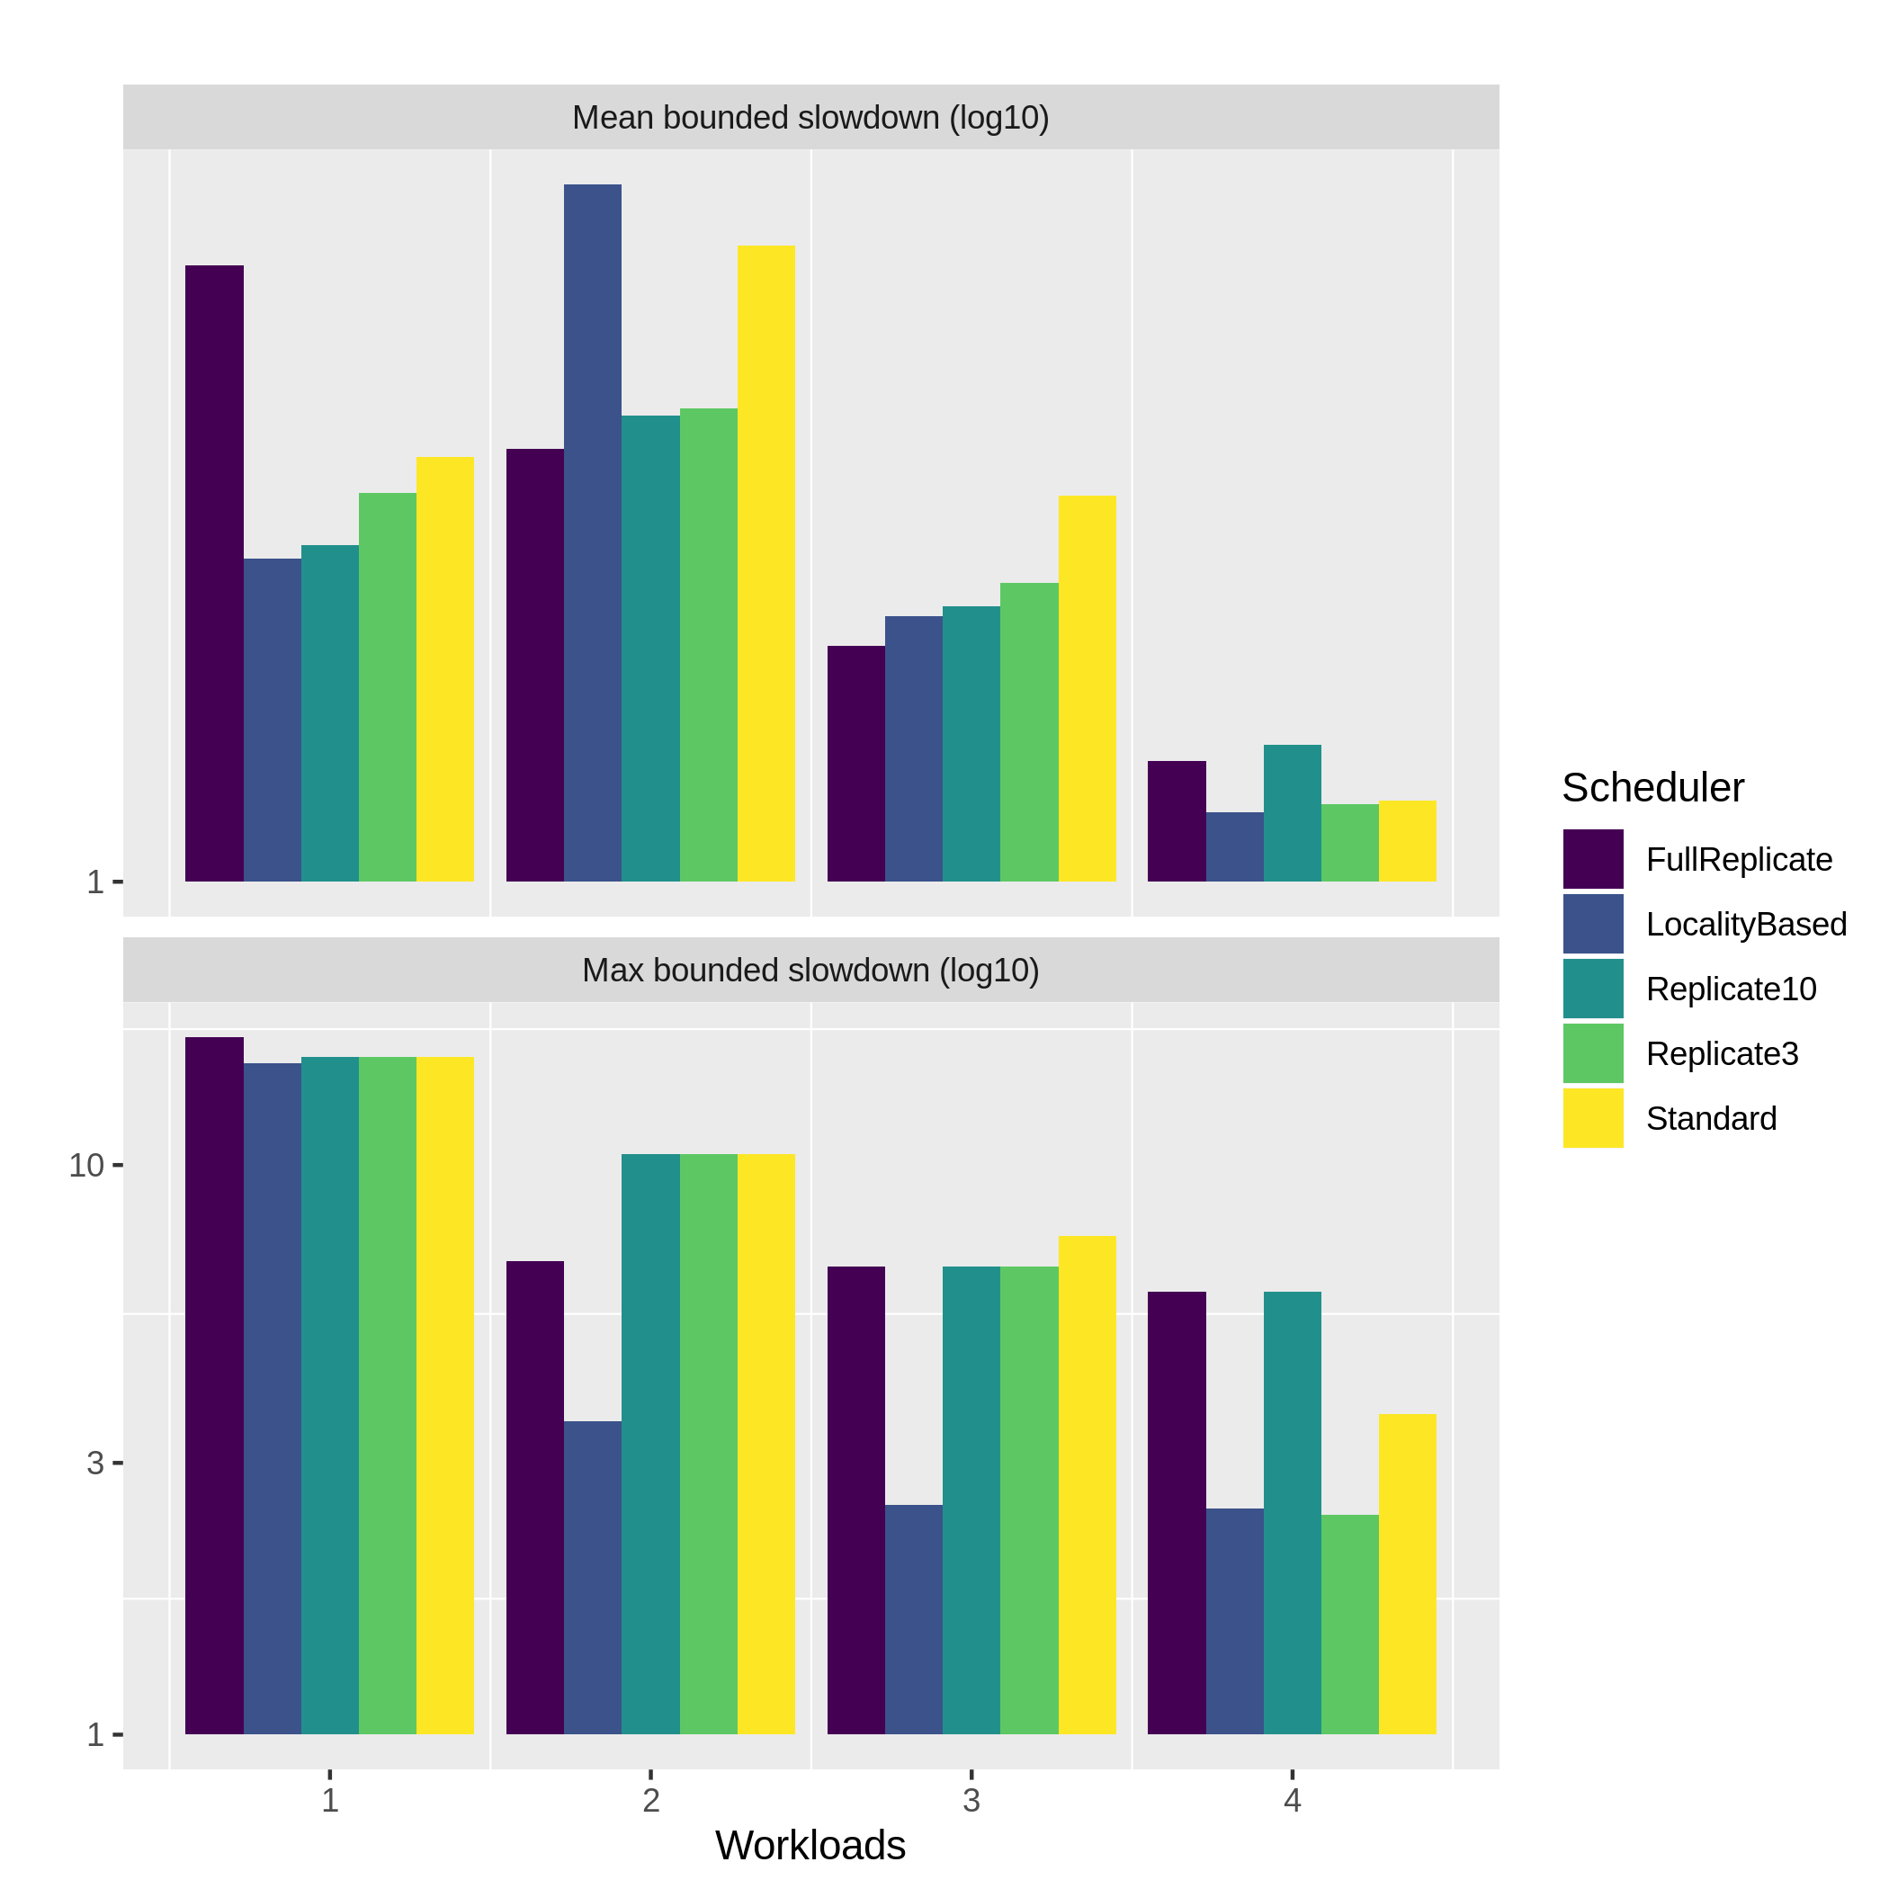
Analyses of Results: Bounded Slowdown for Long Jobs
One can see that:
The values for the FullReplicate now are among the highest ones.
  We justify it by the waiting_time from the allocation decision process that, in general, takes more time to schedule long jobs than short jobs.
Figure 12: Mean Bounded Slowdown 1
Investigating Job Allocation in Edge Computing Platforms
Anderson Andrei DA SILVA, Denis TRYSTRAM
Université Grenoble Alpes
Notes:
Around 600 QRads and jobs 11831

Slide 52
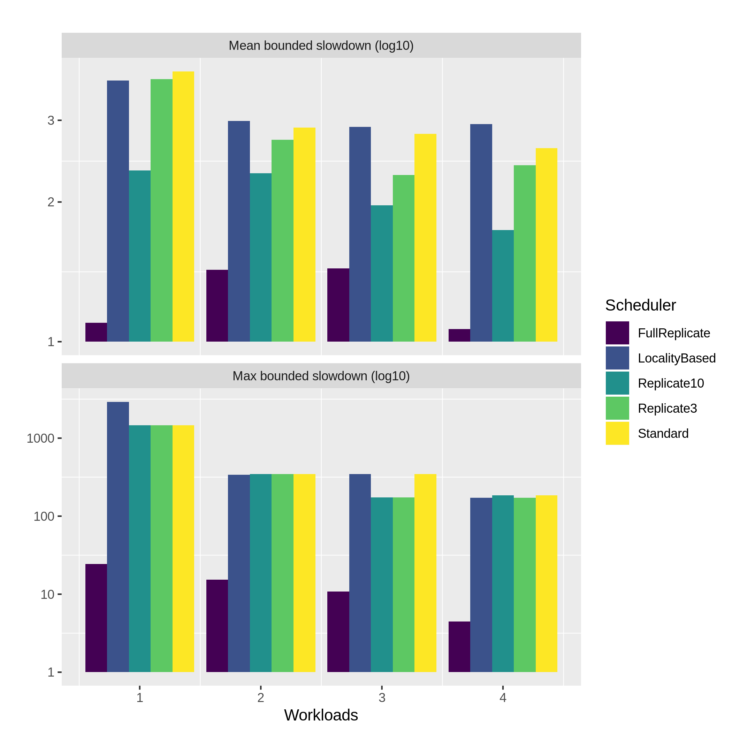
Analyses of Results: Bounded Slowdown for Short Jobs
As one can see that
Presents the same behavior than the one with all jobs together, the highest are owned by the non replicated schedulers.
  We attributed it to the jobs’ waiting_time, since the execution_time is short.
Finally, as the replicate based schedulers present low values when compared with the others.
  We attributed that the waiting_time for the LocalityBased and Standard schedulers.
Figure 13: Mean Bounded Slowdown 1
Investigating Job Allocation in Edge Computing Platforms
Anderson Andrei DA SILVA, Denis TRYSTRAM
Université Grenoble Alpes
Notes:
As this data is composed only for short jobs, its execution_time is low, then, we attributed the high values visible in Figure 7.8 to its waiting_time.

Slide 53
Analyses of Results: Bounded Slowdown
Comparing the results filtered by short and long jobs, the premise that short jobs are more sensitive to these metrics is true in our case, because the first figure presents much more high values than the second.
And considering that 75% of the jobs are being represented as the short jobs and 25% in as long jobs, we understood that the general behavior of this metric is much more impacted by the short jobs into these workloads.
Investigating Job Allocation in Edge Computing Platforms
Anderson Andrei DA SILVA, Denis TRYSTRAM
Université Grenoble Alpes
Notes:
Around 600 QRads and jobs 11831

Slide 54
Conclusions
Edge Computing is a computational paradigm that have been evolved from the Cloud Computing due to the growth of Mobile / IoT devices that embedded enough computation power to avoid the data processment centralization on the Cloud.
In order of the heterogeneity of such devices, it is still difficult to extend the known solutions of Cloud to the Edge Computing, then its importance of study.
From the literature review is not known a good Edge Platform simulator, then this thesis aimed to show an example of Simulated Platform, that still on going, but is already possible to be applied in use cases as the Qarnot Computing.
Using such platform, we implemented different scheduling policies and realized experiments following the jobs’ processing time, data sets’ dependencies, data transfers and bounded slowdown.
Instead we do not have large experimental input, our analyses characterized the Qarnot’s workload as composed by 75% of short jobs and 25% of long jobs, within high dependency on the same data sets, and we were able to indicate the best scheduling policies are those based on replication.
In addition, these results are used in a paper [11] submitted to the IEEE MASCOTS 2019.
Investigating Job Allocation in Edge Computing Platforms
Anderson Andrei DA SILVA, Denis TRYSTRAM
Université Grenoble Alpes

Slide 55
Further Remarks
The work developed during this thesis is very useful to the Qarnot Computing as:
  The results showed that the replication based scheduling policies could be better.
  An example of easy implementation and modification of scheduling policies to be studied.
  A platform to predict behavior simulating more external events.
  A platform to simulate specific environment such as an new office where QRads will be installed.
From the literature, several challenges have been emerged in the context of Cloud and Edge Computing. We believe that this thesis contributed with an example of implementation of scheduling policies in an Simulated Edge Platform, hence it was good step to continue investigating such challenges, as the development of a Digital Twin, a goal of our work group.
Investigating Job Allocation in Edge Computing Platforms
Anderson Andrei DA SILVA, Denis TRYSTRAM
Université Grenoble Alpes

Slide 56
Bibliography
[1] W. Shi, J. Cao, Q. Zhang, Y. Li, and L. Xu. Edge computing: Vision and challenges. IEEE Internet of Things Journal, 3(5):637–646, Oct 2016.
[2] W. Shi and S. Dustdar. The promise of edge computing. Computer, 49(5):78–81, May 2016.
[4] Y. Mao, C. You, J. Zhang, K. Huang, and K. B. Letaief. A survey on mobile edge computing: The communication perspective. IEEE Communications Surveys Tutorials, 19(4):2322–2358, Fourthquarter 2017.
[5] Luiz Bittencourt, Roger Immich, Rizos Sakellariou, Nelson Fonseca, Edmundo Madeira, Marilia Curado, Leandro Villas, Luiz DaSilva, Craig Lee, and Omer Rana. The internet of things, fog and cloud continuum: Integration and challenges. Internet of Things, 3-4:134 – 155, 2018.
[6] S. M. Parikh. A survey on cloud computing resource allocation techniques. In 2013 Nirma University International Conference on Engineering (NUiCONE), pages 1–5, Nov 2013.
[7] Lu Huang, Hai-shan Chen, and Ting-ting Hu. Survey on resource allocation policy and job scheduling algorithms of cloud computing1. Journal of Software, 8, 02 2013.
[8] Hameed Hussain, Saif Ur Rehman Malik, Abdul Hameed, Samee Ullah Khan, Gage Bickler, Nasro Min-Allah, Muhammad Bilal Qureshi, Limin Zhang, Wang Yongji, Nasir Ghani, Joanna Kolodziej, Albert Y. Zomaya, Cheng-Zhong Xu, Pavan Balaji, Abhinav Vishnu, Fredric Pinel, Johnatan E. Pecero, Dzmitry Kliazovich, Pascal Bouvry, Hongxi- ang Li, Lizhe Wang, Dan Chen, and Ammar Rayes. A survey on resource allocation in high performance distributed computing systems. Parallel Computing, 39(11):709 – 736, 2013.
Investigating Job Allocation in Edge Computing Platforms
Anderson Andrei DA SILVA, Denis TRYSTRAM
Université Grenoble Alpes

Slide 57
Bibliography
[9] Henri Casanova, Arnaud Giersch, Arnaud Legrand, Martin Quinson, and Frédéric Suter. Versatile, Scalable, and Accurate Simulation of Distributed Applications and Platforms. Journal of Parallel and Distributed Computing, 74(10):2899–2917, June 2014.
[10] Pierre-François Dutot, Michael Mercier, Millian Poquet, and Olivier Richard. Batsim: a Realistic Language-Independent Resources and Jobs Management Systems Simulator. In 20th Workshop on Job Scheduling Strategies for Parallel Processing, Chicago, United States, May 2016.
[11] Anderson da Silva, Clement Mommessin, Pierre Neyron, Denis Trystram, adwait bauskar, Adrien Lebre, Alexandre Van Kempen, Yanik Ngoko, and yoann ricordel. Investigating Placement Challenges in Edge Infrastructures through a Common Simulator. In Mascots 2019 - 27th IEEE International Symposium on the Modeling, Analysis, and Simulation of Computer and Telecommunication Systems, pages 1–16, Rennes, France, October 2019.
Investigating Job Allocation in Edge Computing Platforms
Anderson Andrei DA SILVA, Denis TRYSTRAM
Université Grenoble Alpes

Slide 58
Thank you for your attention!
Investigating Job Allocation Policies in Edge Computing Platforms
Master of Science in Informatics at Grenoble
Parallel, Distributed and Embedded Systems
Université Grenoble Alpes
Anderson Andrei DA SILVA
Advisor: Prof. Denis TRYSTRAM
Jury
Prof. Martin HEUSSE
Prof. Christophe CÉRIN
Prof. Hubert GARAVEL

Slide 59
Platform Simulators: Simgrid
Platform simulator with realistic network and computation models.
Used to simulate the Qarnot platform:
CPUs in QMobos
QBox disks and CEPH
Network links between CEPH and QBox disks
Plugin for temperature support (QRad and ambient air) w.r.t. power consumption.
Investigating Job Allocation in Edge Computing Platforms
Anderson Andrei DA SILVA, Denis TRYSTRAM
Université Grenoble Alpes

Slide 60
Platform Simulators: Batsim
Infrastructure simulator for jobs and I/O scheduling, built on top of SimGrid.
Completes SimGrid’s simulation with:
The submission of tasks
The submission of external events (e.g., target/outside temperature change)
The communication with the decision making process
Investigating Job Allocation in Edge Computing Platforms
Anderson Andrei DA SILVA, Denis TRYSTRAM
Université Grenoble Alpes

Slide 61
Platform Simulators: PyBatsim
Decision making process, which talks with the Batsim process via a socket to manage:
The dispatch of tasks/instances (QNode scheduler)
The placement of instances (QBox scheduler)
The different storages and data movements (Storage Controller)
The heating needs (Frequency Regulator)
Investigating Job Allocation in Edge Computing Platforms
Anderson Andrei DA SILVA, Denis TRYSTRAM
Université Grenoble Alpes

Slide 62
Platform Simulators: Limitations
No cluster tasks
No booting time of QMobos before starting instances
No real values of poweR/speed of CPUs
Empty initial state of the platform
No external event “QMobo X becomes (un)available” (do we want that?)
Investigating Job Allocation in Edge Computing Platforms
Anderson Andrei DA SILVA, Denis TRYSTRAM
Université Grenoble Alpes

Slide 63
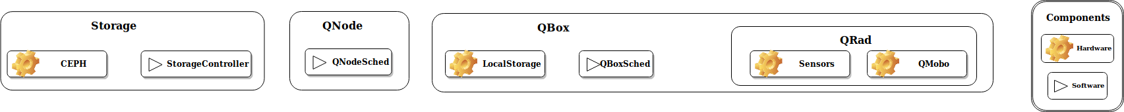
The real platform
Investigating Job Allocation in Edge Computing Platforms
Anderson Andrei DA SILVA, Denis TRYSTRAM
Université Grenoble Alpes

Slide 64
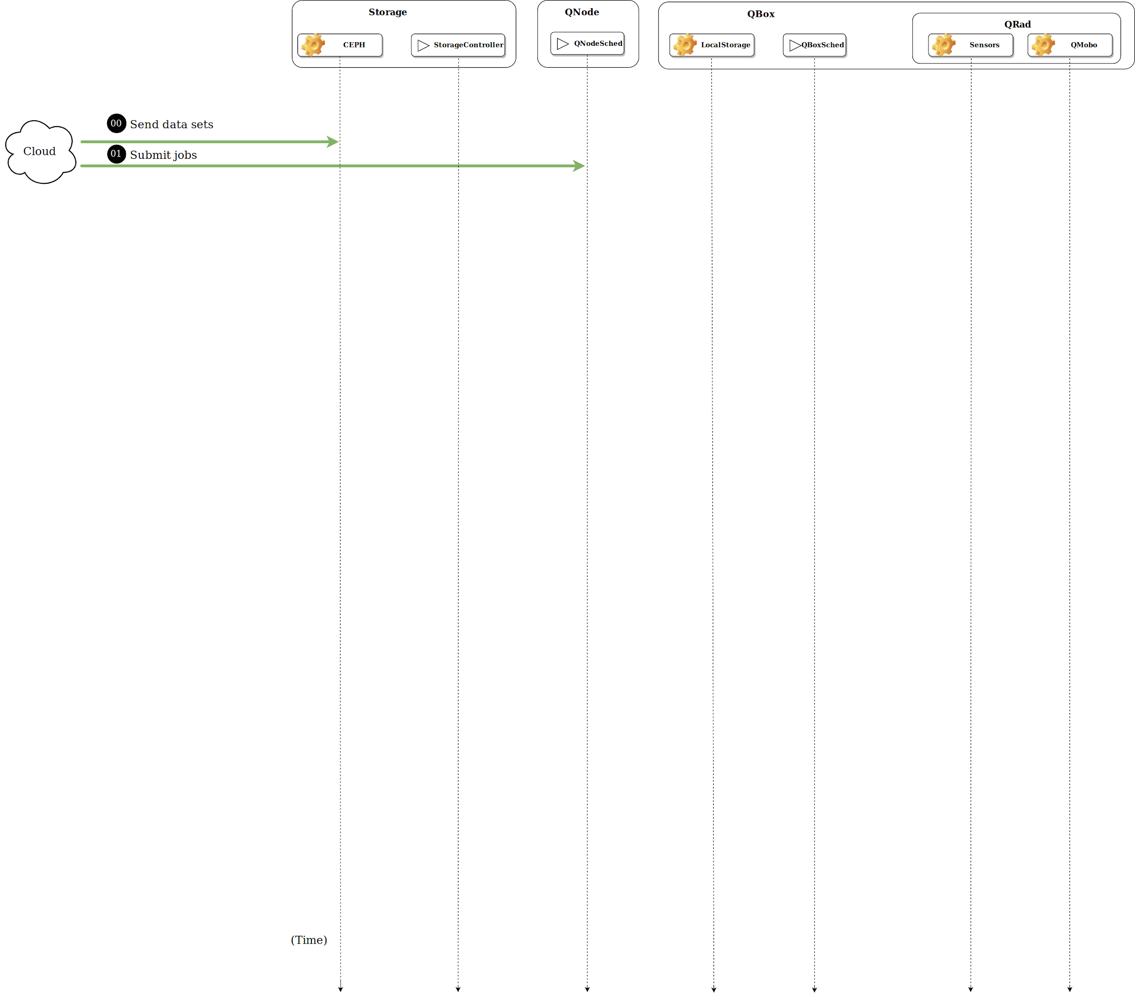
Investigating Job Allocation in Edge Computing Platforms
Anderson Andrei DA SILVA, Denis TRYSTRAM
Université Grenoble Alpes

Slide 65
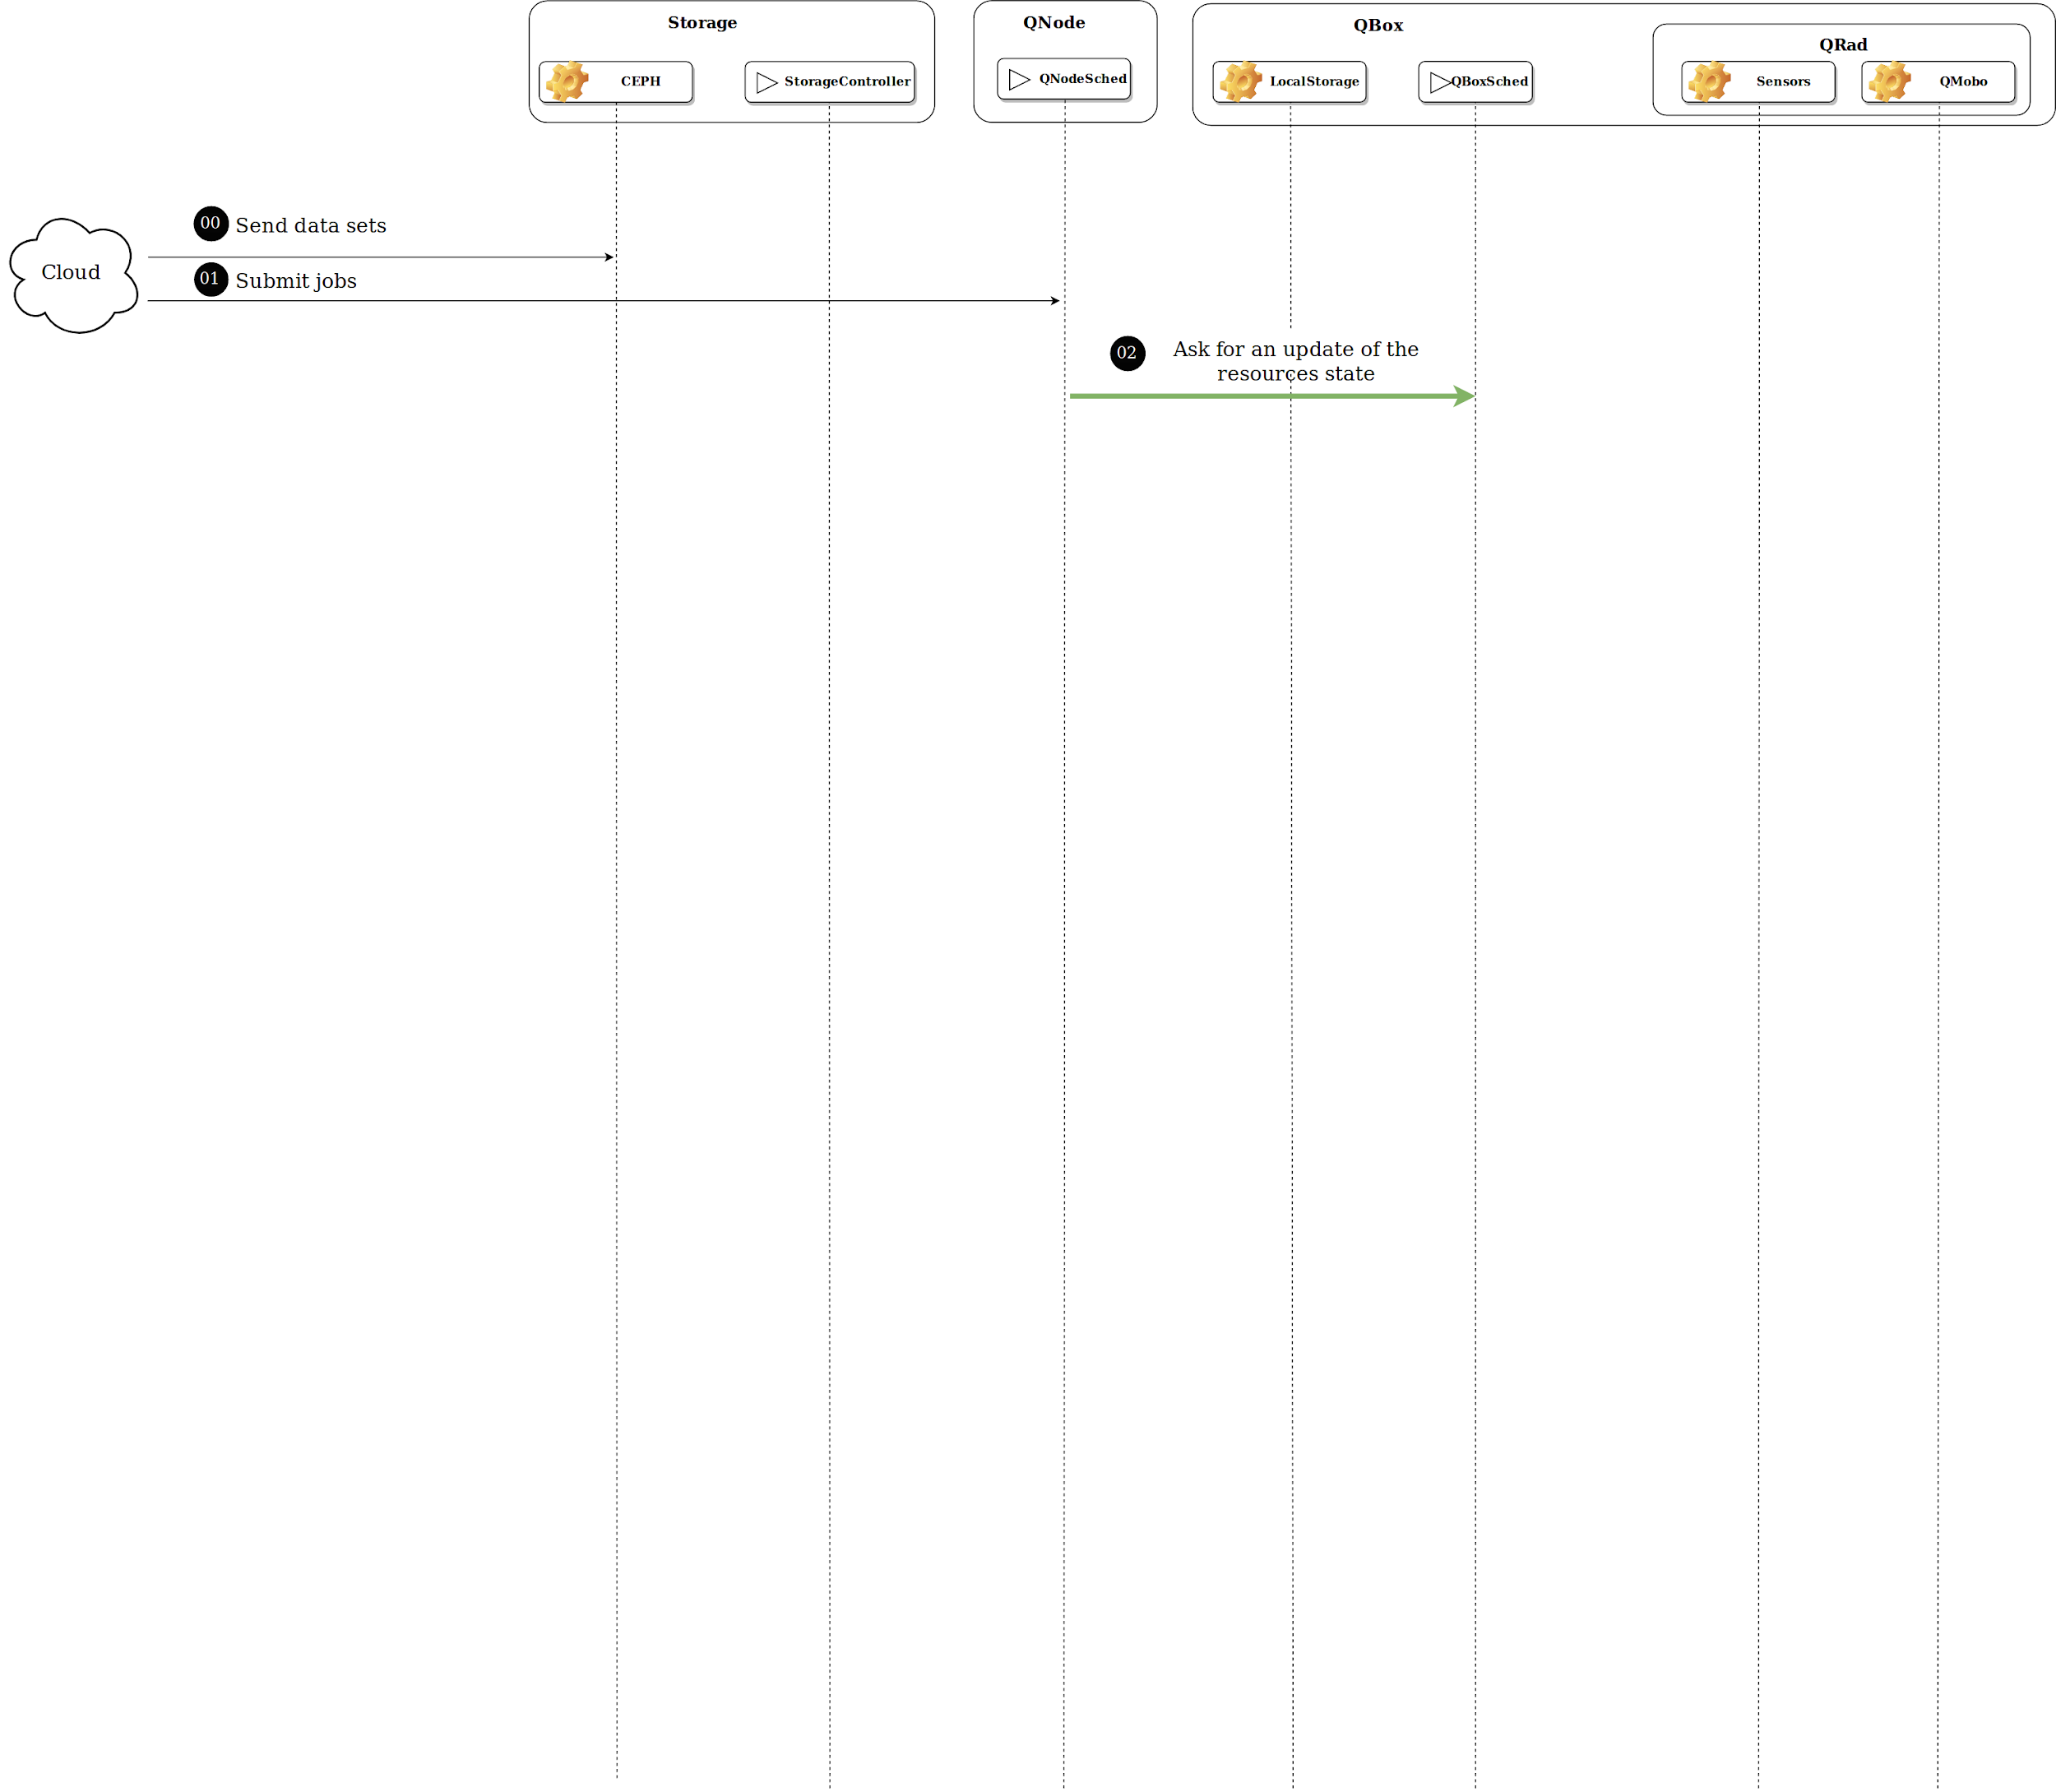
Investigating Job Allocation in Edge Computing Platforms
Anderson Andrei DA SILVA, Denis TRYSTRAM
Université Grenoble Alpes

Slide 66
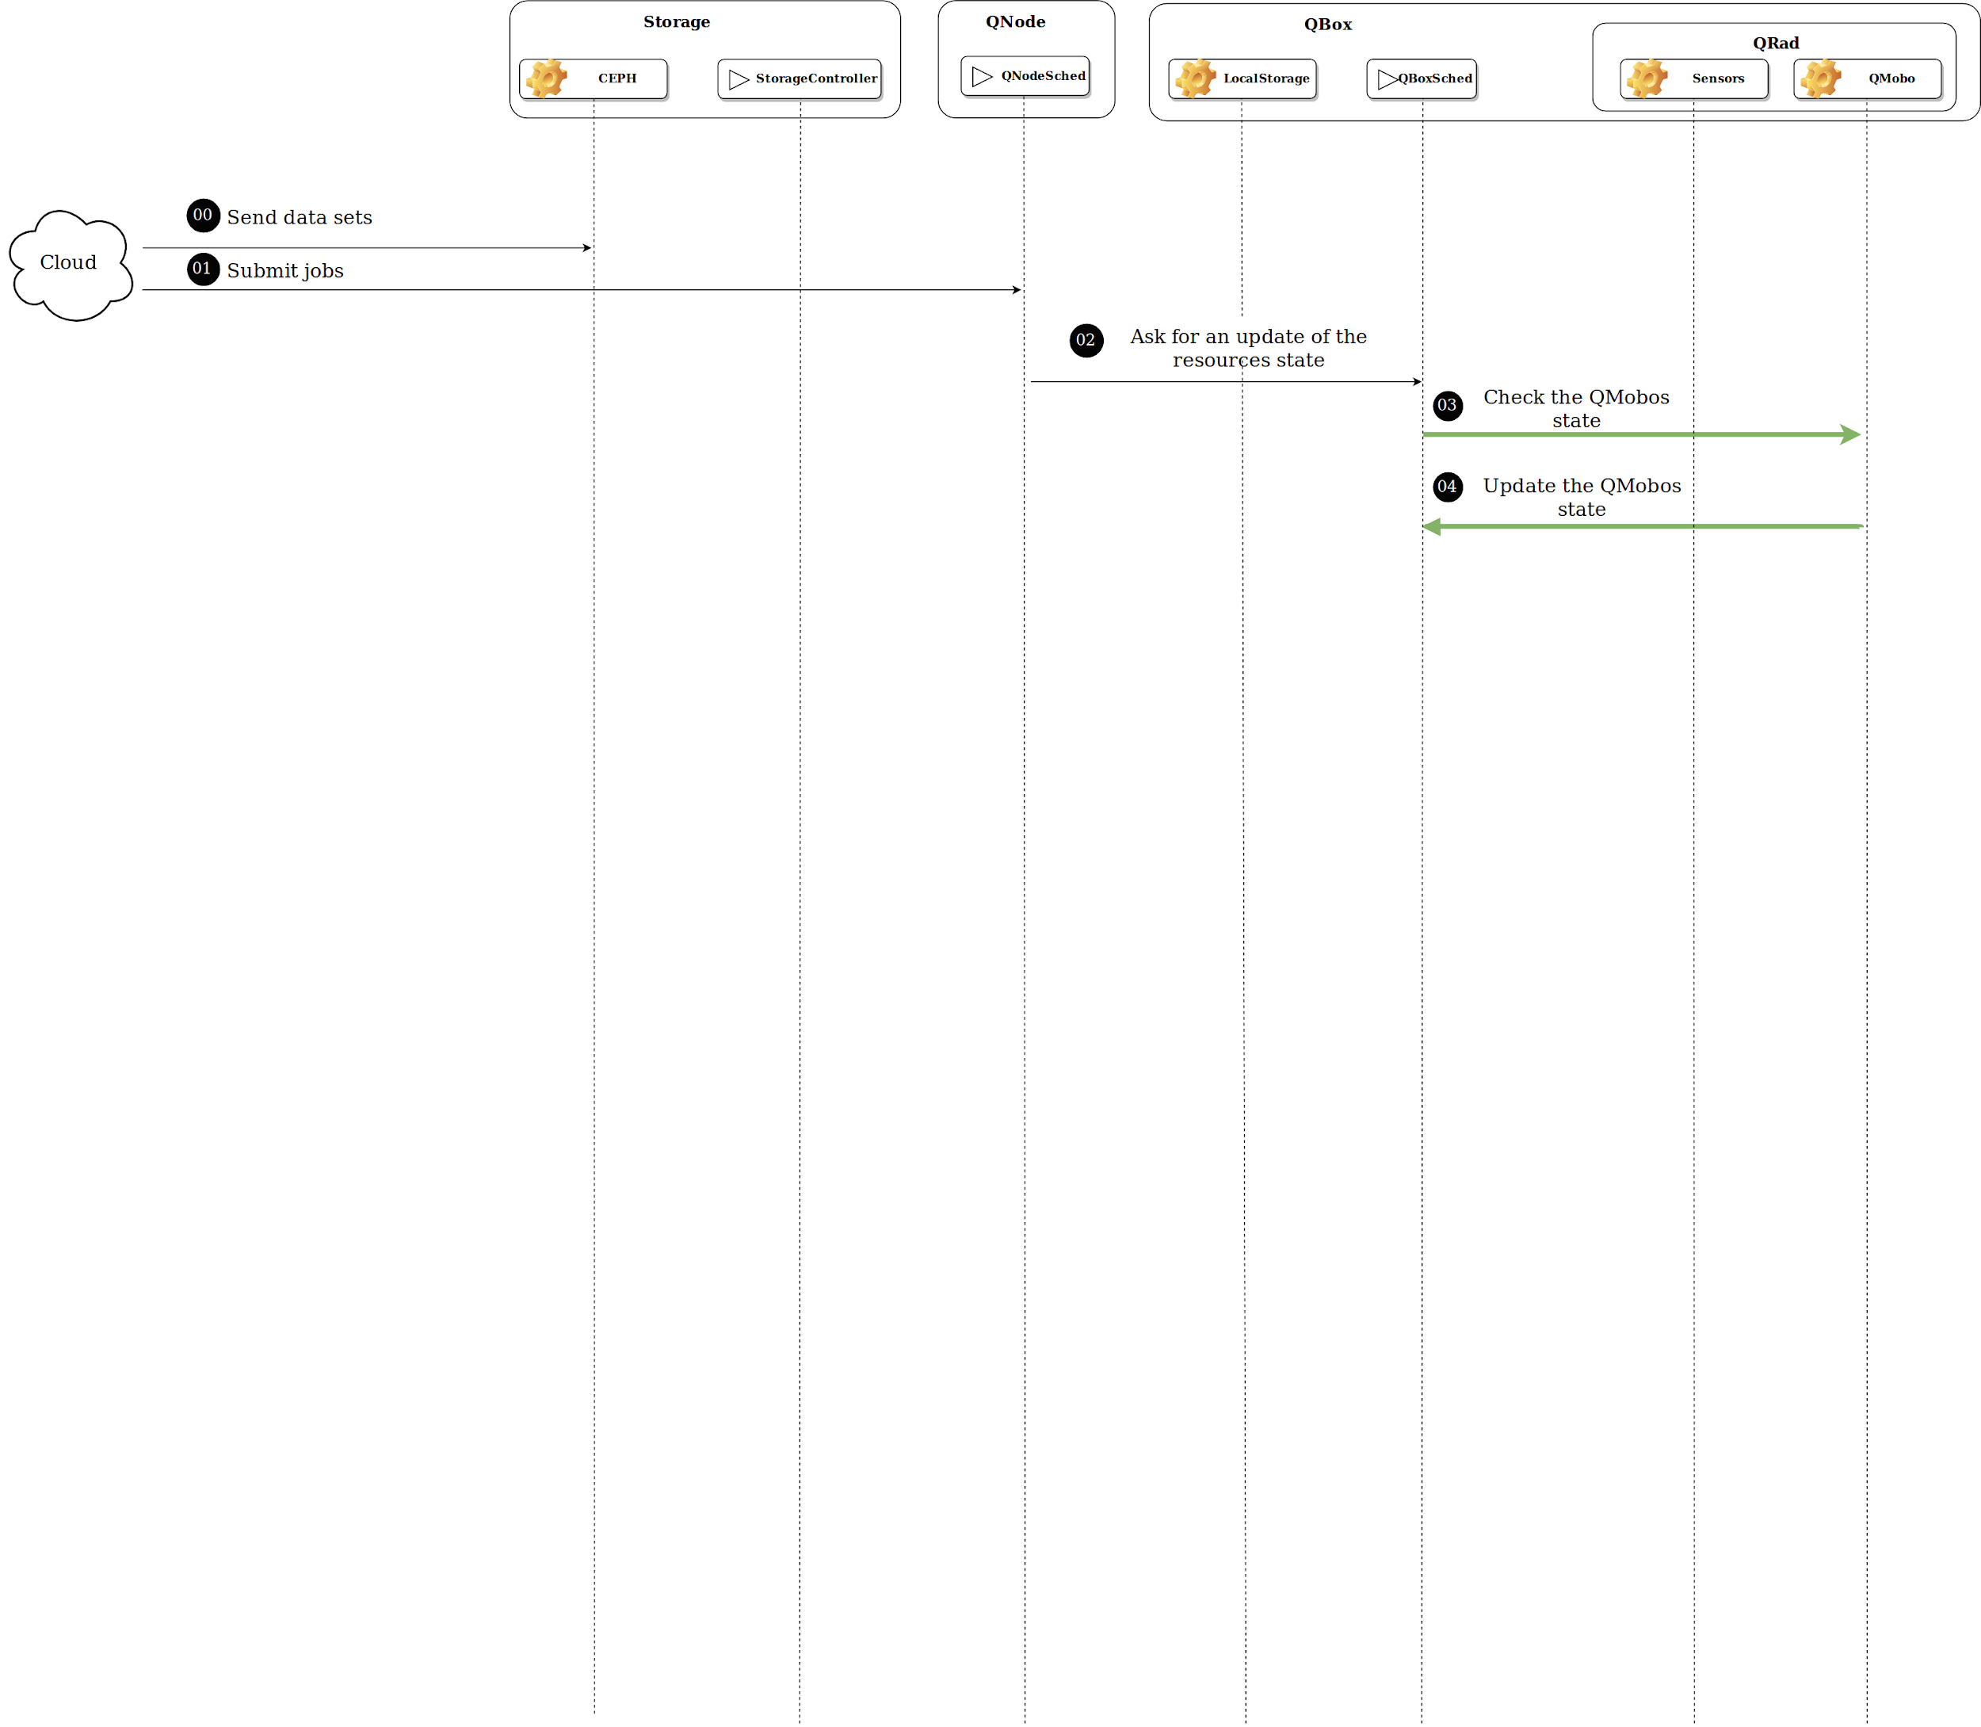
Investigating Job Allocation in Edge Computing Platforms
Anderson Andrei DA SILVA, Denis TRYSTRAM
Université Grenoble Alpes

Slide 67
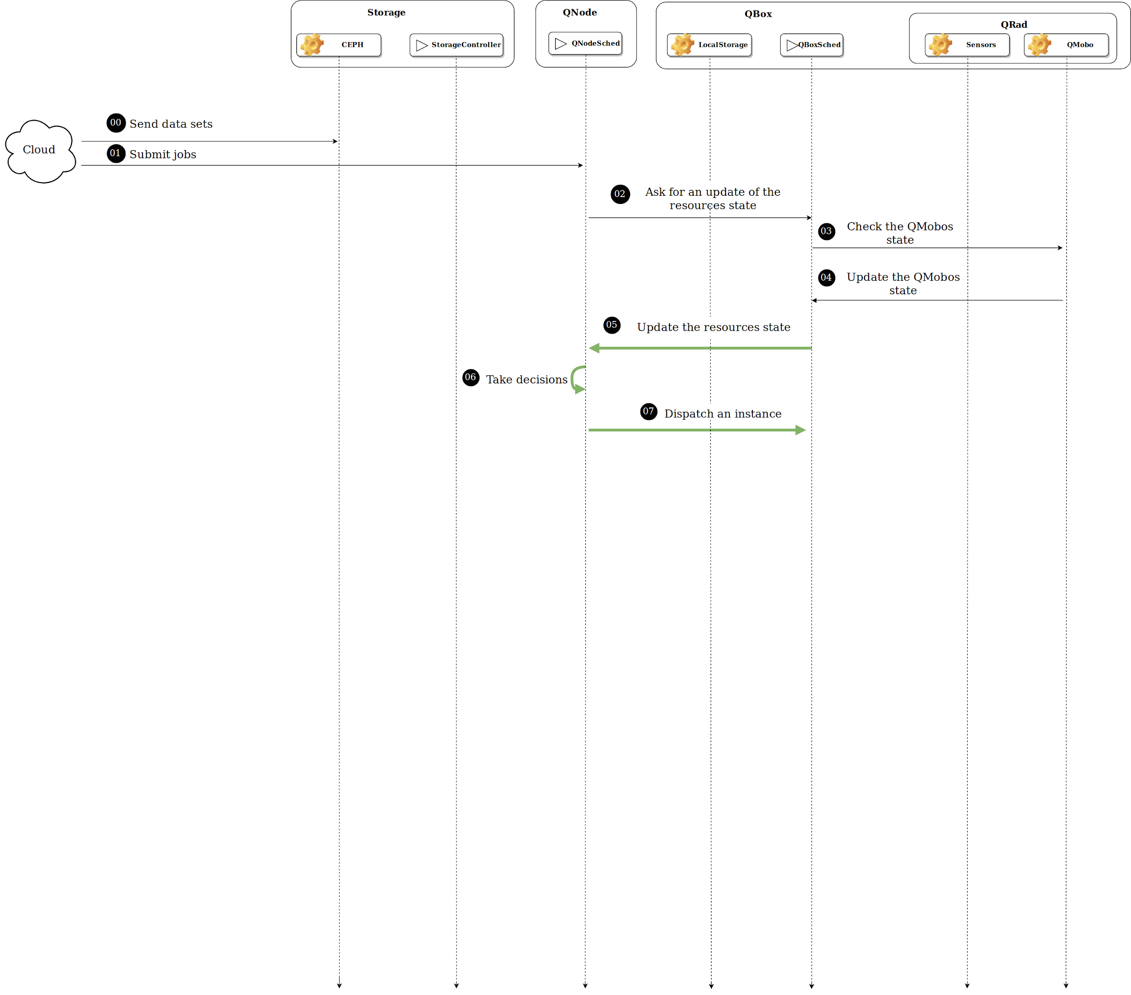
Investigating Job Allocation in Edge Computing Platforms
Anderson Andrei DA SILVA, Denis TRYSTRAM
Université Grenoble Alpes

Slide 68
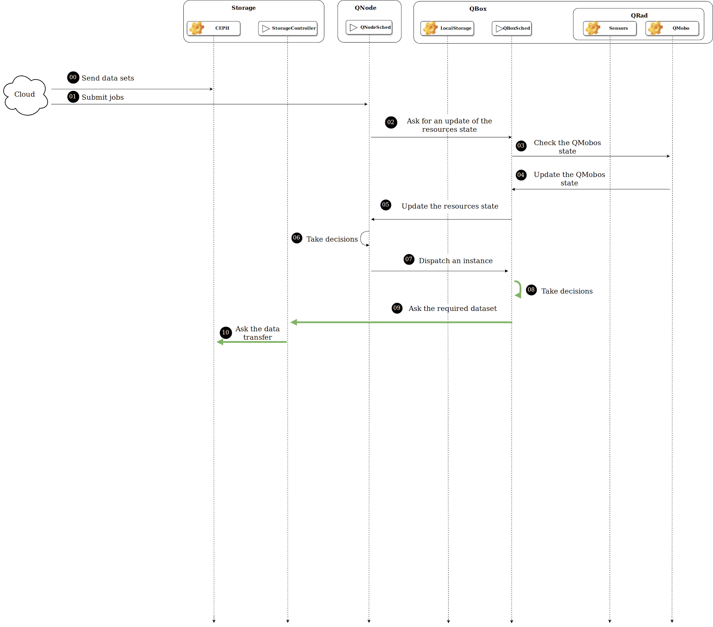
Investigating Job Allocation in Edge Computing Platforms
Anderson Andrei DA SILVA, Denis TRYSTRAM
Université Grenoble Alpes

Slide 69
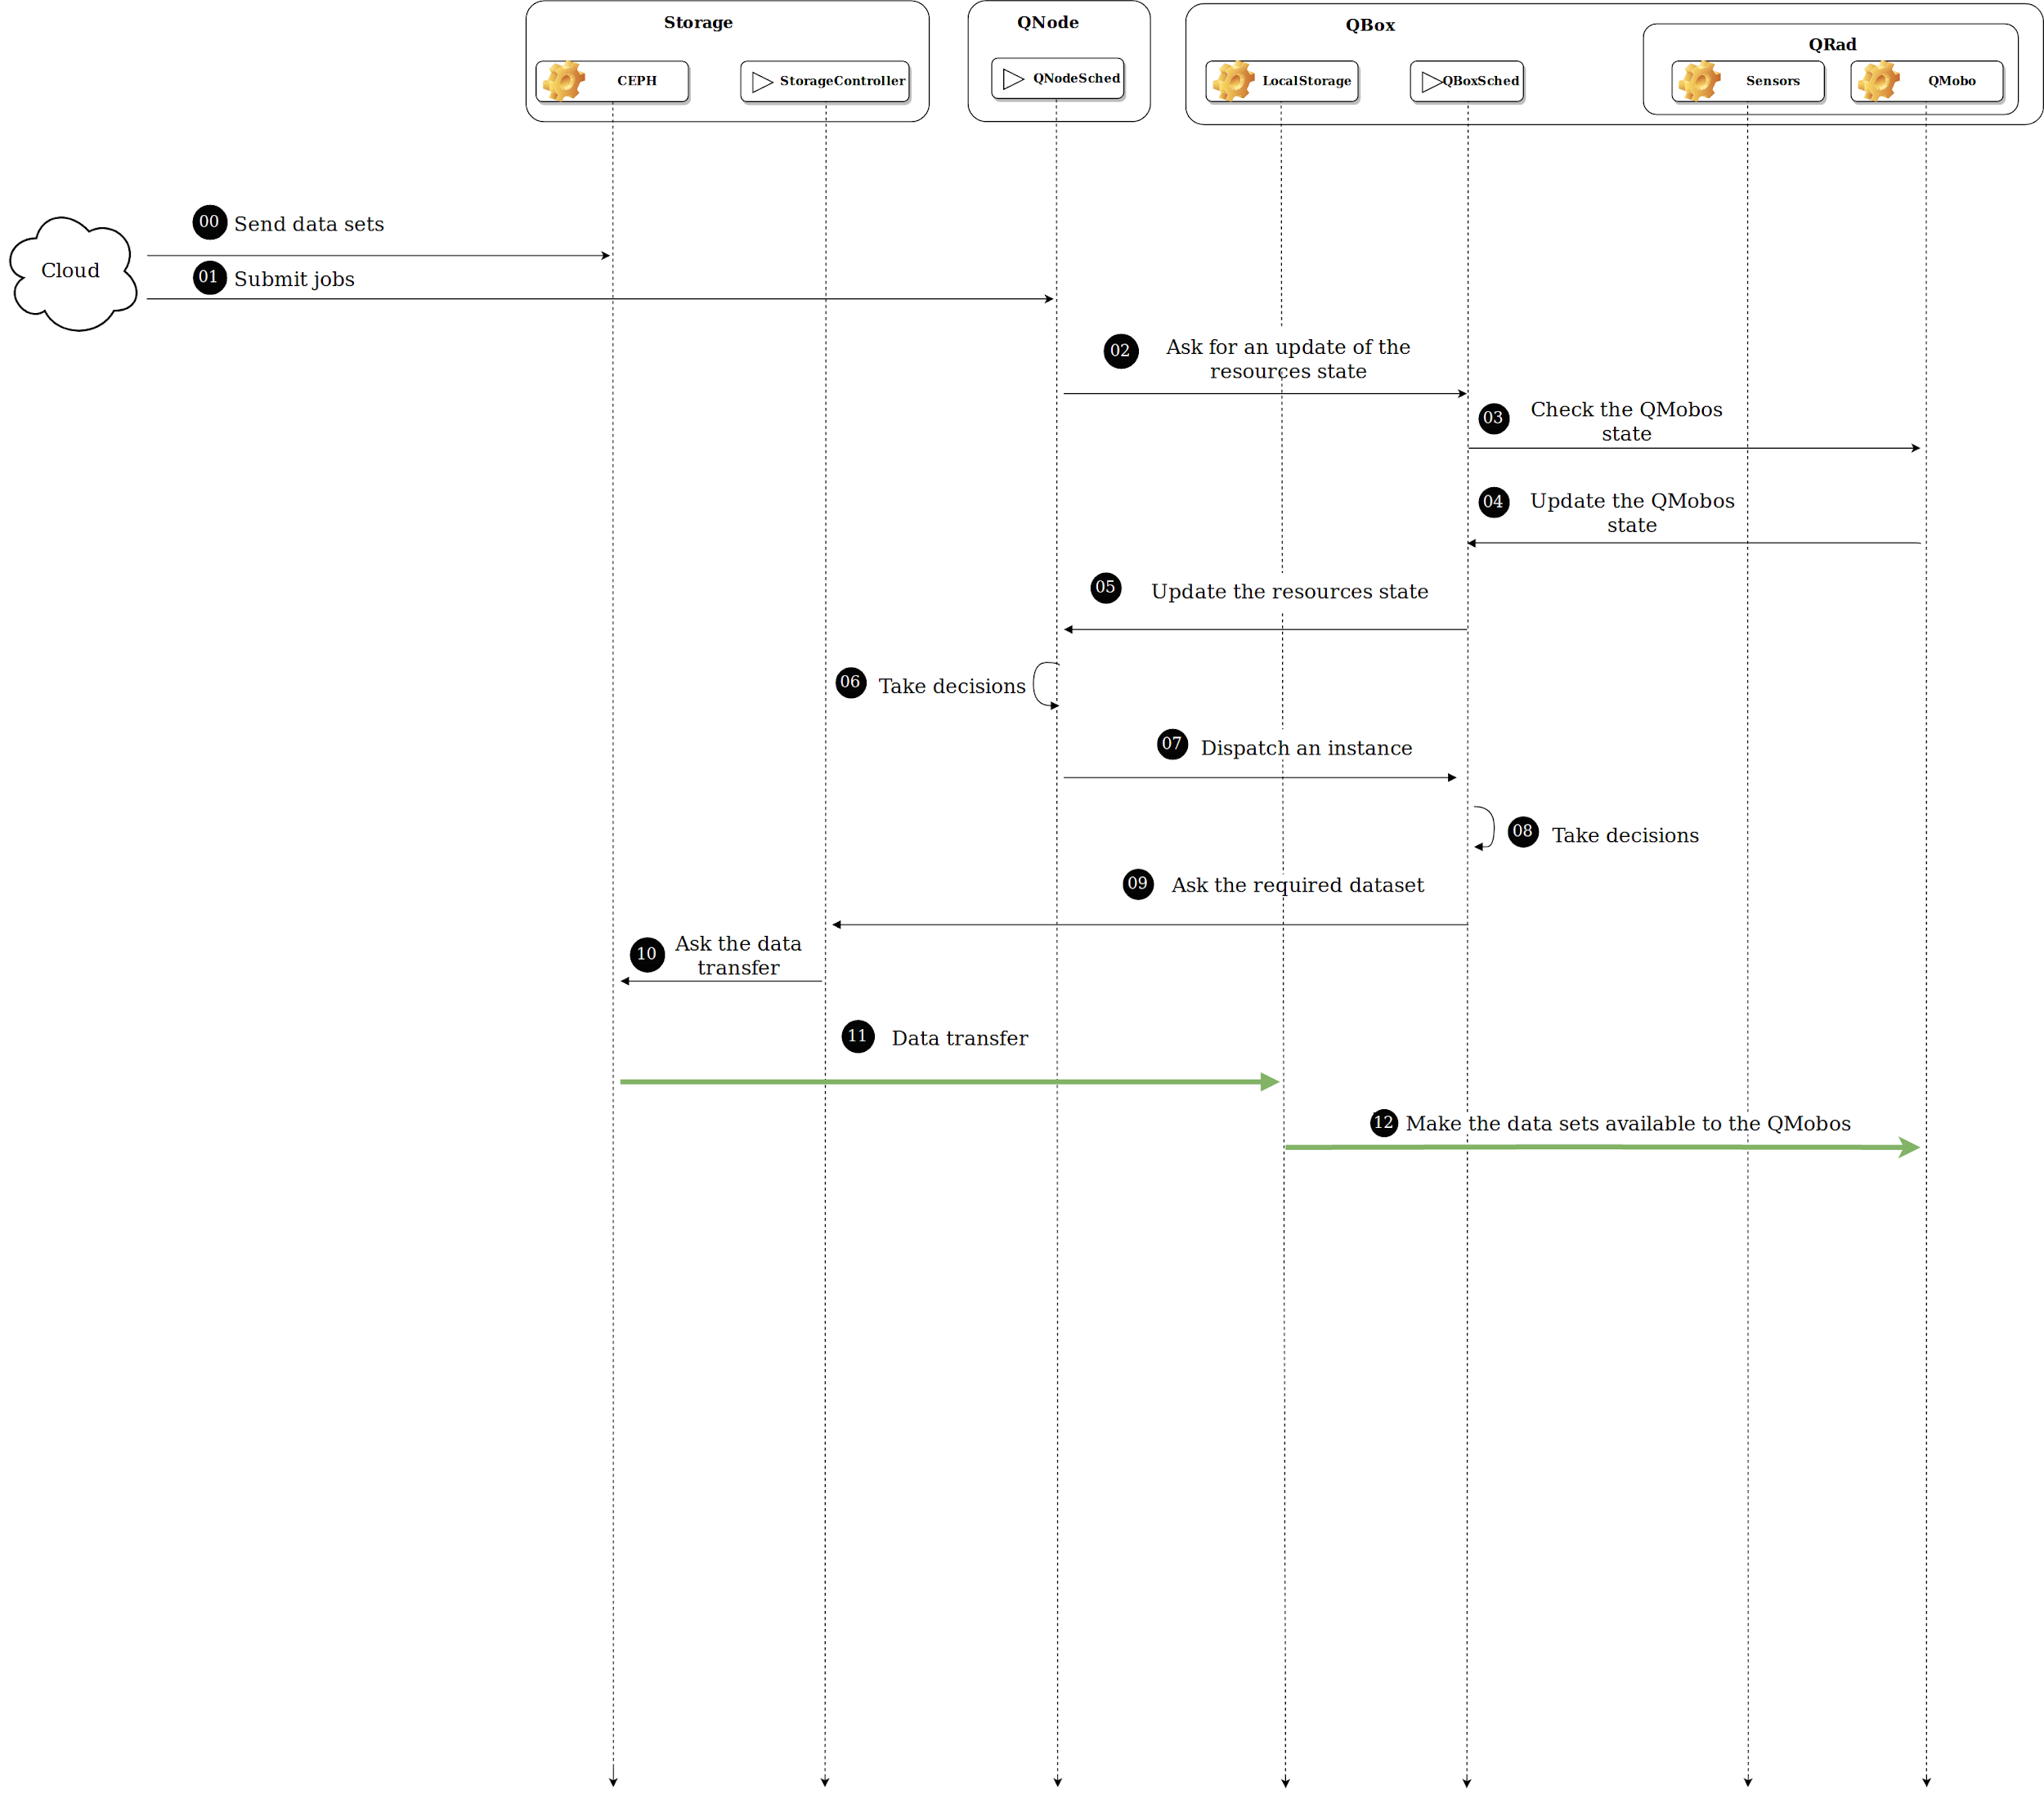
Investigating Job Allocation in Edge Computing Platforms
Anderson Andrei DA SILVA, Denis TRYSTRAM
Université Grenoble Alpes

Slide 70
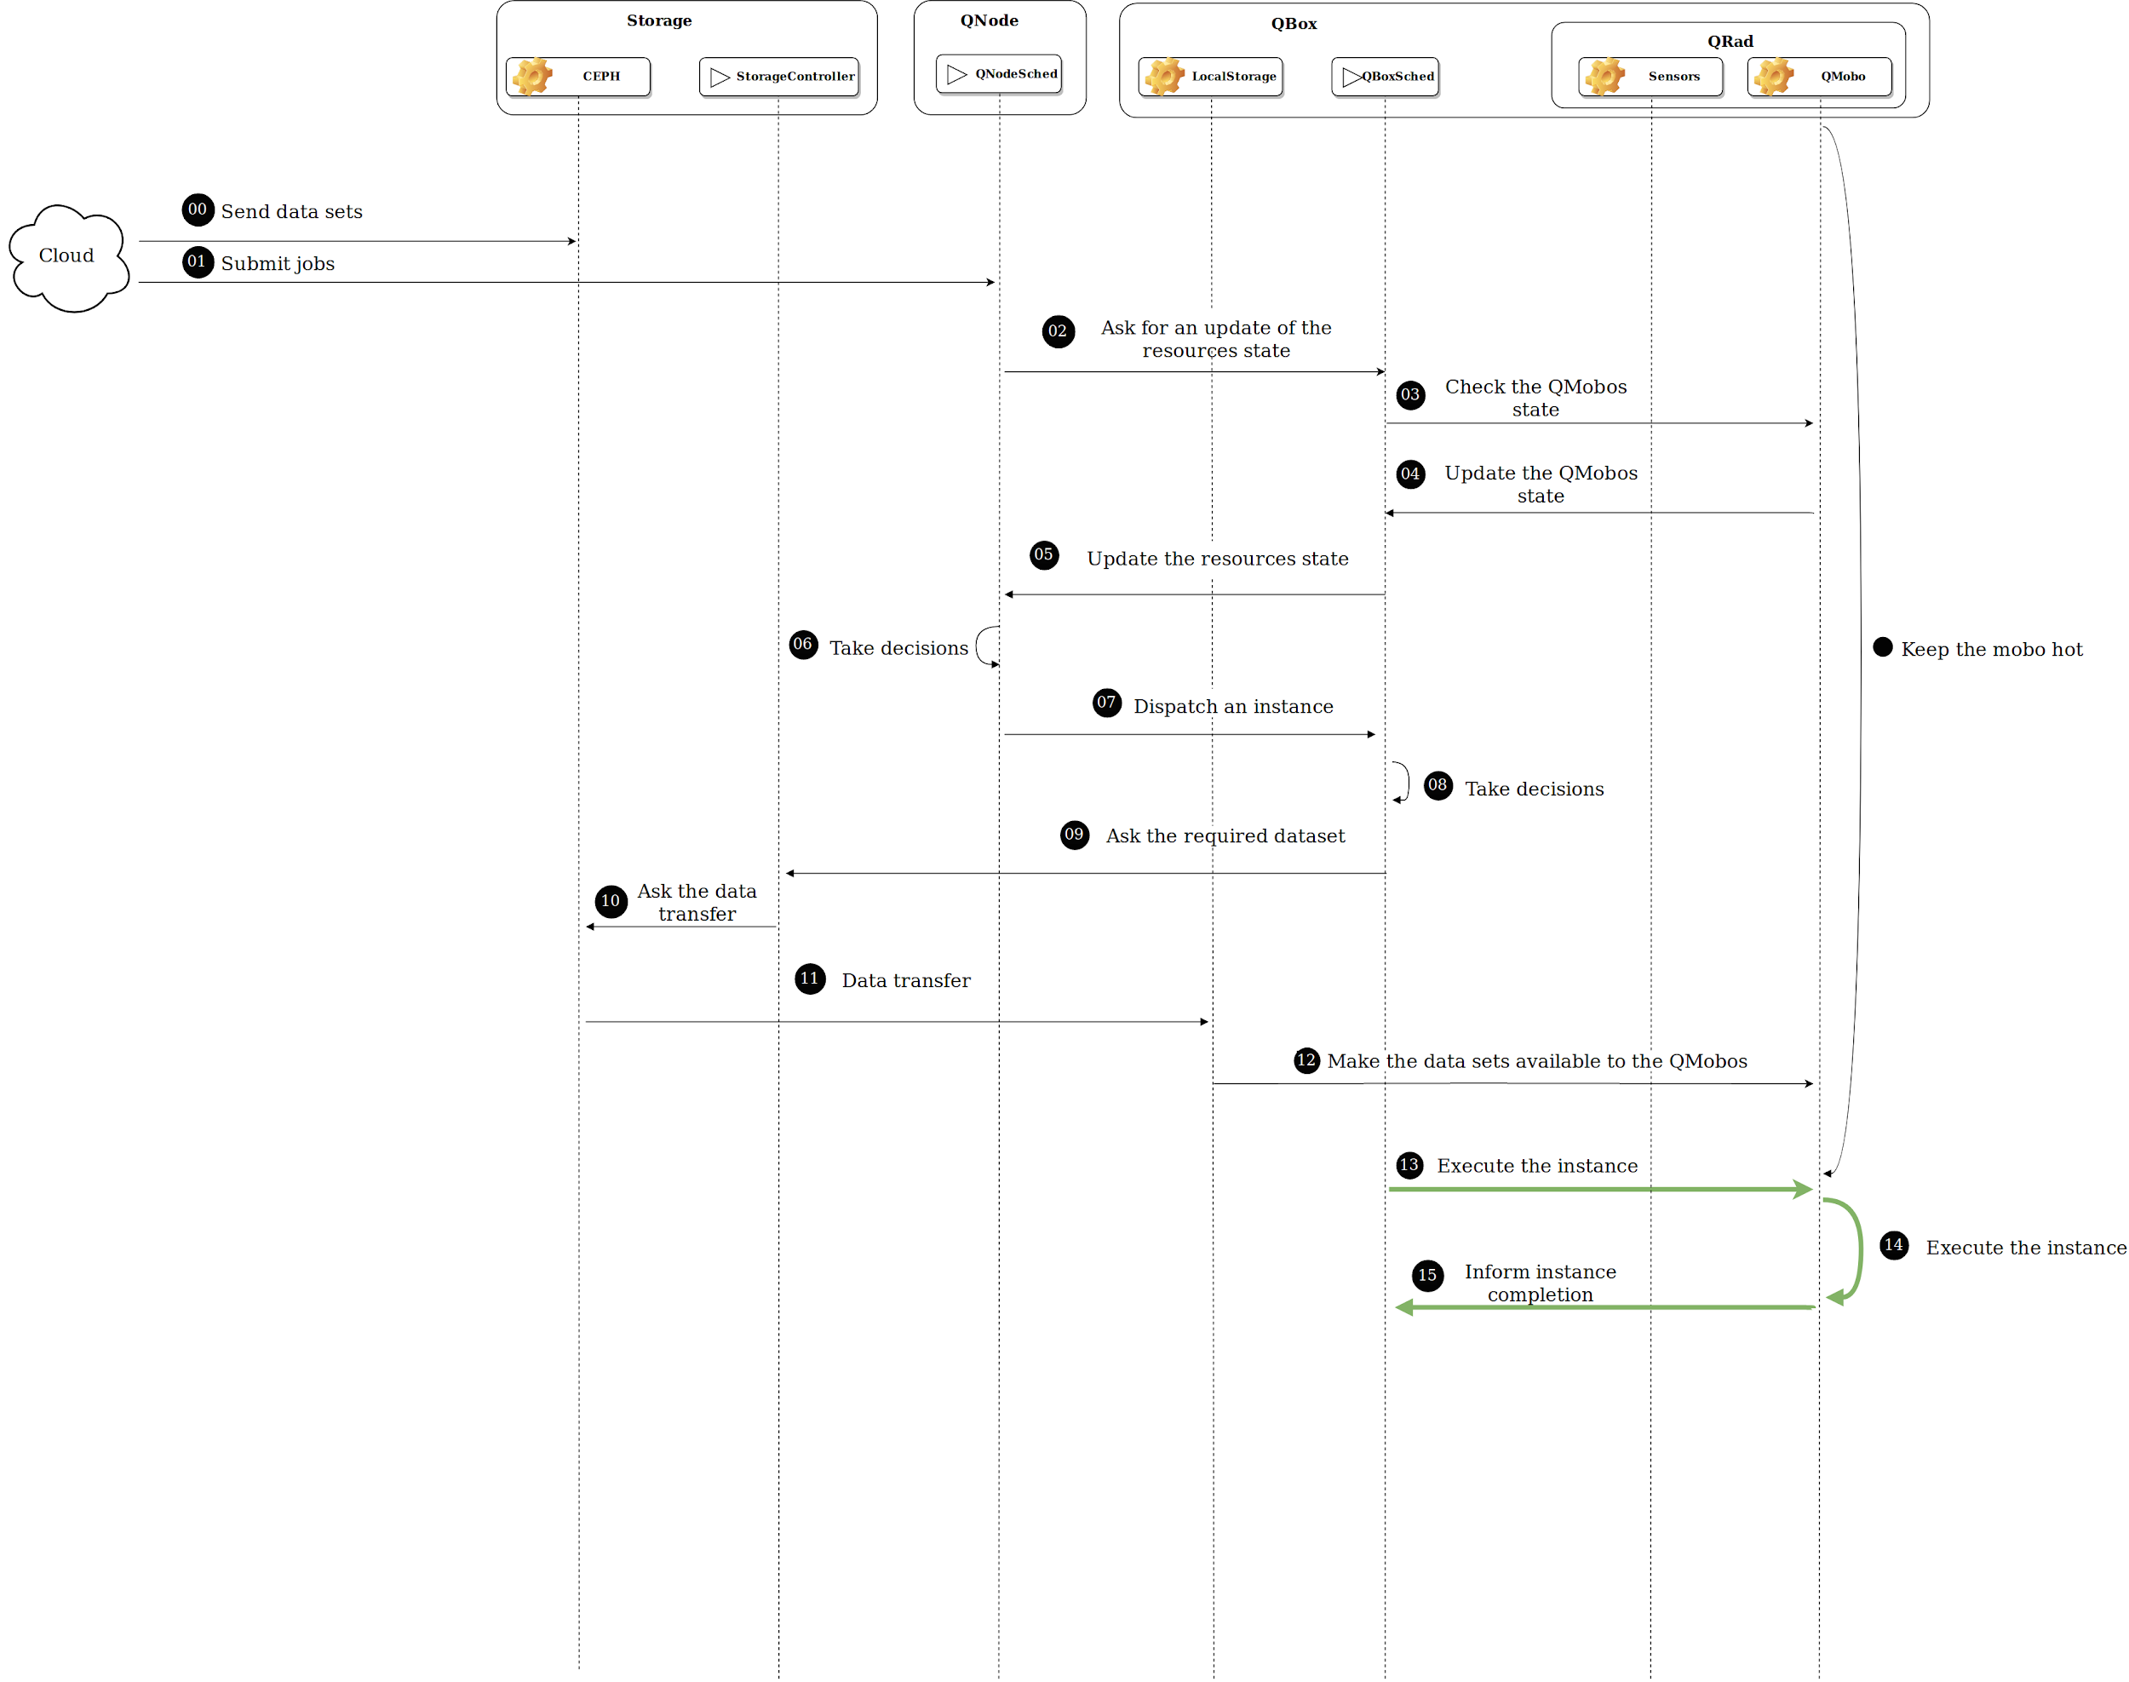
Investigating Job Allocation in Edge Computing Platforms
Anderson Andrei DA SILVA, Denis TRYSTRAM
Université Grenoble Alpes

Slide 71
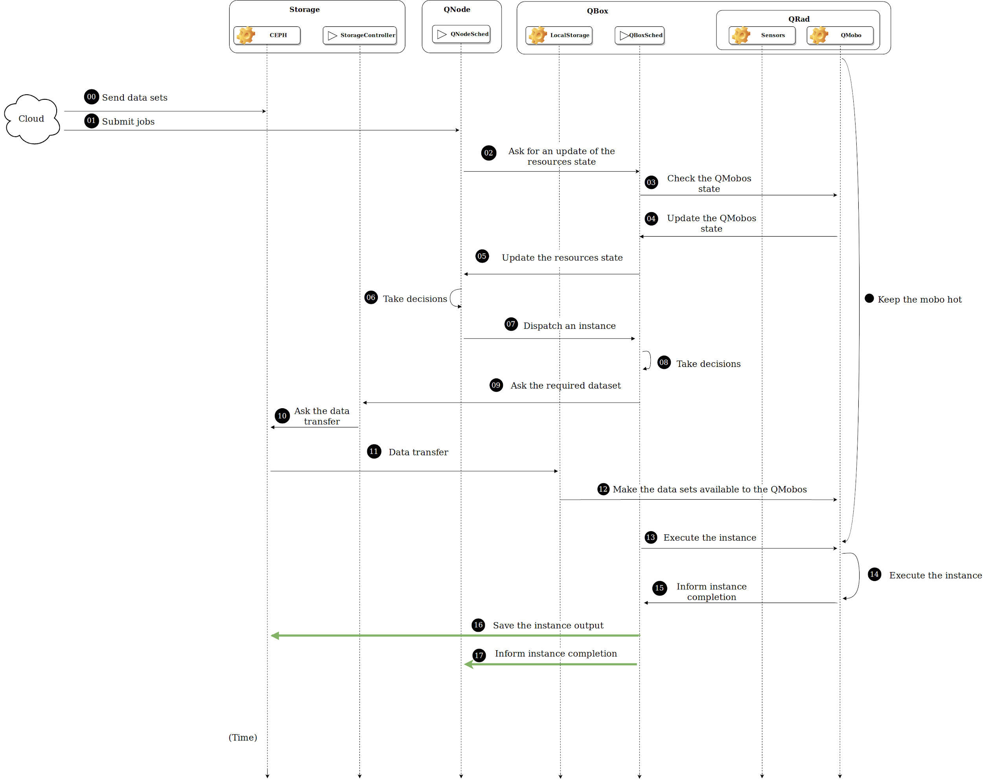
Investigating Job Allocation in Edge Computing Platforms
Anderson Andrei DA SILVA, Denis TRYSTRAM
Université Grenoble Alpes

Slide 72
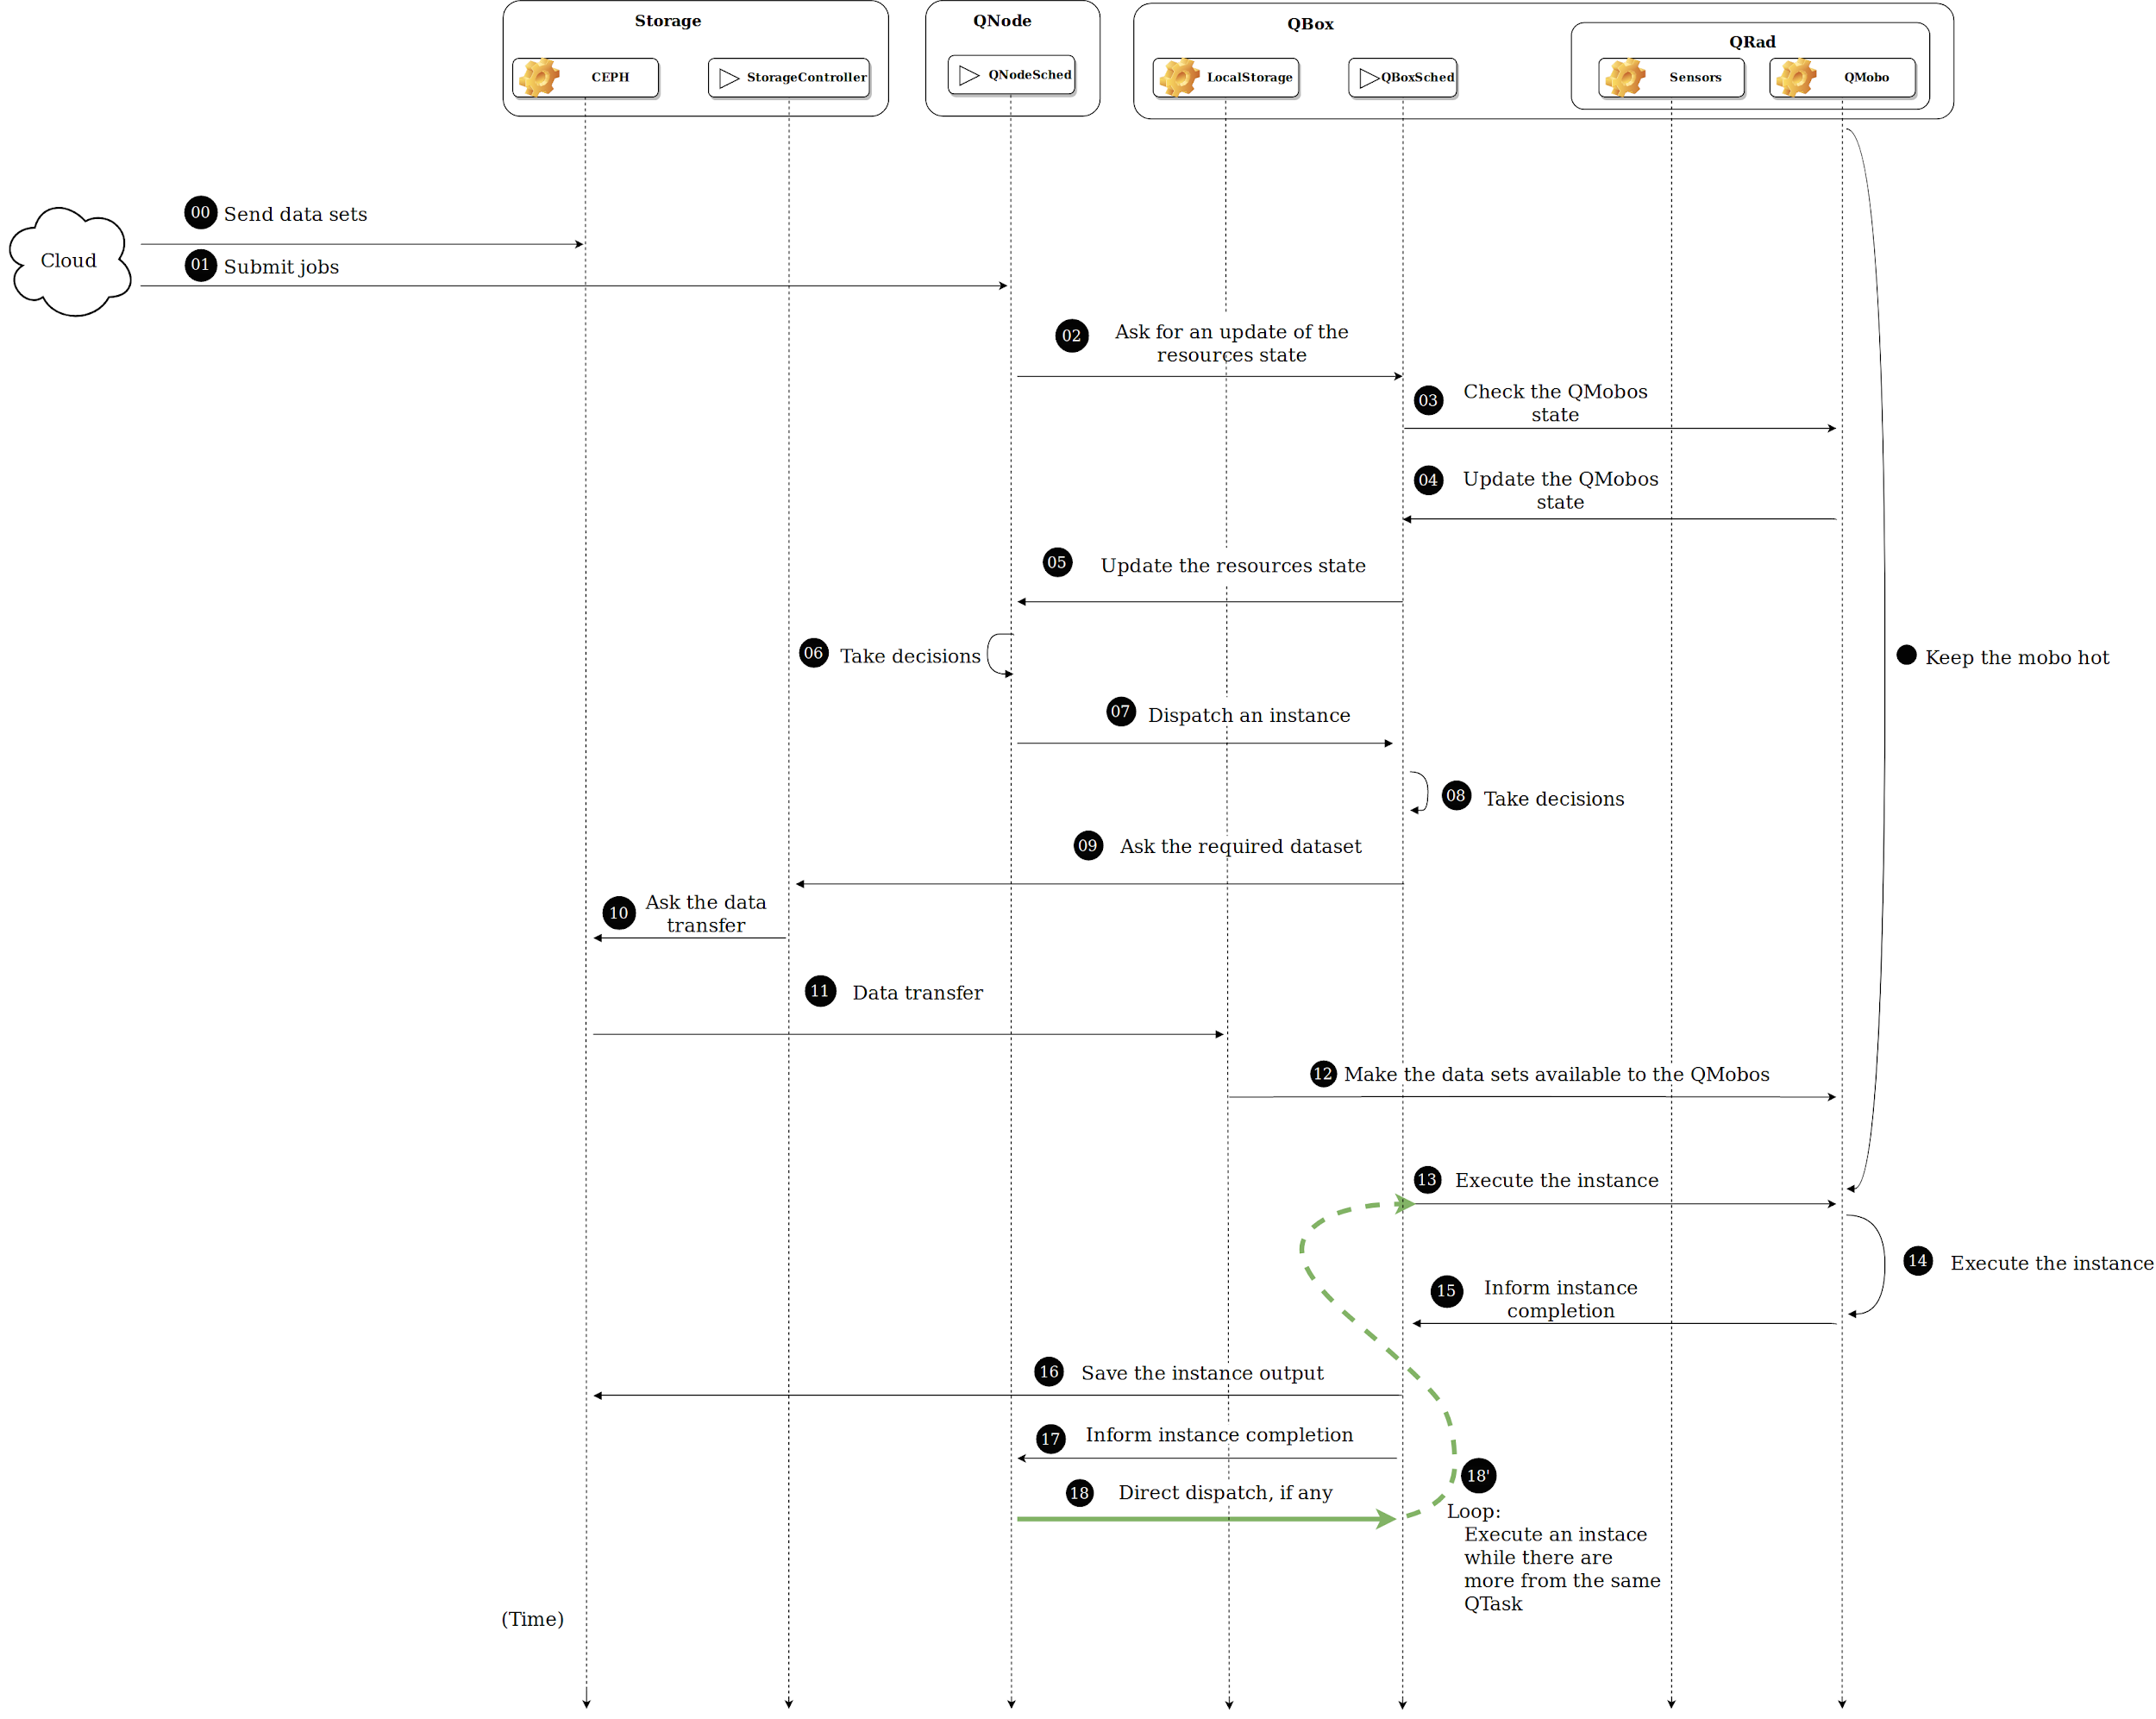
Investigating Job Allocation in Edge Computing Platforms
Anderson Andrei DA SILVA, Denis TRYSTRAM
Université Grenoble Alpes

Slide 73
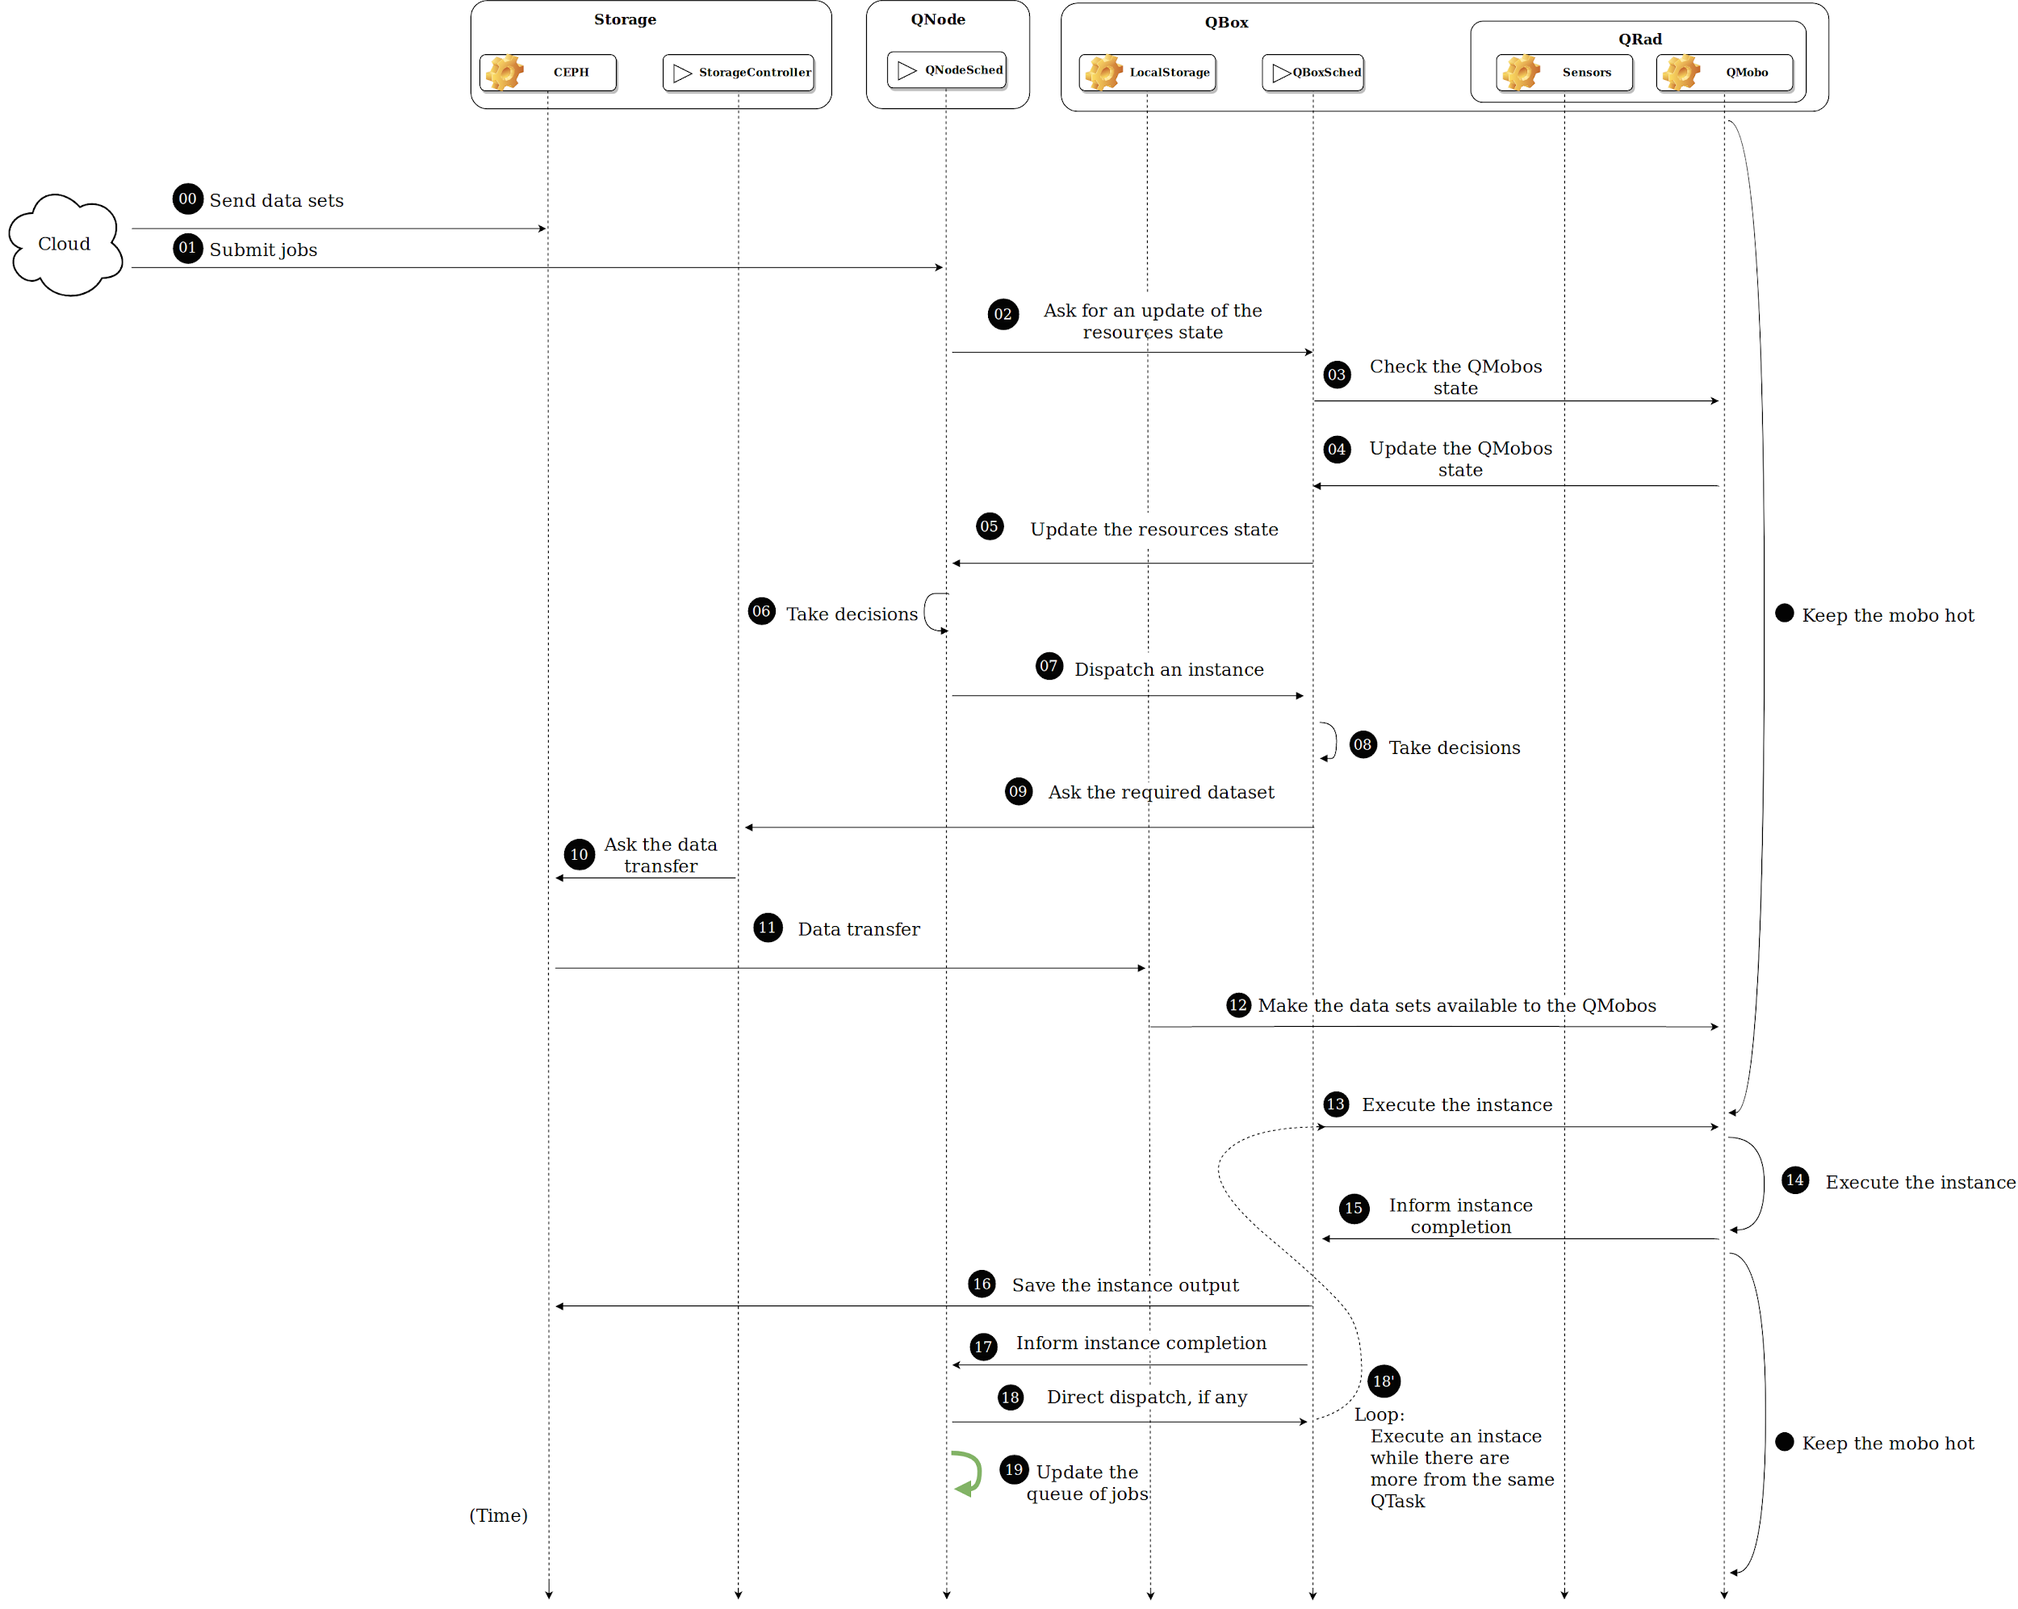
Investigating Job Allocation in Edge Computing Platforms
Anderson Andrei DA SILVA, Denis TRYSTRAM
Université Grenoble Alpes

Slide 74
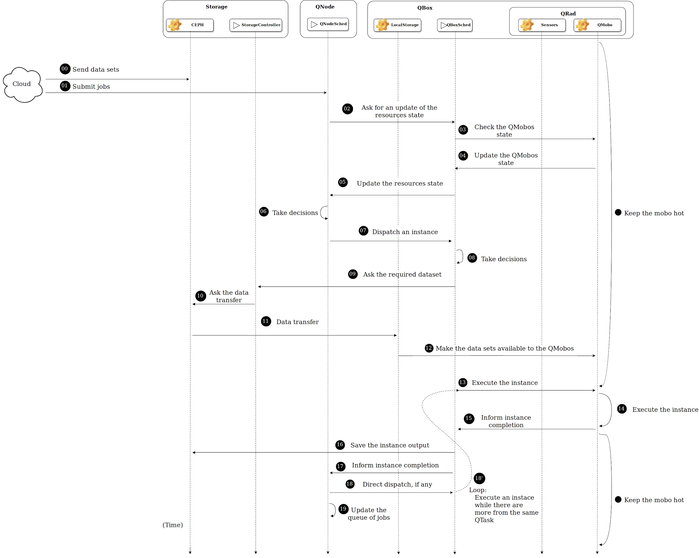
Overview
Based on this platform,
we have developed
our simulation.
Investigating Job Allocation in Edge Computing Platforms
Anderson Andrei DA SILVA, Denis TRYSTRAM
Université Grenoble Alpes
Notes:
I dont know if they know the step by step, if they know I will say nothing usefull

Slide 75
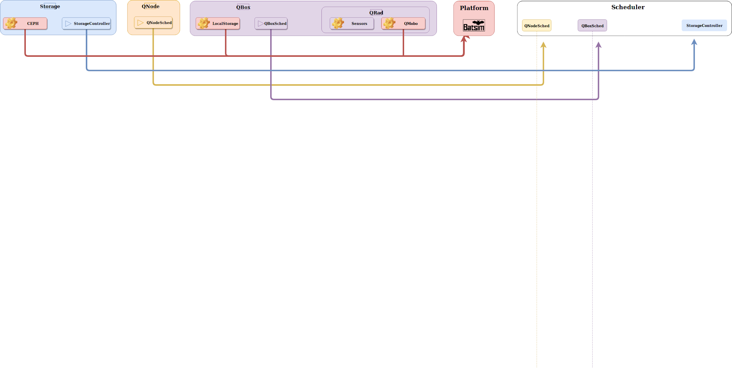
From the real platform to the simulated one
Investigating Job Allocation in Edge Computing Platforms
Anderson Andrei DA SILVA, Denis TRYSTRAM
Université Grenoble Alpes

Slide 76
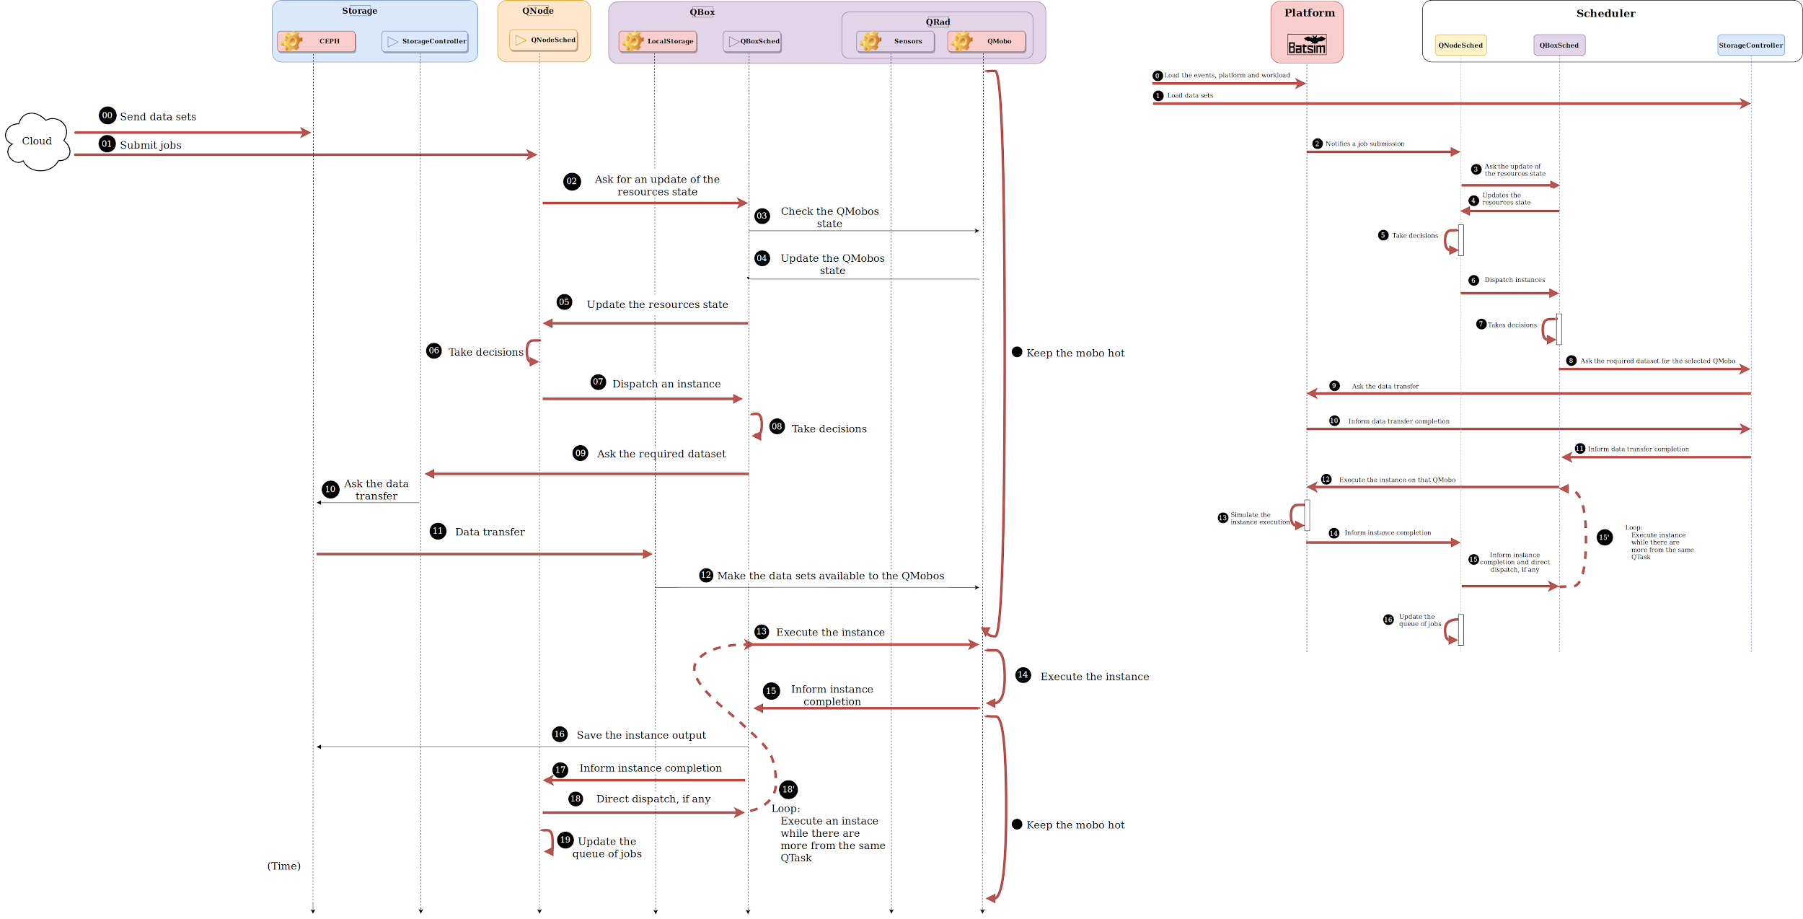
Investigating Job Allocation in Edge Computing Platforms
Anderson Andrei DA SILVA, Denis TRYSTRAM
Université Grenoble Alpes

Slide 77
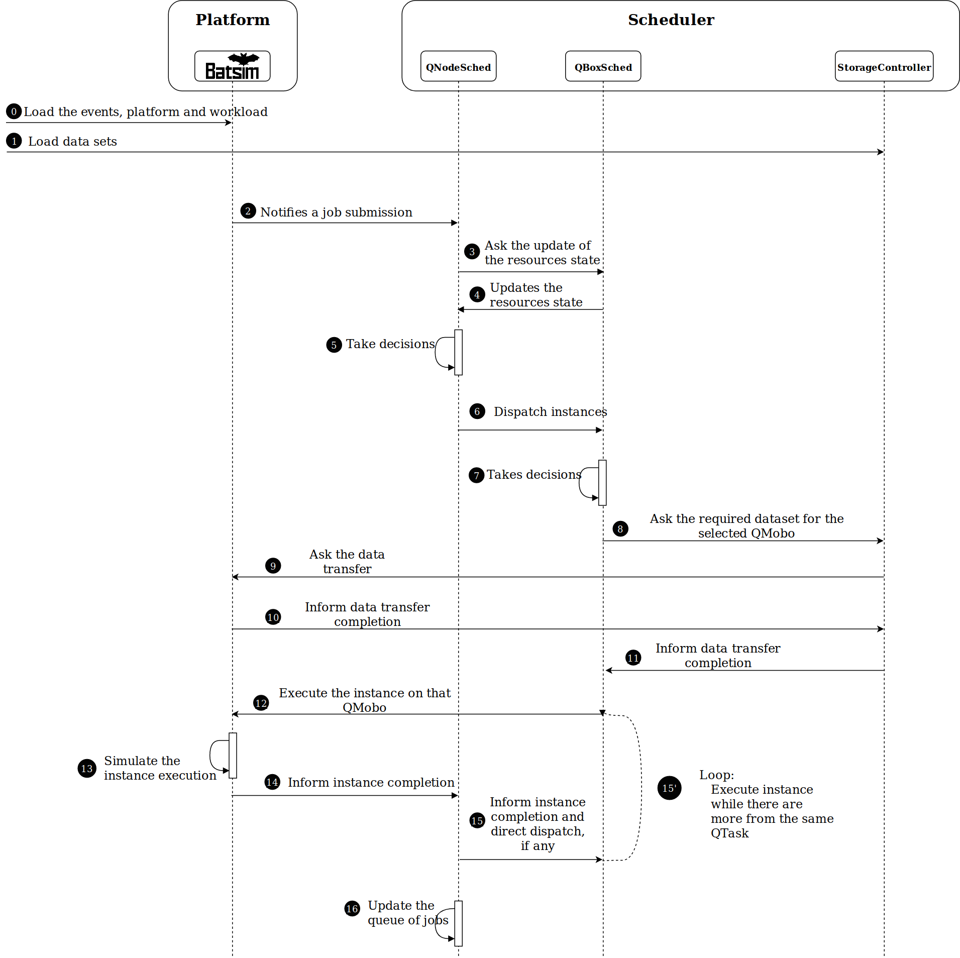
Investigating Job Allocation in Edge Computing Platforms
Anderson Andrei DA SILVA, Denis TRYSTRAM
Université Grenoble Alpes

